Slide 1
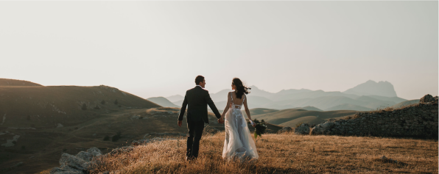
AMERRA STUDIO
WEDDING
PHOTOGRAPHY
Price List
Standard
Premium
Exclusive
$ 1,150
$ 2,250
$ 3,275
3 HOURS COVERAGE
6 HOURS COVERAGE
12 HOURS COVERAGE
200 DIGITAL IMAGES
300 DIGITAL IMAGES
500 DIGITAL IMAGES
PRO IMAGE EDITING
PRO IMAGE EDITING
PRO IMAGE EDITING
ONLINE PROOF GALLERY
ONLINE PROOF GALLERY
ONLINE PROOF GALLERY
THREE 6X10 PRINTS
THREE 8X10 PRINTS
THREE 12X10 PRINTS
SPECIAL OFFER
Get 25% off any package when you book before September 15, 2025 Restrictions apply.
Please contact us for details.
GDOC.IO

