Slide 1
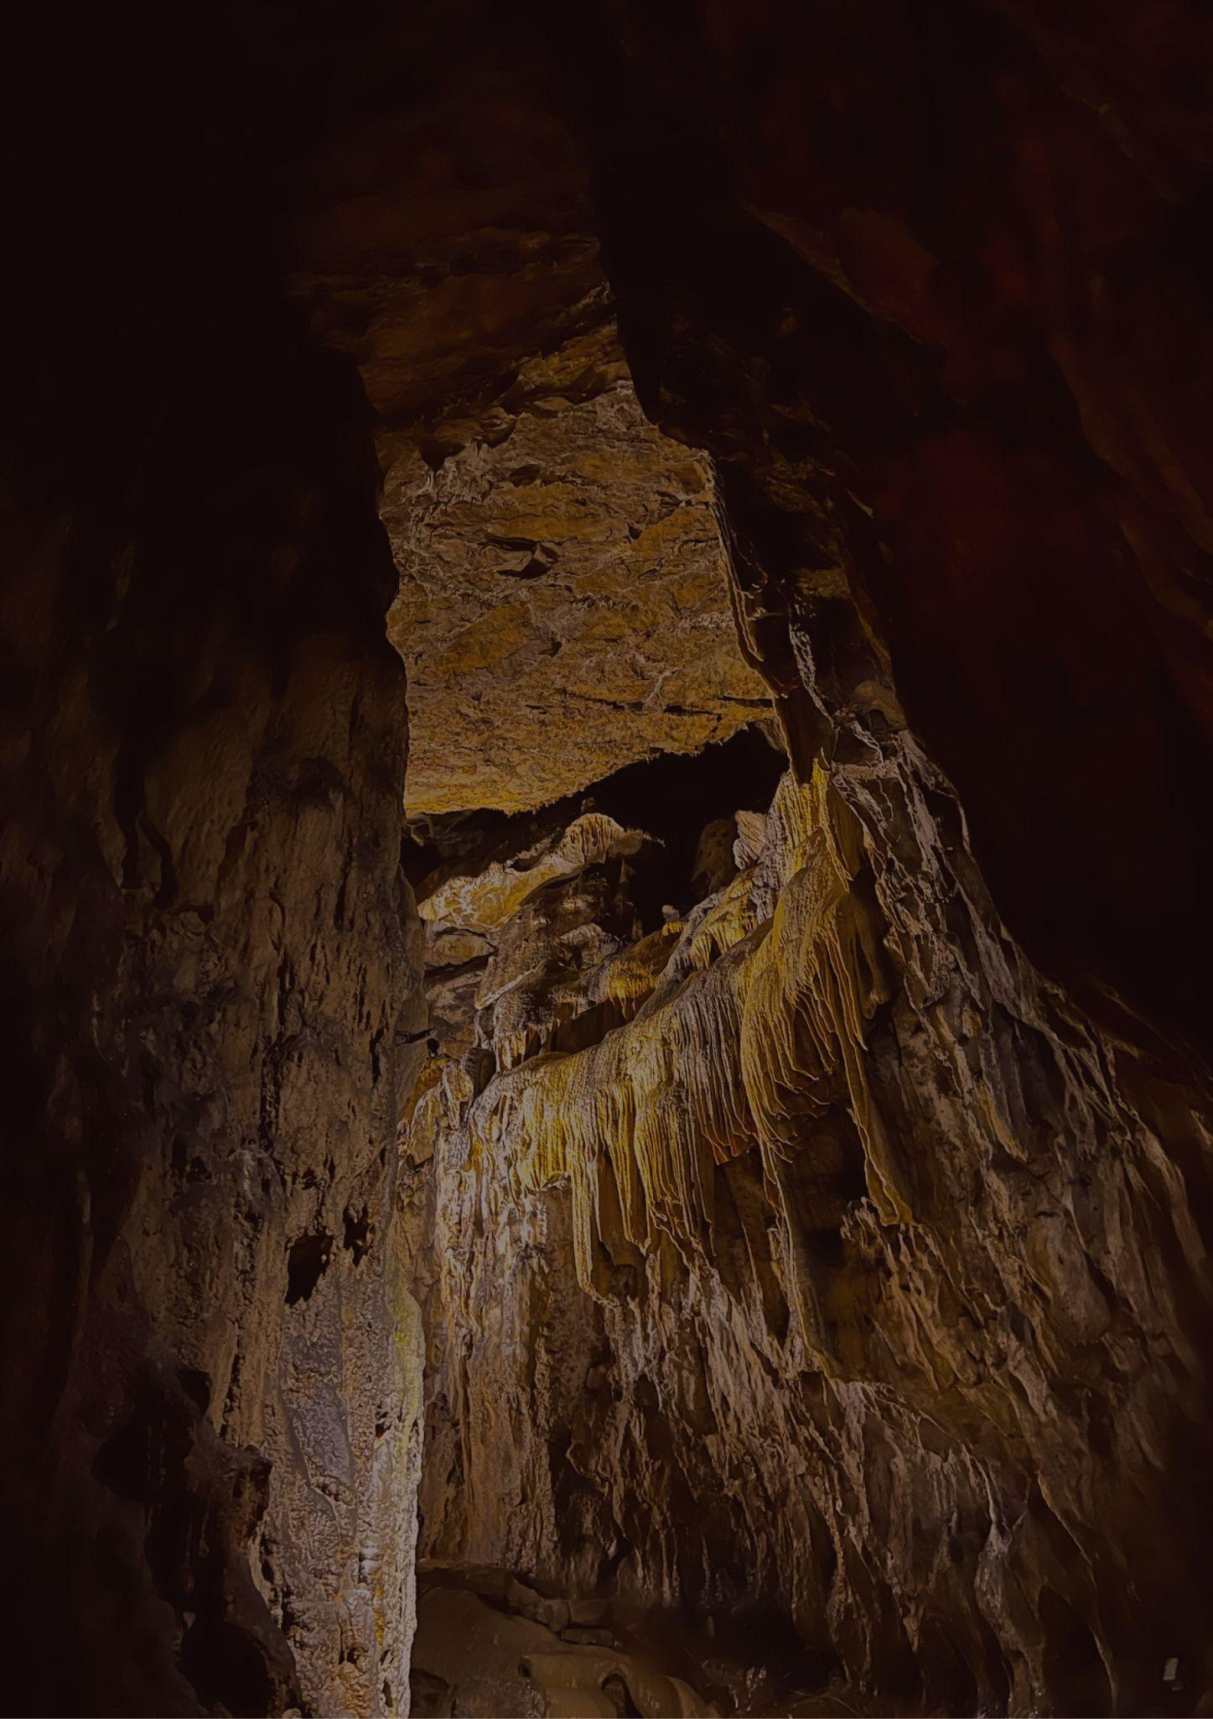
Travel bucket list
VIRGINIA
Luray Caverns
Monticello
Charlottesville
Mount Vernon
Arlington Cemetery
Assateague Islands
Virginia Beach
Virginia Aquarium
Colonial Williamsburg
Marine Science Center
Skyline Drive
Hollywood Cemetery
Shenandoah National Park
Lee Chapel
Colonial Williamsburg
Byrd Theatre
Busch Gardens
Dinosaur Kingdom II
Jamestown and Yorktown
Maymont Park
Steven F. Udvar-Hazy Center
Mount Vernon
Richmond
Kiptopeke’s Concrete Fleet
Chincoteague Islands
Champlain Islands

