Slide 1
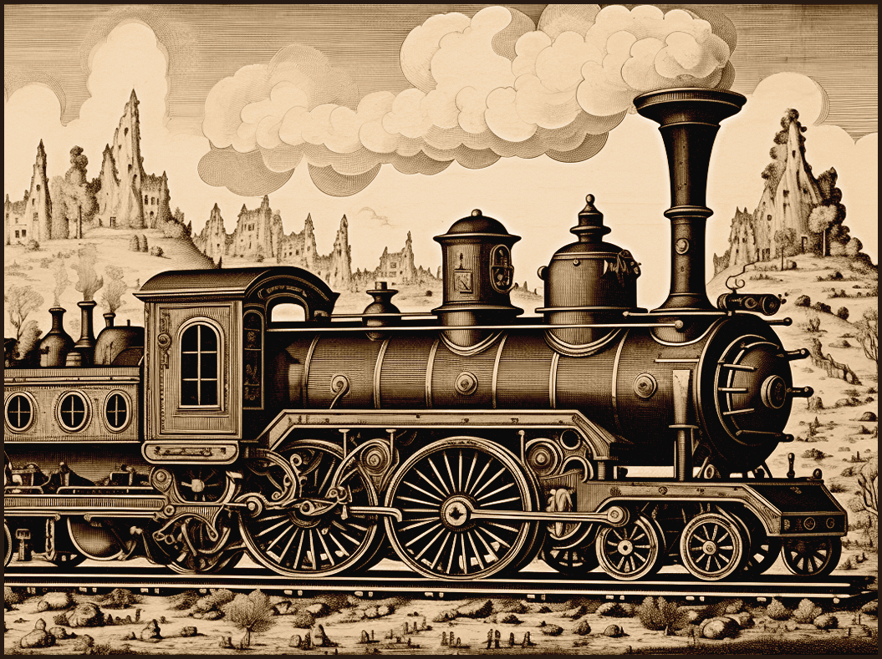
This vintage edition captures the essence of a bygone
era, celebrating the spirit and simplicity of 1884
THE DAILY
CHRONICLE
WORLD NEWS GLOBAL HEADLINES
LIGHTS
STUN LONDON
Master of the Sea: Captain Jonathan Harrington
CAPTAIN JONATHAN HARRINGTON
London, April 5, 1884 Residents of London were left astounded last night as mysterious lights were seen hovering over the city. Witnesses describe them as bright, flickering orbs moving in erratic patterns. Speculations range from celestial phenomena to otherworldly visitors. Authorities urge calm while investigations continue. Authorities urge calm while investigations continue.
Master of the Sea: Captain Jonathan Harrington
The Marvel of Modern Transport: The Steam Train
By Margaret T. Fielding - In an era where steamships dominate the oceans, few captains command as much respect and admiration as Captain Jonathan Harrington of the SS Endeavor. Born into a family of sailors in Portsmouth, Harrington's life has been intricately linked with the sea from a young age. By Margaret T. Fielding - In an era where steamships dominate the oceans, few captains command as much respect and admiration as Captain Jonathan Harrington of the SS Endeavor. Born into a family of sailors in Portsmouth, Harrington's life has been intricately linked with the sea from a young age.
Captain Harrington's seafaring journey began at the tender age of 14, when he joined his father's merchant vessel as a cabin boy.
Over the years, he climbed the ranks, demonstrating exceptional skill and unwavering dedication. By 25, he had earned his first command.
By Margaret T. Fielding - In an era where steamships dominate the oceans, few captains command as much respect and admiration as Captain Jonathan Harrington of the SS Endeavor. Born into a family of sailors in Portsmouth, Harrington's life has been intricately linked with the sea from a young age.
THE MARVEL OF MODERN
TRANSPORT: THE TRAIN
By William T. Johnson - Few inventions have transformed our world as profoundly as the steam train. This marvel of engineering, often referred to as the "Iron Horse," has reshaped our landscapes, economies, and ways of life since its introduction. Origins and Evolution The steam train's journey began in the early 19th century with the pioneering work of engineers like George Stephenson. His locomotive, the Rocket, set the stage for what would become a global network of railways. These early trains were powered by steam engines, which used boiling water to create the pressure needed to drive pistons and turn wheels.
The advent of the steam train brought about unprecedented changes. It drastically reduced travel time between cities and towns, making it possible to traverse great distances in a fraction of the time it once took. This newfound mobility spurred economic growth, allowing goods.
THE TYPEWRITER
Revolutionizing Writing: The Typewriter
By George F. Pembroke - Among the many marvels of modern invention, few have had as profound an impact on communication and daily life as the typewriter.
This ingenious device has revolutionized the way we write, bringing efficiency, clarity, and a touch of elegance to written correspondence. This ingenious device has revolutionized the way.
FASHION FEATURE: THE VINTAGE DRESS
Elegance and Timeless
Beauty: The Vintage Dress
By Clara P. Winslow - In a world of ever-changing fashion trends, the vintage dress stands as a testament to timeless elegance and enduring style. These exquisite garments, often passed down through generations, carry with them the grace and charm of bygone eras them the grace and charm.

Slide 2
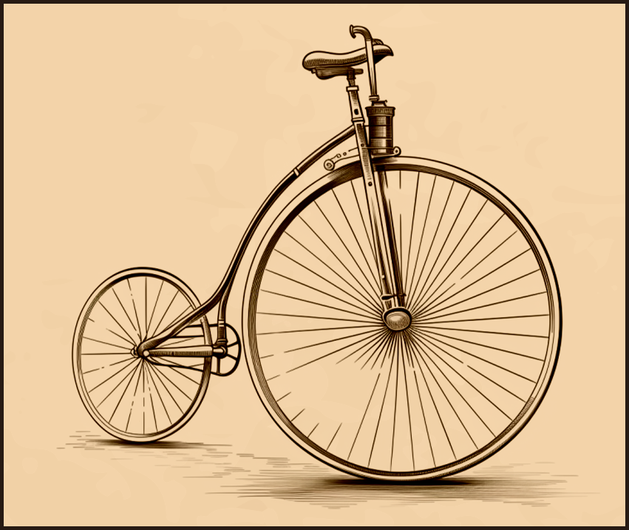
IMPACT ON BUSINESS
AND COMMUNICATION
The introduction of the typewriter transformed practices
Airships offer several advantages over traditional aircraft and other forms of transportation. Their ability to hover and travel at low speeds makes them ideal for observational and reconnaissance missions. Additionally, airships can carry substantial payloads over long distances without the need for extensive infrastructure, such as runways or roads.
The potential for airships extends beyond exploration and adventure. In the commercial sector, they offer a luxurious and scenic mode of travel, with spacious cabins and panoramic views.
Companies have begun to explore their use in transporting goods, especially to remote or underserved areas.
The Marvel of Modern Transport: The Steam Train
FASHION FEATURE: THE VINTAGE DRESS
CONQUERING THE SKIES:
THE RISE OF THE AIRSHIP
THE TYPEWRITER
By William T. Johnson - Few inventions have transformed our world as profoundly as the steam train. This marvel of engineering, often referred to as the "Iron Horse," has reshaped our landscapes, economies, and ways of life since its introduction. Origins and Evolution The steam train's journey began in the early 19th century with the pioneering work of engineers like George Stephenson. His locomotive, the Rocket, set the stage for what would become a global network of railways. These early trains were powered by steam engines, which used boiling water to create the pressure needed to drive pistons and turn wheels.
The advent of the steam train brought about unprecedented changes. It drastically reduced travel time between cities and towns, making it possible to traverse great distances in a fraction of the time it once took. This newfound mobility spurred economic growth, allowing goods and people to move more efficiently than ever before. The advent of the steam train brought about unprecedented changes. It drastically reduced travel time between cities and towns, making it possible to traverse great distances in a fraction of the time it once took. This newfound mobility spurred economic growth, allowing goods.
The advent of the steam train brought about unprecedented changes. It drastically reduced travel time between cities and towns, making it possible to traverse great distances in a fraction of the time it once took. This newfound mobility spurred economic growth, allowing goods and people to move.
Revolutionizing Writing: The Typewriter
Elegance and Timeless Beauty: The Vintage Dress
By George F. Pembroke - Among the many marvels of modern invention, few have had as profound an impact on communication and daily life as the typewriter. This ingenious device has revolutionized the way we write, bringing efficiency, clarity, and a touch of elegance to written correspondence.
By Clara P. Winslow - In a world of ever-changing fashion trends, the vintage dress stands as a testament to timeless elegance and enduring style. These exquisite garments, often passed down through generations, carry with them the grace and charm of bygone eras them the grace and charm of bygone eras.
By Clara P. Winslow - In a world of ever-changing fashion trends, the vintage dress stands as a testament to timeless elegance and enduring style. These exquisite garments, often passed down through generations.
By Emily K. Harrison
FASHION FEATURE:
THE VINTAGE DRESS
London, April 5, 1884 Residents of London were left astounded last night as mysterious lights were seen hovering over the city. Witnesses describe them as bright, flickering orbs moving in erratic patterns. Speculations range from celestial phenomena to otherworldly visitors. Authorities urge calm while investigations continue. Authorities urge calm while investigations continue. Speculations range from celestial phenomena to otherworldly visitors. Authorities urge calm while investigations continue. Authorities urge calm while investigations continue.
By Emily K. Harrison

Slide 3
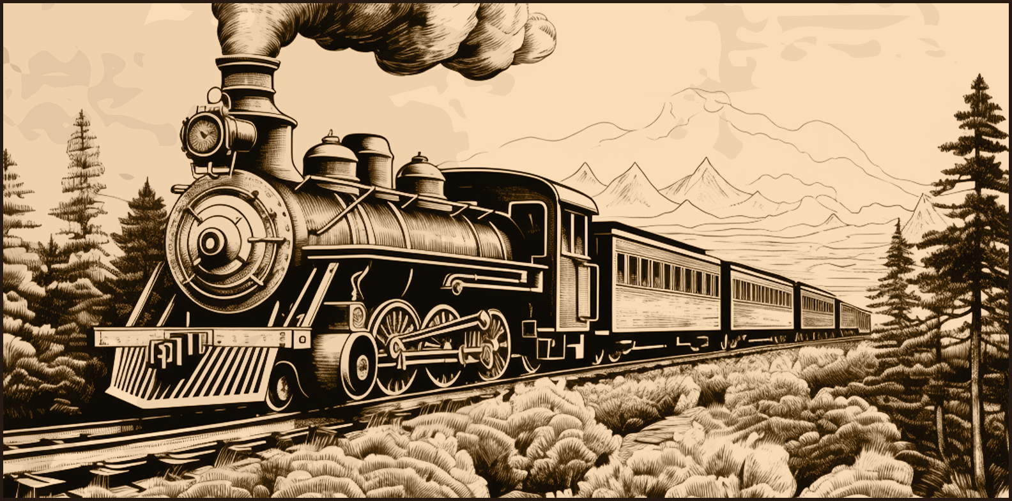
THE FUTURE OF AIRSHIPS
As we look to the future, airships are poised
As we look to the future, airships are poised to play an increasingly important role in transportation and exploration. Their environmental benefits, such as lower fuel consumption and reduced noise pollution, align with growing concerns about sustainability. Furthermore, their unique capabilities make them well-suited for applications ranging from scientific research to humanitarian aid.
The concept of the airship, or dirigible, dates back to the late 18th century, when pioneers like the Montgolfier brothers achieved the first manned flight in a hot air balloon. However, it was not until the development of controlled flight in the mid-19th century that the true potential of airships began to be realized. The invention of the internal combustion engine and advancements in lightweight materials paved the way for practical, navigable airships.
As we look to the future, airships are poised to play an increasingly important role in transportation, exploration. Their environmental benefits.
The Marvel of Modern Transport: The Steam Train
CONQUERING THE SKIES: THE RISE OF THE AIRSHIP
FINANCIAL
INSIGHT
By Richard H. Pendleton - Among the myriad advancements of the modern age
Revolutionizing Writing: The Typewriter
Airships offer several advantages over traditional aircraft and other forms of transportation. Their ability to hover and travel at low speeds makes them for observational and reconnaissance missions.
The potential for airships extends beyond exploration and adventure. In the commercial sector, they offer a luxurious and scenic mode of travel, with spacious cabins and panoramic views.
Despite their promise, airships face several challenges. The use of hydrogen, while providing excellent lift, poses significant safety risks due to its flammability. The Hindenburg disaster of 1937 starkly illustrated these dangers.
However, advancements in materials science and the development of non-flammable helium have mitigated some of these risks advancements in materials science and the development of non-flammable helium have mitigated some helium have mitigated some.
Innovations continue to improve the design and functionality of airships. Modern airships incorporate lightweight composites, advanced propulsion systems, and improved aerodynamics to enhance performance and safety. Hybrid airships, combining elements of traditional airships and fixed-wing aircraft, are being developed to further expand their capabilities.
Innovations continue to improve the design and functionality of airships. Modern airships incorporate lightweight composites, advanced propulsion systems, and improved aerodynamics to enhance performance and safety. Hybrid airships, combining elements of traditional airships and fixed-wing aircraft.
LIGHTS STUN LONDON
London, April 5, 1884 Residents of London were left astounded last night as mysterious lights were seen hovering over the city. Witnesses describe them as bright, flickering orbs moving in erratic patterns. Speculations range from celestial phenomena to otherworldly visitors.
THE FUTURE OF AIRSHIPS
Before the advent of money, people relied on barter to exchange goods and services. This system, while effective on a small scale, posed challenges in terms of convenience and standardization. To address these issues, early civilizations began using commodities such as shells, livestock, and precious metals as mediums of exchange. Before the advent of money, people relied on barter to exchange goods and services. This system, while effective on a small scale, posed challenges in terms of convenience and standardization.
To address these issues, early civilizations began using commodities such as shells such as shells such as shells such as shells, livestock, and precious metals as mediums of exchange metals as mediums of exchange.
By Emily K. Harrison - Money, in its various forms, has been an essential aspect of human civilization for millennia. From simple bartering systems to complex digital currencies, the concept of money has evolved alongside society.
By Emily K. Harrison
THE TYPEWRITER
By George F. Pembroke - Among the many marvels of modern invention, few have had as profound an impact on communication and daily life as the typewriter. This ingenious device.
By Emily K. Harrison

Slide 4
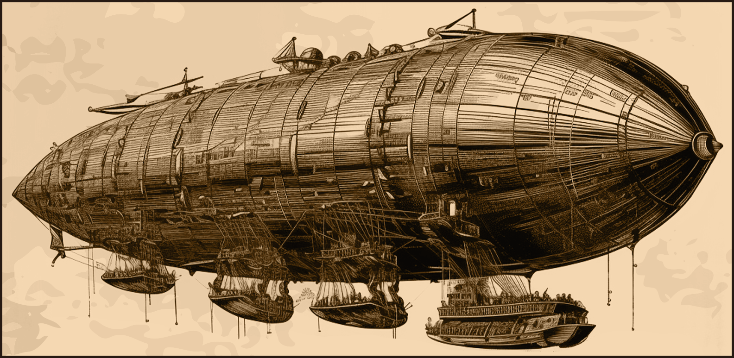
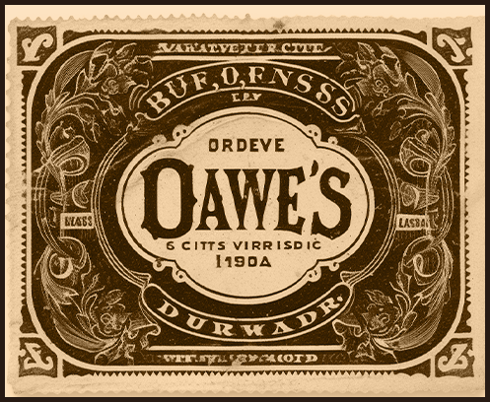
THE FUTURE OF AIRSHIPS
As we look to the future, airships are poised
As we look to the future, airships are poised to play an increasingly important role in transportation and exploration. Their environmental benefits, such as lower fuel consumption and reduced noise pollution, align with growing concerns about sustainability. Furthermore, their unique capabilities make them well-suited for applications ranging from scientific research to humanitarian aid.
The concept of the airship, or dirigible, dates back to the late 18th century, when pioneers like the Montgolfier brothers achieved the first manned flight in a hot air balloon. However, it was not until the development of controlled flight in the mid-19th century that the true potential of airships began to be realized. The invention of the internal combustion engine and advancements in lightweight materials paved the way for practical, navigable airships.
As we look to the future, airships are poised to play an increasingly important role in transportation and exploration. Their environmental benefits, such as lower.
Conquering the Skies: The Rise of the Airship
CONQUERING THE SKIES: THE RISE
OF THE AIRSHIP
By Richard H. Pendleton - Among the myriad advancements of the modern age, the airship stands out as a marvel of engineering and a symbol of mankind's enduring quest.
Airships offer several advantages over traditional aircraft and other forms of transportation. Their ability to hover and travel at low speeds makes them ideal for observational and reconnaissance missions. Additionally, airships can carry substantial payloads over long distances without the need for extensive infrastructure, such as runways or roads.
Airships offer several advantages over traditional aircraft and other forms of transportation.
The potential for airships extends beyond exploration and adventure. In the commercial sector, they offer a luxurious and scenic mode of travel, with spacious cabins and panoramic views.
Companies have begun to explore their use in transporting goods, especially to remote or underserved areas. Militaries around the world have also recognize around the world have also recognize around the world have also recognized the strategic value of airships.
Despite their promise, airships face several challenges. The use of hydrogen, while providing excellent lift, poses significant safety risks due to its flammability. The Hindenburg disaster of 1937 starkly illustrated these dangers. However, advancements in materials science and the development of non-flammable helium have mitigated some of these risks advancements in materials science and the development of non-flammable helium have mitigated some helium have mitigated some.
FINANCIAL
INSIGHT
Before the advent of money, people relied on barter to exchange goods and services. This system, while effective on a small scale, posed challenges in terms of convenience and standardization. To address these issues, early civilizations began using commodities such as shells, livestock, and precious metals as mediums of exchange. Before the advent of money, people relied on barter to exchange goods and services. This system, while effective on a small scale, posed challenges in terms of convenience and standardization.
To address these issues, early civilizations began using commodities such as shells such as shells such as shells such as shells, livestock, and precious metals as mediums of exchange metals as mediums of exchange.
THE GOLD STANDARD AND FIAT CURRENCY
By Emily K. Harrison - Money, in its various forms, has been an essential aspect of human civilization for millennia. From simple bartering systems to complex digital currencies, the concept of money has evolved
Master of the Sea: Captain Jonathan Harrington
By Emily K. Harrison
By Margaret T. Fielding - In an era where steamships dominate the oceans, few captains command as much respect and admiration as Captain Jonathan Harrington of the SS Endeavor. Born into a family of sailors in Portsmouth, Harrington's life has been intricately linked with the sea from a young age. By Margaret T. Fielding - In an era where steamships dominate the oceans, few captains command as much
Portsmouth, Harrington's life has been intricately linked with the sea from a young age. By Margaret T. Fielding - In an era where steamships dominate the oceans, few captains command as much respect and admiration as Captain Jonathan Harrington of the SS Endeavor. Born into a family of sailors in Portsmouth, Harrington's life has been intricately linked with the sea.
By Emily K. Harrison

