Slide 1
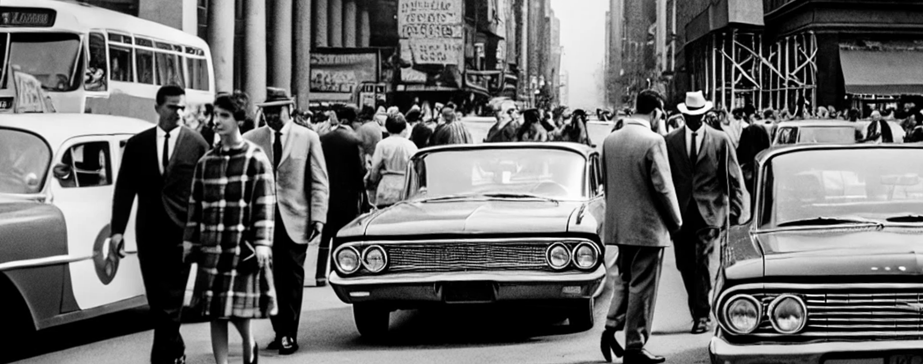
Life in the 60s
Date: September 29, 1964
THE CITY CHRONICLES
Photographer: William Harper.
THE GOLDEN AGE
OF AUTOMOBILES
pedestrians and public transport. However, the post-war economic boom of the 1950s and 1960s saw a sharp increase in car ownership, and city planners had to shift their focus to accommodate this new lifestyle.
While cars provided convenience and independence, they also introduced problems. Traffic congestion became a daily struggle, especially during rush hour in bustling urban centers. The streets of cities like New York and Los Angeles became synonymous with gridlock, and the honking of horns was an ever-present soundtrack to urban life. Additionally, air pollution from the growing number of vehicles became a concern, leading to health issues and environmental damage.
In response to these growing challenges, some cities began to develop extensive mass transit systems, while others expanded their road networks and infrastructure to accommodate increasing traffic.
How Cars Shaped Urban Life in the 1960s
The 1960s marked the zenith of the automobile era, where cars became not just a mode of transportation but a symbol of personal freedom and status. The streets of major cities like New York, Chicago, and Los Angeles were crowded with a variety of vehicles, from the sleek Ford Mustang to the elegant Cadillac. This boom in automobile ownership drastically transformed the urban landscape, as cities adapted to the growing number of cars on the road.
The rise of automobiles led to the construction of highways, parking lots, and garages, fundamentally changing the structure of cities. Before the automobile era, cities were built for

Slide 2
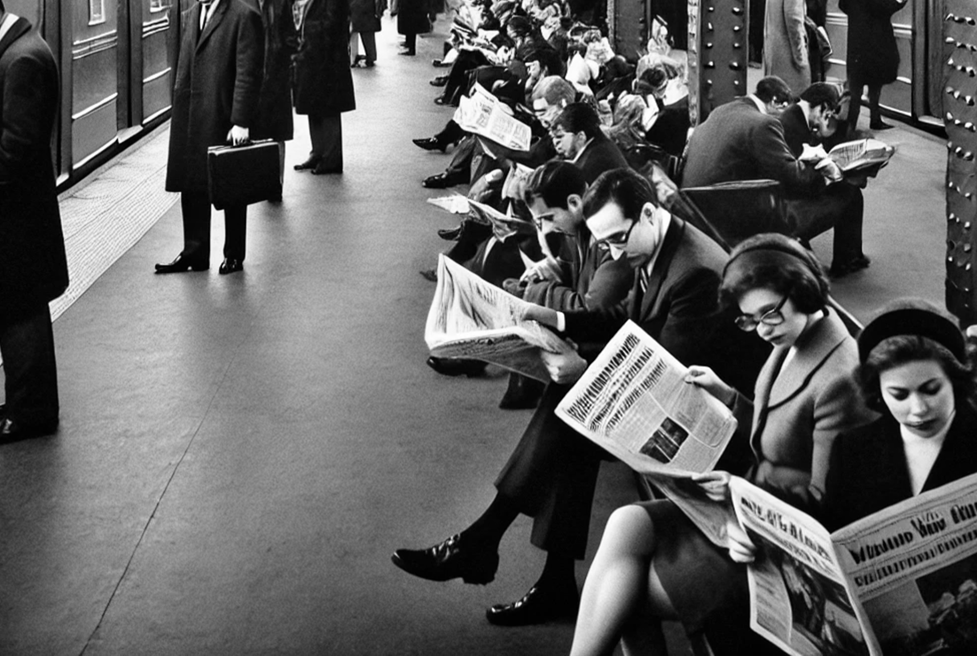
Life in the 60s
Date: September 29, 1964
Photographer: William Harper.
SUBWAY: THE LIFELINE OF THE CITY
Public Transportation and the Changing Face of Urban Mobility
In the 1960s, the subway was the heartbeat of major cities like New York, London, and Paris. Public transportation had been central to urban life for decades, but as cities expanded and populations grew, the subway system became more critical than ever. It wasn’t just a means of getting from point A to point B; it was a symbol of the city’s constant motion, connecting people across neighborhoods and cultural divides.
The subway stations of the 1960s were bustling, vibrant places. Every morning and evening, thousands of commuters would flood the
bustling, vibrant places. Every morning and evening, thousands of commuters would flood the platforms, catching trains to work or home. The clatter of trains, the screeching of brakes, and the hum of voices created a symphony of sounds that became synonymous with urban living. The subway was a great equalizer, where people from all walks of life, from corporate executives to blue-collar workers, shared the same space. During this period, many cities were investing heavily in their subway systems.

Slide 3
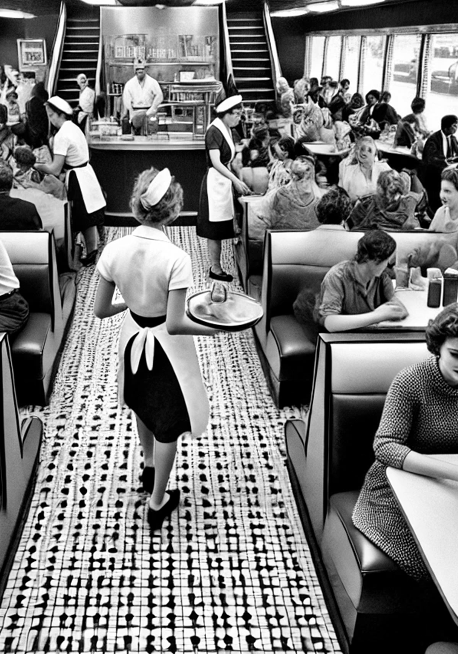
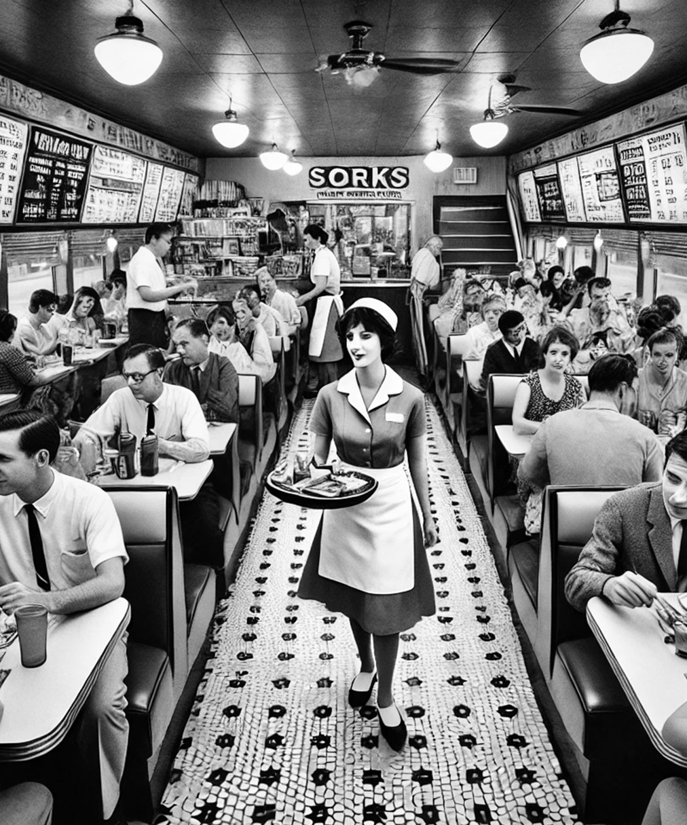
Life in the 60s
Date: September 29, 1964
THE URBAN
DINER:
A Slice of City Life
The urban diner was a cultural icon of the 1960s, serving as more than just a place to grab a quick meal—it was a social hub where city life played out in miniature. Whether you were a businessman stopping by for a cup of coffee, a teenager meeting friends after school, or a night-shift worker grabbing a bite before heading home, the diner was a space that brought people together.
With their chrome finishes, neon signs, and cozy booths, diners became synonymous with urban life in the 60s. The typical diner menu offered simple, affordable food—eggs,
Photographer: William Harper.
bacon, burgers, and milkshakes—catering to a diverse range of customers. You could sit at the counter and chat with the waitress or take a booth with friends and linger over coffee. For many city dwellers, the diner was a second home, a place where you could find comfort in both food and familiar faces.
The diner was also a reflection of the changes happening in society. As cities grew and diversified, so did the clientele at these establishments. Diners became places where people from different backgrounds could sit side by side, sharing space in a way that was both ordinary and revolutionary.
Photographer: William Harper.

Slide 4
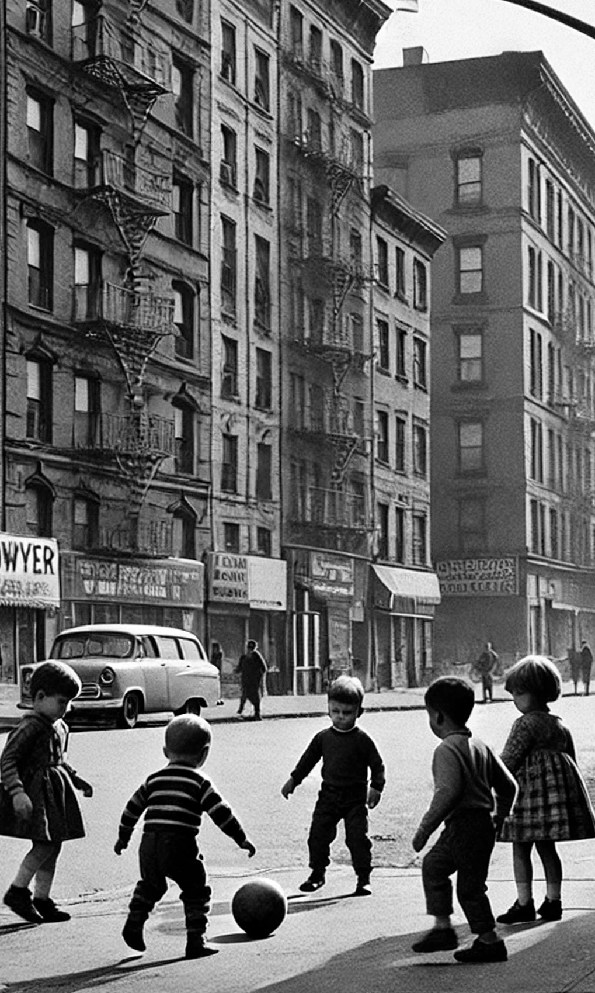
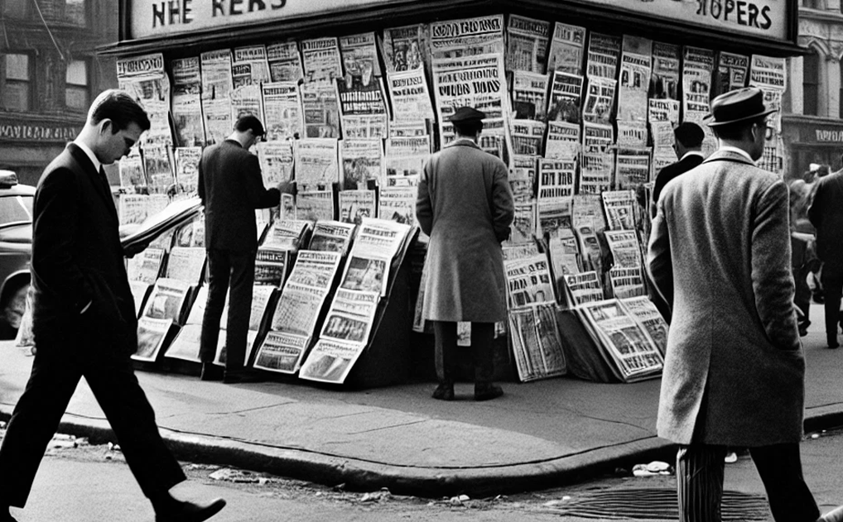
Life in the 60s
Date: September 29, 1964
CHILDHOOD IN
URBAN SPACES
Growing Up in the City
For children growing up in the city during the 1960s, life was filled with a unique blend of excitement and constraint. With limited access to expansive outdoor spaces, many children made the streets their playground. Sidewalks, alleyways, and the small patches of green in urban parks became places of adventure, imagination, and socialization.
Unlike today, where technology dominates childhood, the children of the 60s were often seen playing simple games like hopscotch, jump rope, or stickball. Many remember the thrill of chasing after an ice cream truck or hearing the whistle of the neighborhood police officer, who became a familiar figure.
Photographer: William Harper.
THE CITY
NEWSSTAND
the primary source of news, and people relied on their morning or evening paper to stay informed.
A Hub of Information in the 1960s
In the 1960s, the newspaper stand was a cultural institution in cities across the world. These small, often unassuming kiosks served as a vital artery of information, connecting urban residents with the events of the day. Before the rise of television and radio as dominant media, newspapers were the primary source of news,
Photographer: William Harper.

