Slide 1
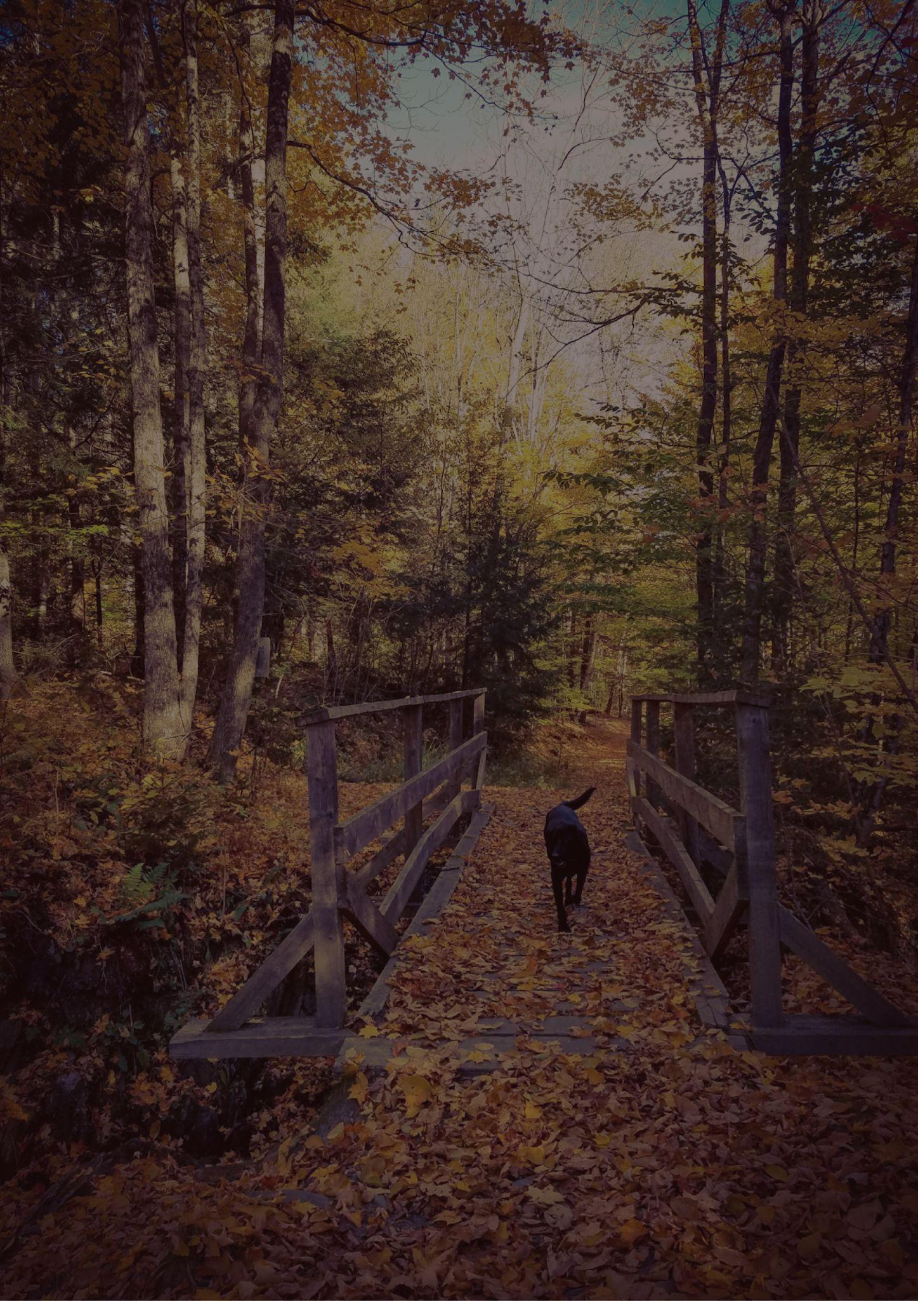
VERMONT
TRAVEL BUCKET LIST
Grafton
Covered Bridges
Billings Farm
Rockefeller Park
Cabot Creamery
VINS Nature Center
Shelburne Museum
Rock of Ages
Stowe
The Lincoln Family Home
Woodstock Inn
University of Vermont
Tallest Filing Cabinet
Mount Mansfield
Naulakha
Lake Champlain
Vermont State House
Burlington
Everything Robert Frost
The Alchemist
Woodstock
Quechee Gorge
Manchester
Montpelier
Shelburne
Killington Resort
Ben & Jerry's Factory Tour
Champlain Islands

