Slide 1
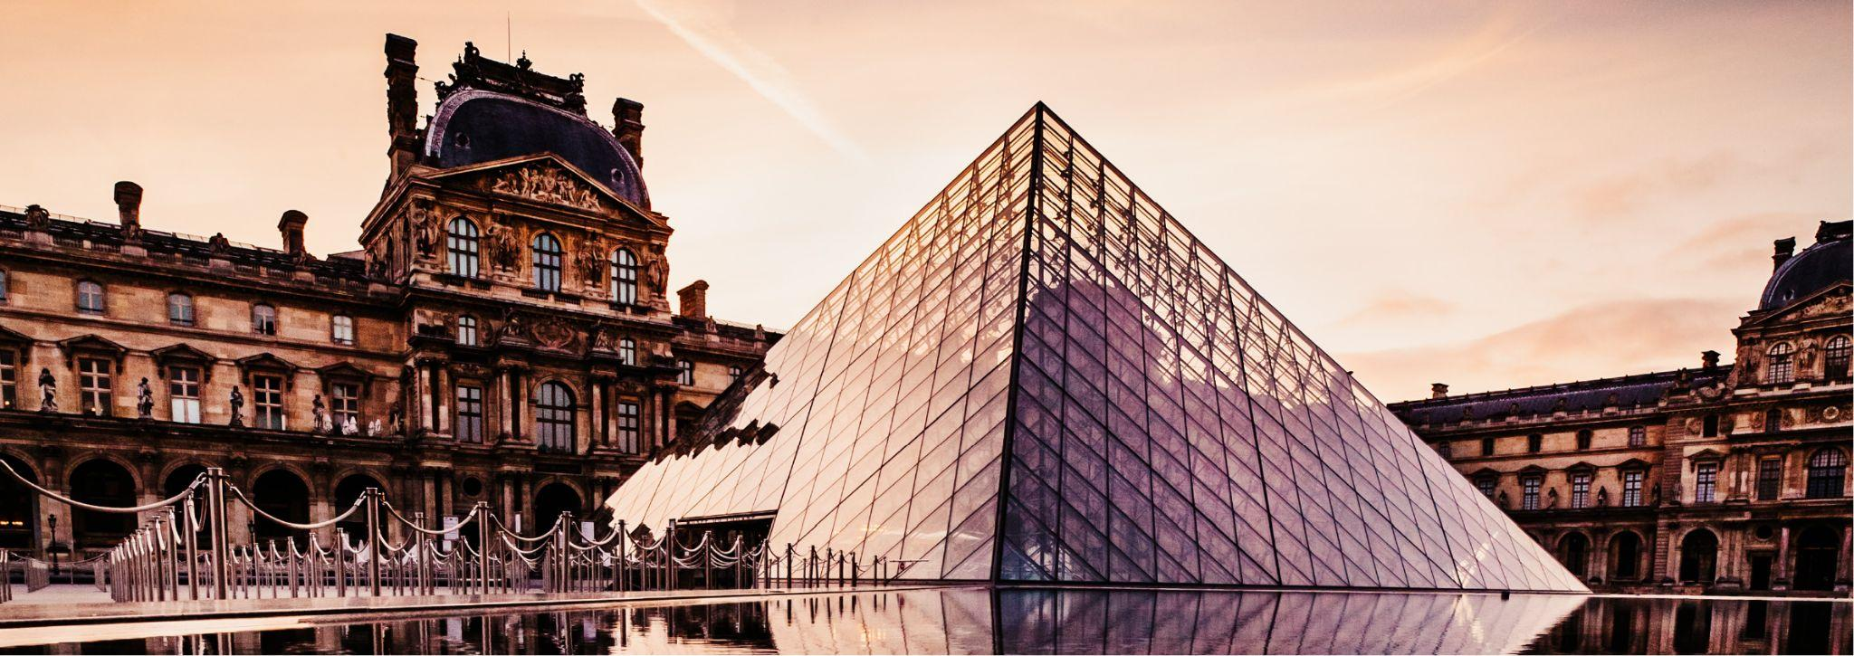
Paris
July 17
Itinerary
8:30AM - 9:30AM
Bakery (optional)
9:30AM - 10:30AM
Bus to brunch (42 min)
10:30AM - 11:00AM
Explore Montmartre neighborhood
11:00AM - 12:00PM
Brunch @ La Maison Rose or Le Consulat
1:00PM - 1:15PM
Walk to Sacré-Cœur (4 min)
1:15PM - 3:00PM
Explore Sacré-Cœur
3:00PM - 4:00PM
Explore Montmartre neighborhood
4:00PM - 4:30PM
Bus to Arc De Triomphe (20 min)
4:30PM - 5:30PM
Explore Arc De Triomphe
5:30PM - 6:30PM
Eat dinner near Arc or Eiffel Tower
6:30PM - 7:30PM
Bus to Point Alexandre III bridge (12 min)
7:30PM - 8:15PM
Walk to Hotel des Invalides (7 min)
8:15PM - 9:00PM
Walk to Champ de Mars for Eiffel (23 min)
9:00PM - 9:30PM
Walk to Trocadero (best Eiffel pics) (17 min)
9:30PM - 10:15PM
Watch sunset + Eiffel sparkle
10:15PM - 10:45PM
Bus to dessert (26 min)
10:45PM - 11:30PM
Eat dessert @La Creperie de Josselin
11:30PM - 12:00AM
Bus back to Airbnb (13 min)

