Slide 1
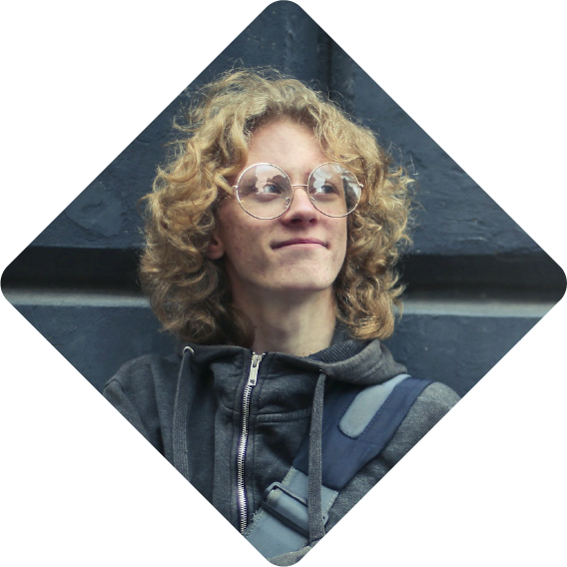
WORK EXPERIENCE
Junior English Tutor
Hickle and Pollich | 2021 - 2022
- Sed non enim vestibulum, aliquet libero.
- Suspendisse leo nulla, consectetur ac quam.
- Aliquam orci nunc, tristique sit amet risus.
Junior English Tutor
MARTINE
JACOBSON
Hettinger-Olson | 2020 - 2021
- Phasellus auctor sapien eros fermentum.
- Nam in pharetra lacus, quis viverra mi.
- Etiam eros arcu, tempus sit amet iaculis.
College Student
EDUCATION HIGHLIGHTS
EXECUTIVE SUMMARY
South Dakota University
Forming Machine Operator | 2020 - Present
- Integer dignissim dui lobortis est molestie at.
- Phasellus venenatis tincidunt rutrum.
- Duis ultricies velit erat, id bibendum augue.
Aliquam iaculis vulputate orci, efficitur tempor ipsum ullamcorper eu. Sed hendrerit hendrerit tellus, ac maximus urna pharetra tristique.
Quitzonchester High School
Class Valedictirian | 2016 - 2020
- Sed non enim vestibulum, aliquet libero.
- Integer dignissim dui lobortis est molestie at.
- Phasellus auctor sapien eros fermentum.
SPECIALIZATIONS
• History
• Reading comprehension
• Reporting
• Journalistic writing
• Theater
• Public speaking
• Literary writing
• Political science
• Play production
LANGUAGES SPOKEN
European:
Asian:
• Dutch
• Italian
• Spanish
• English
• Chinese
• Japanese
• Korean
CONTACTS
RELEVANT COURSES
1-123-456-7890
my@mail.com
www.mywebsite.com
8094 Kemmer Junction, Raestad, Maine, 37855
Intro to marketing
Marketing research
Electronic commerce

Slide 2
MARTINE
JACOBSON
College Student
February 01,2025
Lawson Pagac
Health Specialties Teacher
5756 Bogan Curve
Hickletown, New Hampshire 57378
Dear Mr. Pagac
Sed vitae ultrices elit. Mauris ut iaculis ex. In accumsan sit amet arcu at dictum. Sed eu faucibus purus, in malesuada sapien.
Mauris turpis erat, pretium nec efficitur vitae, volutpat nec ex. Suspendisse luctus erat ex, a vulputate nunc accumsan ac. Phasellus dui mi, posuere vel velit ac, mattis tempus lacus. Nulla lacus turpis, porttitor vitae convallis quis, pharetra sed urna. Integer facilisis, lectus non vestibulum rutrum, dui felis efficitur massa, eget tempus libero elit at lacus.
Donec viverra sem sed ex tincidunt finibus. Nullam ac pulvinar augue, eget porta enim. Sed sit amet finibus augue, fringilla congue diam. Donec mollis cursus consectetur. Donec a dignissim ante. Proin quis turpis molestie, pharetra erat id, mattis ligula. Nam facilisis pellentesque ipsum eu tempus.
Donec laoreet luctus sem, dignissim sollicitudin erat hendrerit vitae. Class aptent taciti sociosqu ad litora torquent per conubia nostra, per inceptos himenaeos.
Sincerely,
MartiJa
Martine Jacobson

