Slide 1
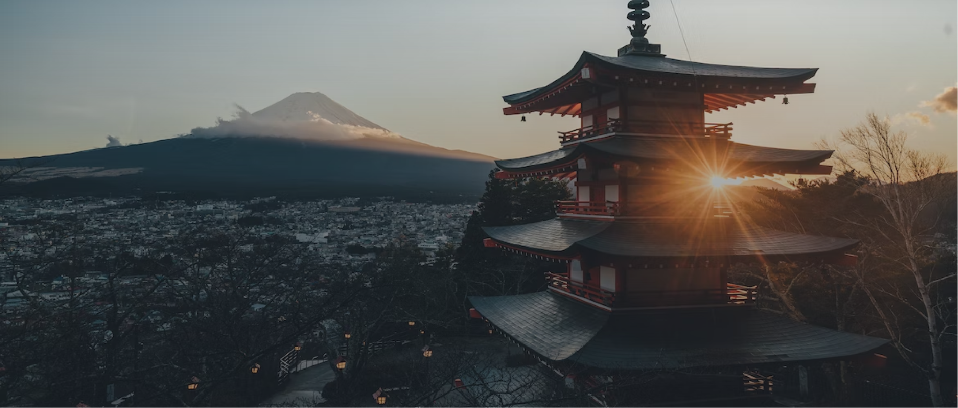
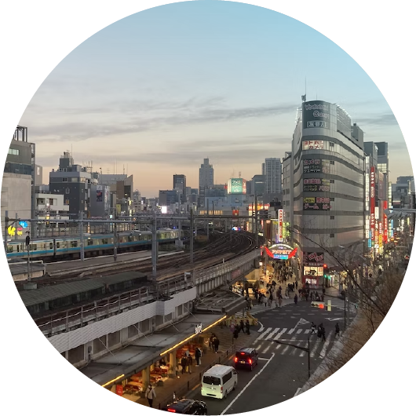
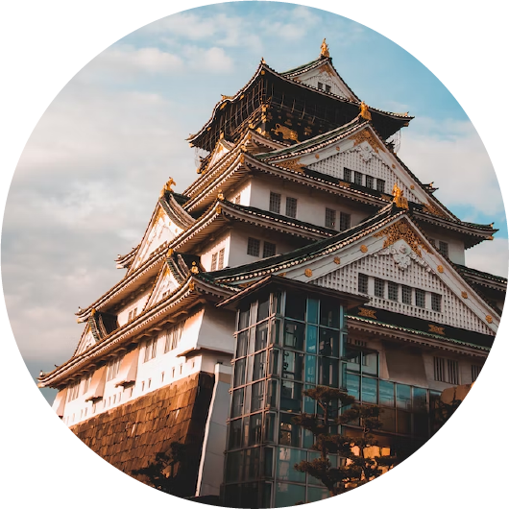
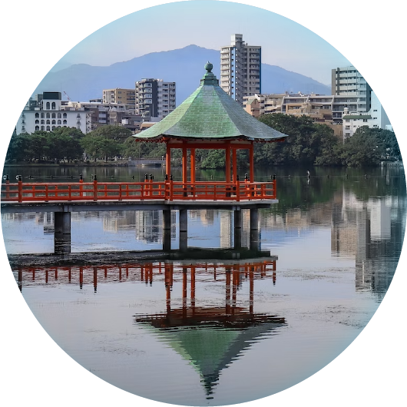
9 DAY TRIP
Japan Itinerary
Day 1 - 3 : Tokyo
09:00 - 12:00
Meiji Shrine
12:00 - 15:00
Sensō-ji Temple
15:00 - 18:00
Tokyo National Museum
18:00 - 21:00
Edo-Tokyo Museums
Day 4 - 6 : Osaka
09:00 - 12:00
Osaka Castle
12:00 - 15:00
Shitennō-ji Temple
15:00 - 18:00
Osaka Aquarium Kaiyukan
18:00 - 21:00
The Kobe Port Tower
Day 7 - 9 : Fukuoka
09:00 - 12:00
Fukuoka Castle
12:00 - 15:00
Kyūshū National Museum
15:00 - 18:00
Ōhori Park
18:00 - 21:00
Fukuoka Art Museum

