Slide 1
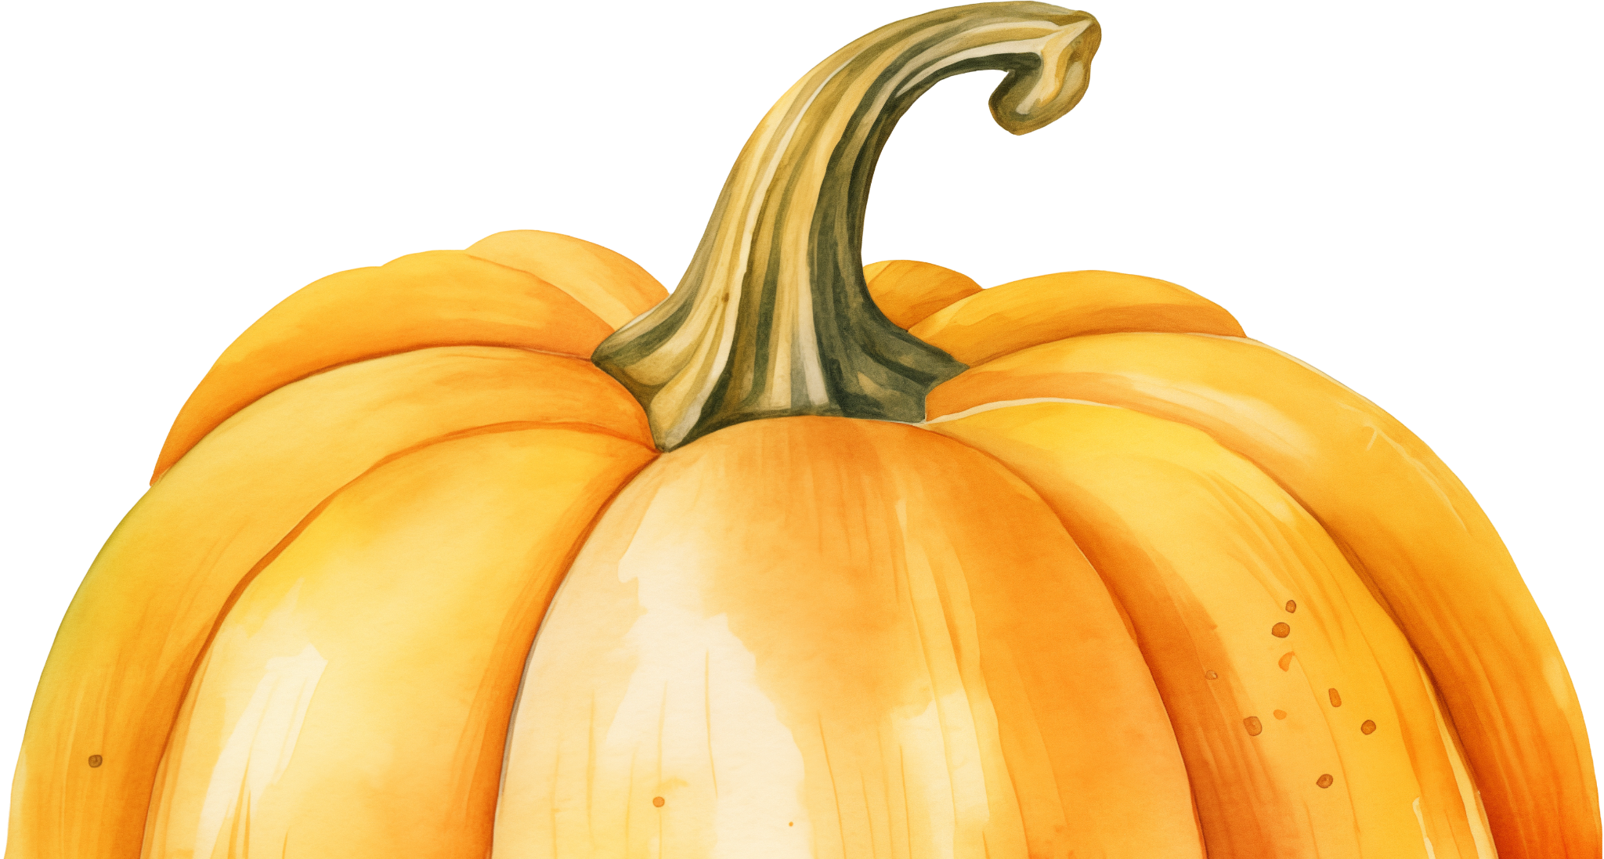
Thanksgiving
D I N N E R
STARTERS
Roasted turkey slices with cranberry sauce served with cornbread stuffing, mashed potatoes
MAIN COURSE
Honey-glazed ham with roasted sweet potatoes
wild rice with cranberries and pecans
assorted roasted root vegetables
DESSERTS
Pumpkin pie with whipped cream
Pecan pie

