Slide 1
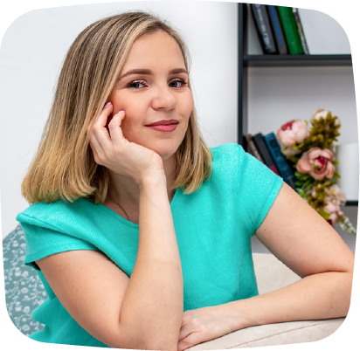
WELCOME TO
GRADE 3
Welcome students! We are ready for a great year!
Nice to Meet You!
Hello students! I'm Ms. Olivia, and I'm very excited to be your teacher. School starts next week, and we have a lot to look forward to. I look forward to seeing you!
What to Bring
My Background
Check the school supplies list sent in last weeks email. Don't forget to bring a healthy lunch too!
I've been teaching Grade 3 at this school for 5 years and I love it. I went to college at Borcelle College of Education and have been a teacher since 2010.
My Favorites
My Contact Info
Favorite Food:
Favorite Sport:
Favorite Subject:
Favorite Hobby:
Pasta
Volleyball
Art
Painting
hello@reallygreatsite.com
+123-456-7890

