Slide 1




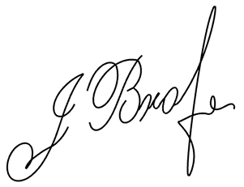
J E N N I F E R
B R O W N
Washington, DC
(123) 456-7890
jenniferexample@gmail.com
linkedin.com/in/examplebrown
M i d d l e S c h o o l T e a c h e r
To Elizabeth Miller
Division Manager
Human Resources
Washington Middle School
September 7, 2027
LETTER OF RESIGNATION
Dear Mrs. Miller,
Please accept this letter as my formal resignation from my position as a Middle School Teacher at Washington Middle School, with my final working day being November 7, 2027, in line with my contractual notice period.
This was not an easy decision to make, but after careful consideration, I have decided to move forward with a new opportunity that will allow me to continue growing both personally and professionally.
I am truly grateful for the time I have spent at Washington Middle School. Over the past four years, I have had the privilege of teaching and learning alongside inspiring colleagues and wonderful students. The experience has been rewarding and has helped me grow as an educator. I particularly value the guidance, encouragement, and trust that I have received from the leadership team.
To ensure a smooth transition, I am committed to preparing lesson materials, organizing classroom resources, and assisting in the handover process so that my successor can step into the role as seamlessly as possible.
I will always look back fondly on my time at Washington Middle School and wish the school, its staff, and its students continued success in the future.
Sincerely,
Jennifer Brown

