Slide 1


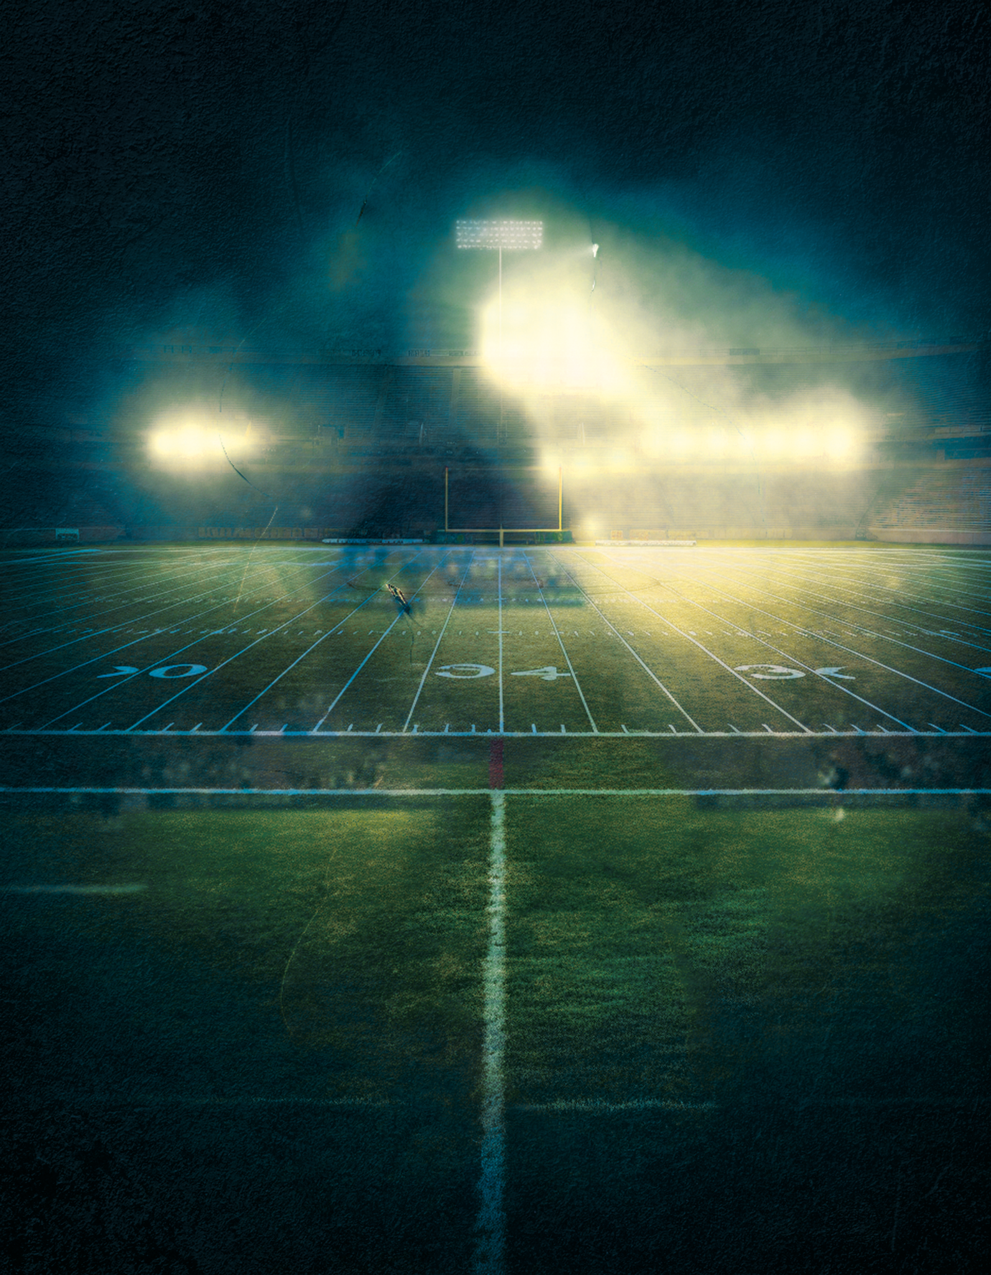



F E B R U A R Y 8 , 2 0 2 6
SUPER
BOWL
FINAL GAME
TEAMNAME 1
vs
TEAMNAME 2
YOUR CLUB NAME, 19TH AVENUE, NY
DOORS OPEN AT 5PM, ENTRY $5
More info: 123-456-7890 - yourname@mail.ltd - yourname.ltd

