Slide 1
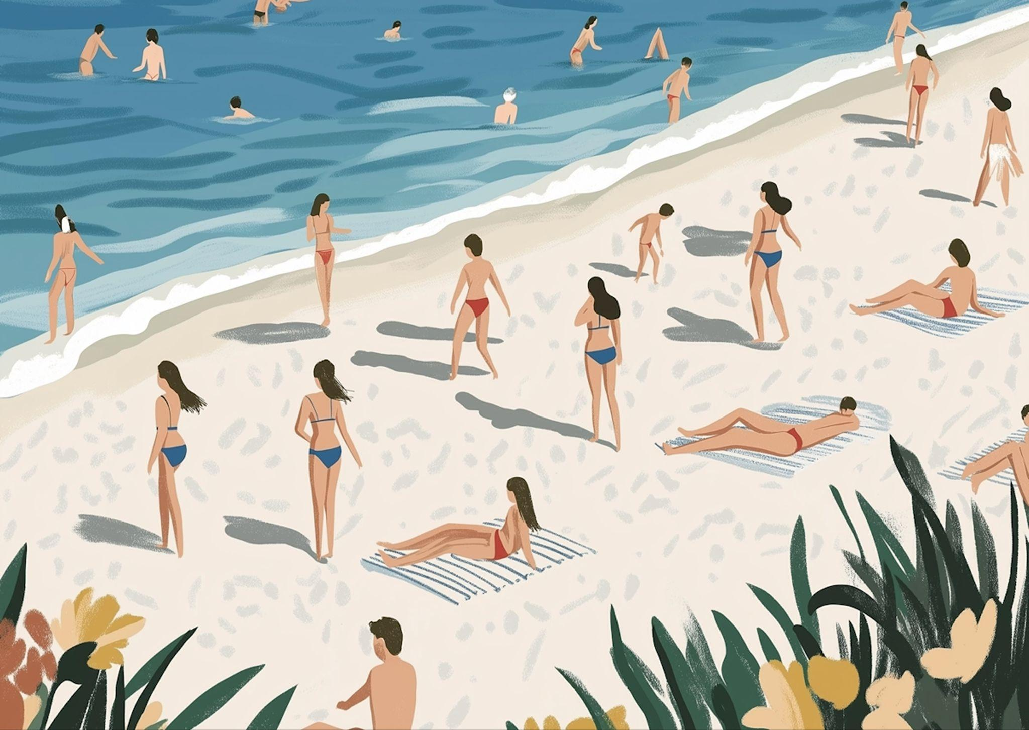


Summer vacation planner
Summer vacation planner
Mon | Tue | Wed | Thu | Fri | Sat | Sun
1 | 2 | 3 | 4 | 5 | 6 | 7
8 | 9 | 10 | 11 | 12 | 13 | 14
15 | 16 | 17 | 18 | 19 | 20 | 21
22 | 23 | 24 | 25 | 26 | 27 | 28
29 | 30 | 1 | 2 | 3 | 4 | 5
6 | 7 | 8 | 9 | 10 | 11 | 12
13 | 14 | 15 | 16 | 17 | 18 | 19
20 | 21 | 22 | 23 | 24 | 25 | 26
June
July

