Slide 1
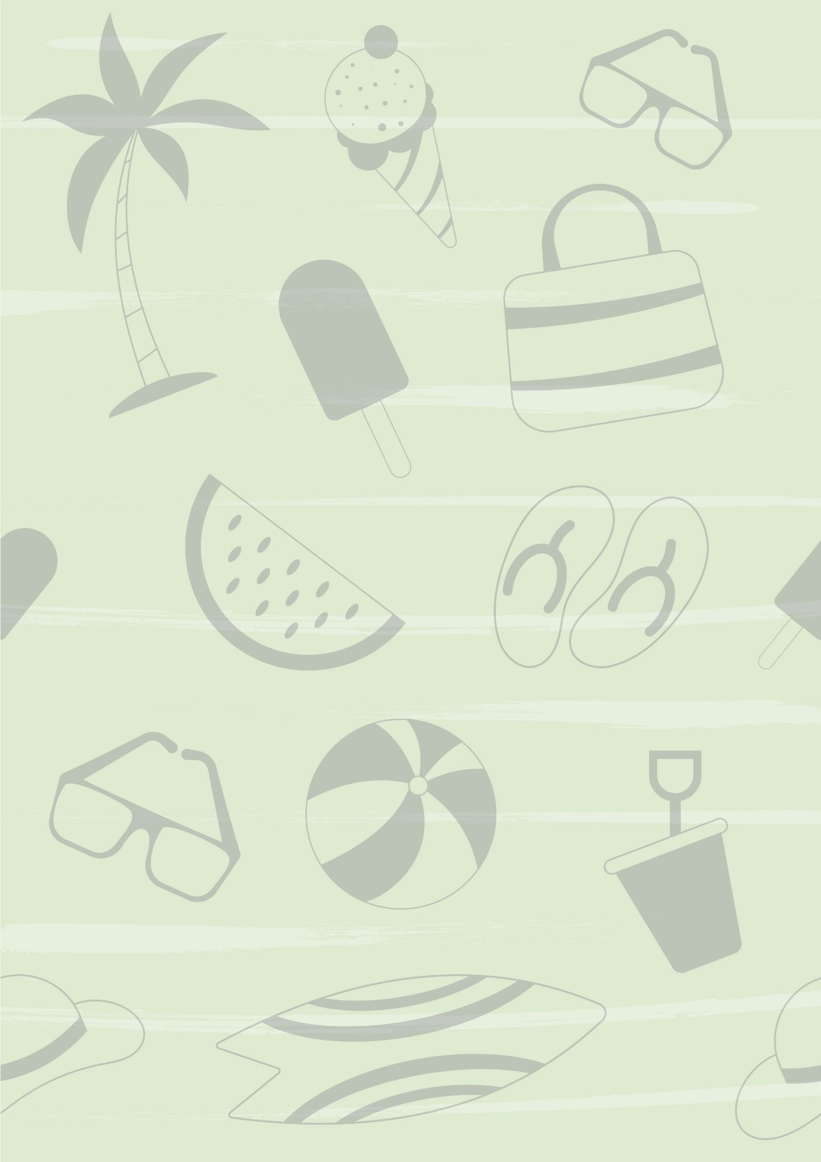
My Beach Packing List
Beach Gear:
Food:
Umbrella
Beach Chair
Waterproof Blanket
Beach Cart
Umbrella
Hooded Towel
Cooler
Snacks
Water
Ice cream
Fun:
Clothes:
Water wings
Mask
Water Toys
Beach toys or games
Kites
Bubbles
Swimsuits
Shirt
Hats
Sandals
Water shoes
Toiletries:
Baby:
Shampoo
Conditioner
Bug spray
SPF Lip Balm
Anti-Itch Cream
Baby Powder
Face Wipes
Life Jacket
Spare Clothes
Hair Detangler
Rash Cream

