Slide 1
PHOTOGRAPHY
BUSINESS CARD
Example@mail.com

Slide 2
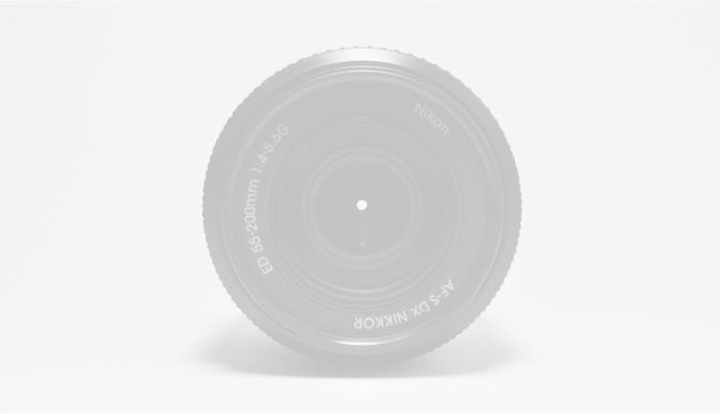
PHOTOGRAPHY
BUSINESS CARD
+1 012-345-6789
Example.com
Example@mail.com
5703 Rippin Crescent Apt.

