Slide 1
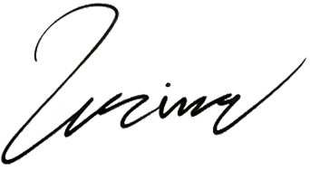
To: Michael Johnson
johnson@nexustech.com
FUSION
3 Street, Suite 4, Linkville,
Techland, ZIP679
Dear Michael Johnson,
I trust this letter finds you well. It is with great pleasure that I extend my warmest greetings on behalf of [Your Company Name]. As a distinguished presence in the [your industry or field], we are delighted to establish a connection and explore potential avenues for collaboration with [Recipient's Company Name].
At [Your Company Name], we are driven by a commitment to [briefly describe your company's mission or core values]. Armed with a team of accomplished professionals and a steadfast dedication to innovation, we have achieved remarkable milestones, including [mention any notable accomplishments, projects, or partnerships].
I am eager to explore these avenues further and discuss how our collaboration can be symbiotic and fruitful. Please feel free to reach out to me via email at [Your Email Address] or by phone at [Your Phone Number]. It would be an honor to arrange a meeting at your convenience to delve deeper into the possibilities. Thank you for considering this proposal. We anticipate the chance to bring our collective talents together and achieve remarkable heights.
Best regards,
Emily Reynolds
Chief Executive Officer
+1 (555) 987-6543
23 Main Street, Suite 6
rec@company.com

