Slide 1
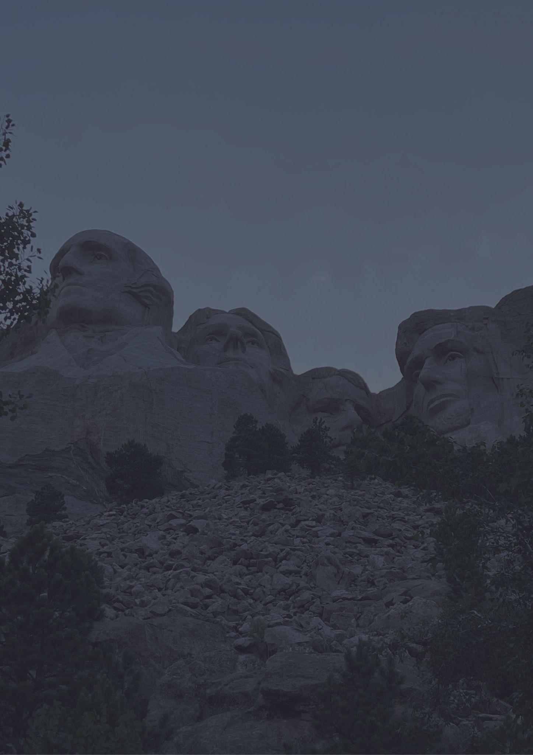
South Dakota
Travel bucket list
Mount Rushmore Memorial
Sylvan Lake
Crazy Horse Memorial
Jewel Cave Monument
Mitchell Corn Palace
Good Earth State Park
Black Hills National Forest
Ingalls Homestead
Badlands National Park
South Dakota Air
Mammoth Site of Hot Springs
Children’s Museum
Wind Cave National Park
Old Courthouse Museum
National Music Museum
Bear Butte State Park
Sioux Falls Park
Badlands National Park
Spearfish Canyon
Custer State Park
Deadwood
Crazy Horse Memorial
South Dakota Air
Sertoma Butterfly House
Space Museum
Old Courthouse Museum

