Slide 1
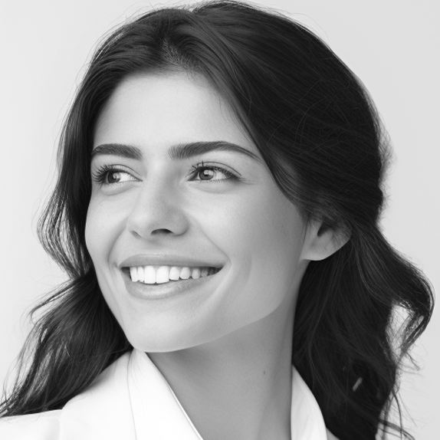
Emma Caldwell
V o l u n t e e r a t L o c a l W o m e n ’ s S h e l t e r
SUMMARY
CONTACT
Motivated and detail-oriented student with strong leadership skills, a passion for community service, and a proven track record of academic excellence. Experienced in team management, event organization, and interpersonal communication.
012-345-4567
emma.caldwell@email.ltd
instagram.com/emmaexample
EXPERIENCE
123 Rosewood Avenue
Austin, TX 78701
Event Coordinator Intern
City Youth Center – (June 2022 – Present)
EDUCATION
Managed communication between staff, volunteers, and participants
to ensure successful events.
AUSTIN HIGH SCHOOL
Developed marketing materials to boost event attendance by 25%.
2019-2023
GPA: 4.1
Camp Counselor
SAT: 1520
Camp Wildwood – (May 2020 – August 2021)
Supervised and mentored groups of 15+ children, leading daily activities and team-building exercises.
AWARDS
Fostered a positive and inclusive environment, ensuring the safety and enjoyment of all participants.
Dean’s List Recipient
Leadership Award
Volunteer of the Year
COMMUNITY INVOLVEMENT
National Arts Scholar
Debate Club Captain
Volunteer at Local Women’s Shelter
Model UN Participant
Habitat for Humanity Organizer
Phi Beta Kappa Society
Fundraiser for Animal Rescue Center
Volunteer at Food Bank
INTERESTS
GREEK AFFILIATION
Performing Arts
Environmental Sustainability
Aunt: Megan Carter // Delta Gamma
Creative Writing
Cousin: James Taylor // Sigma Chi
International Relations
Uncle: David Harris // Kappa Alpha Order
Photography

