Slide 1

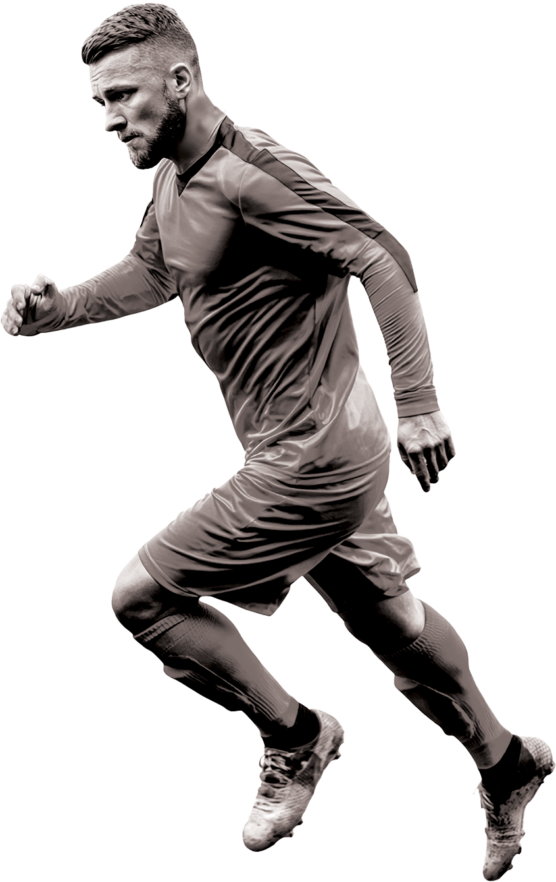








BARCELONA VS MANCHESTER CITY
GAME
DAY
SAT 30
september
beers from $5 i all you can eat from $10 i free parking
YOUR PLACE NAME, 12 FOOTBALL ST., SAN ANTONIO, TX
www.yourbarname.COM

