Slide 1
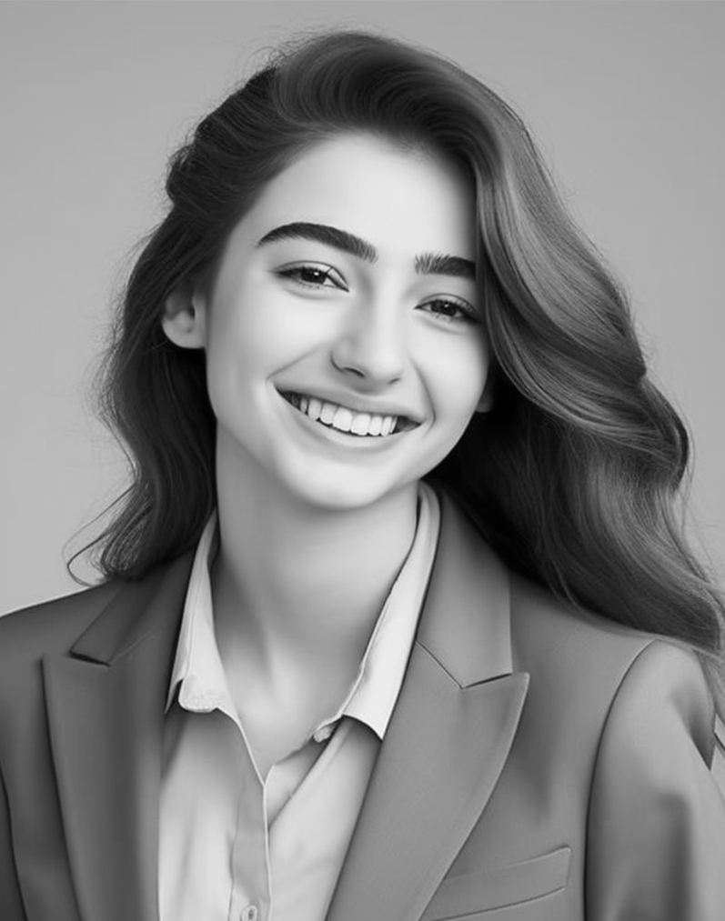
Education:
Bachelor of Fine Arts
(BFA) in Painting and Sculpture, Art Institute of Creativity, Creative City, State,
Graduated 20XX
Master of Fine Arts
(MFA) in Multimedia Art, Contemporary
Art College, Urban Center, State,
Graduated 20XX
Skills:
Proficient in sculpture
Strong understanding of art history
Excellent communication
SERAPHINA
RAMIREZ
Ability to work collaboratively in team
Proficient in Adobe Creative Suite
Languages:
3D Artist
English
Spanish
German
Objective:
Work Experience:
Passionate and versatile artist seeking opportunities to showcase creativity and contribute to artistic endeavors. With a background in a dedication to continuous learning,
I aim to bring unique perspectives and innovative techniques to the
3d art world.
Lead Artist, Spectrum Art Studios, Urban Center, State, 20XX - Present
Conceptualize and execute original
artwork for clients in various mediums,
including painting, sculpture.
Collaborate with clients to develop
custom art installations for commercial.
Contact:
Art Director, Creative Visions Agency, Metropolitan City, State, 20XX - 20XX
123 Artistic Avenue
Creative City, State, 56789
Oversaw the creative direction of
projects from concept to completion,
ensuring alignment with client.
(123) 456-7890
Developed and implemented innovative
marketing strategies to promote artwork
and attract new clients.
seraphina@example.ltd
www.seraphina.ltd

