Slide 1

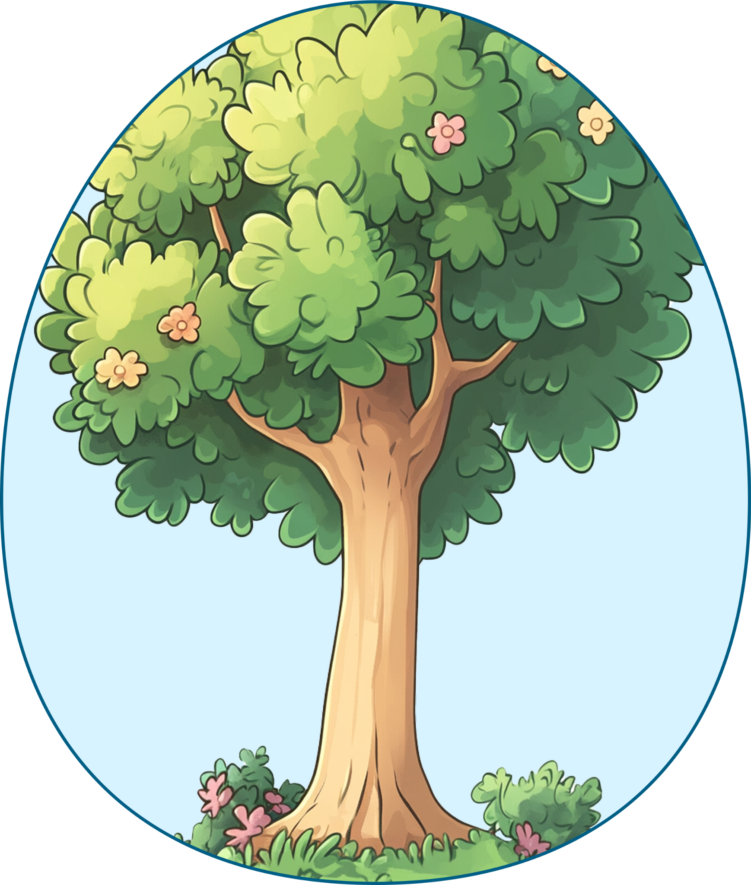

My Family Tree
GRANNY
GRANDPA
GRANNY
GRANDPA
MOTHER
FATHER
ME

