Slide 1
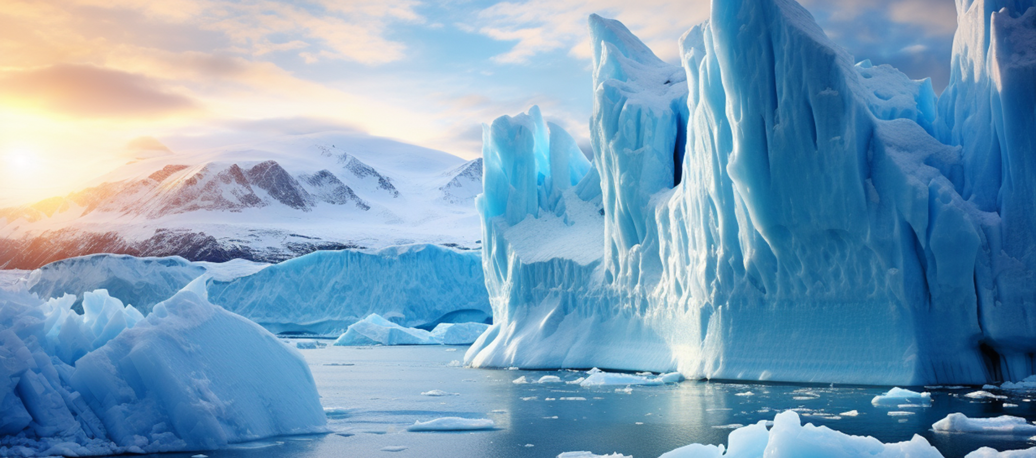
DIGEST
GLOBAL SCIENCE
Volume 23, Issue 7
Global Science Digest Publications
July 2028
A striking image of a melting glacier in Patagonia at sunrise, showcasing the impact of climate change on our planet's ice.
An Expedition into the Heart of Melting Glaciers
Journey into the world of glaciers with the new documentary, Frozen Titans. As global temperatures rise, these majestic ice rivers are retreating at alarming rates, revealing secrets locked in the ice for millennia. The documentary explores the beauty and fragility of these natural wonders, offering a stark reminder of the urgent need to address climate change. Viewers will get an intimate look at the ongoing transformation of our planet’s cryosphere, capturing the stunning yet sobering reality of melting glaciers. Journey into the world of glaciers with the new documentary, Frozen Titans sobering reality of melting glaciers.
As global temperatures rise, these majestic ice rivers are retreating at alarming rates, revealing secrets locked in the ice for millennia. The documentary explores the beauty and fragility of these natural wonders, offering a stark reminder of the urgent need to address climate change. Viewers will get an intimate look at the ongoing transformation of our planet’s cryosphere, capturing the stunning yet sobering reality of melting glaciers. Journey into the world of glaciers with the new documentary, Frozen Titans. As global temperatures rise, these majestic ice rivers are retreating at alarming rates, revealing.

Slide 2
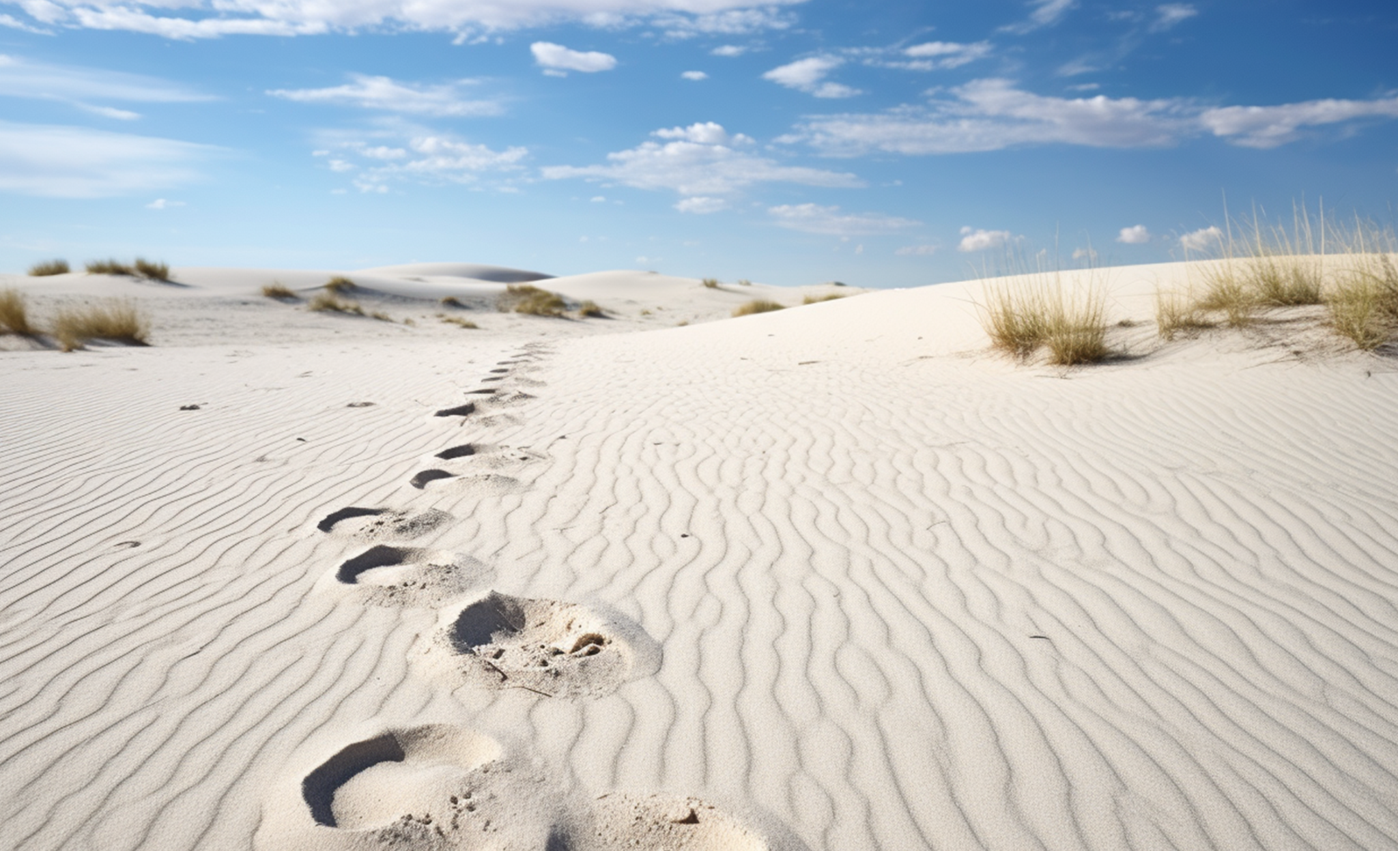
Volume 23, Issue 7
Global Science Digest Publications
July 2028
An aerial view of fossilized human footprints preserved in the sandy terrain, offering clues about early migration routes.
Human Migration to the Americas
A close-up shot of ancient fossilized footprints embedded in the cracked, dry earth of White Sands National Park. The prints, preserved in fine detail, stretch across the landscape, offering a tangible connection to the distant past and the early humans who once walked this ground. A close-up shot of ancient fossilized footprints embedded in the cracked, dry earth of White Sands National Park. The prints, preserved in fine detail, stretch across the landscape, offering a tangible connection to the distant past and the early humans who once walked this ground. A close-up shot of ancient fossilized footprints embedded in the cracked earth.
Beneath the vast skies of New Mexico lies a site that holds one of the most significant pieces of our ancient history. For thousands of years, this sprawling desert landscape has remained a witness to the passage of time, preserving remnants of early human activity. Among the shifting sands, fossilized footprints offer a glimpse into a world long past, where humans once roamed, leaving behind traces of their journey. These ancient marks are not only a testament to the endurance of the human spirit but also a connection to a time when the Americas were first being explored by our ancestors.

Slide 3
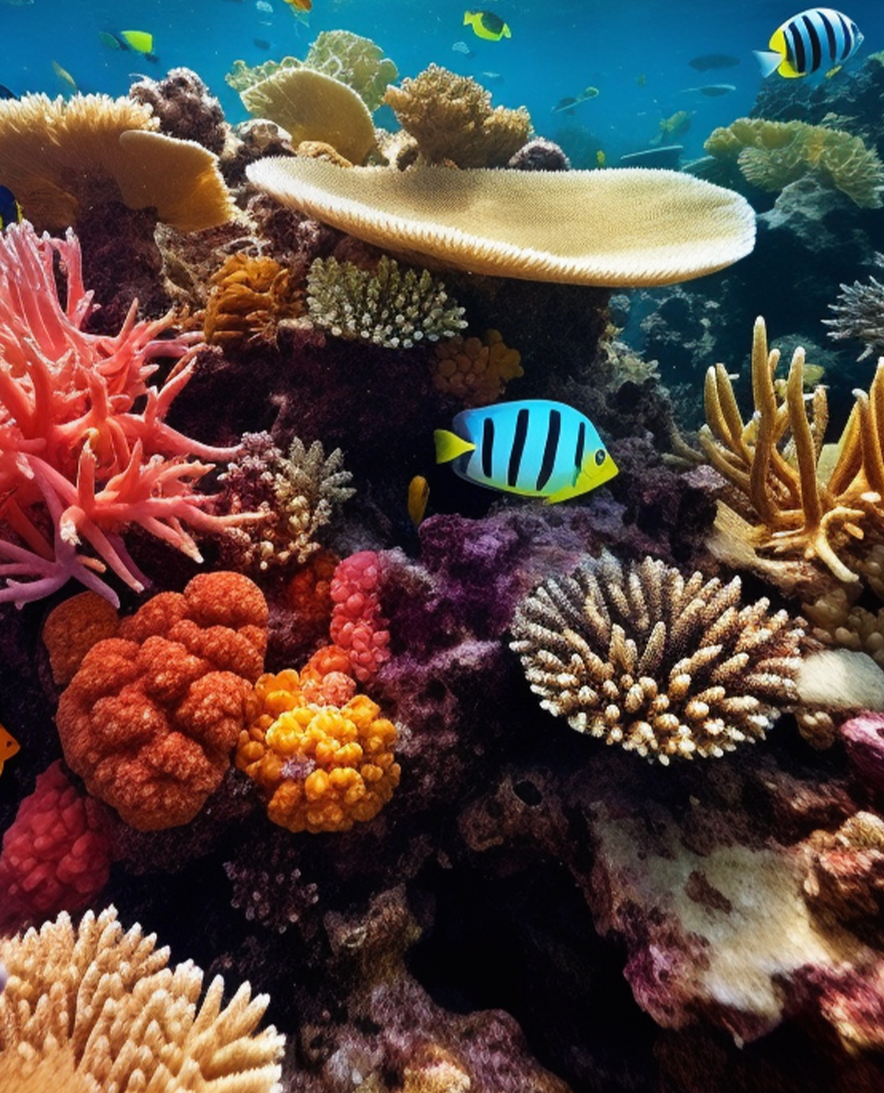
Volume 23, Issue 7
Global Science Digest Publications
July 2028
The Hidden Life of Coral Reefs
Beneath the ocean’s surface lies a vibrant world teeming with life—coral reefs, often referred to as the "rainforests of the sea." These underwater ecosystems are among the most diverse and productive on Earth, supporting thousands of species and providing critical benefits to human communities. However, coral reefs are facing an unprecedented crisis. These underwater ecosystems are among the most diverse and productive on Earth, supporting thousands of species and providing critical benefits to human.
A Struggle for Survival Under the Sea
The Silent Extinction: Pollinators Disappearing at Alarming Rates
The silent extinction of pollinators is unfolding across the globe, with bees, butterflies, and other vital species vanishing at alarming rates. These tiny creatures play a massive role in global food production, pollinating nearly 75% of crops we rely on every day. Habitat loss, pesticide use, climate change, and disease are all contributing to their rapid decline. Scientists warn that without pollinators, ecosystems could collapse and food shortages may become a reality. Despite their importance, pollinators often go unnoticed—until their absence begins to affect what appears on our plates.
"If we lose our pollinators, we lose more than just food; we lose the intricate web of life that sustains
our planet."
— Dr. Maria Silva, Conservation Biologist
Urgent action is needed to protect these species and preserve the balance of nature they help sustain. Without intervention, we risk losing not just these species, but the stability of ecosystems that depend on them. The time to act is now—before the silence of vanishing pollinators becomes permanent!

Slide 4
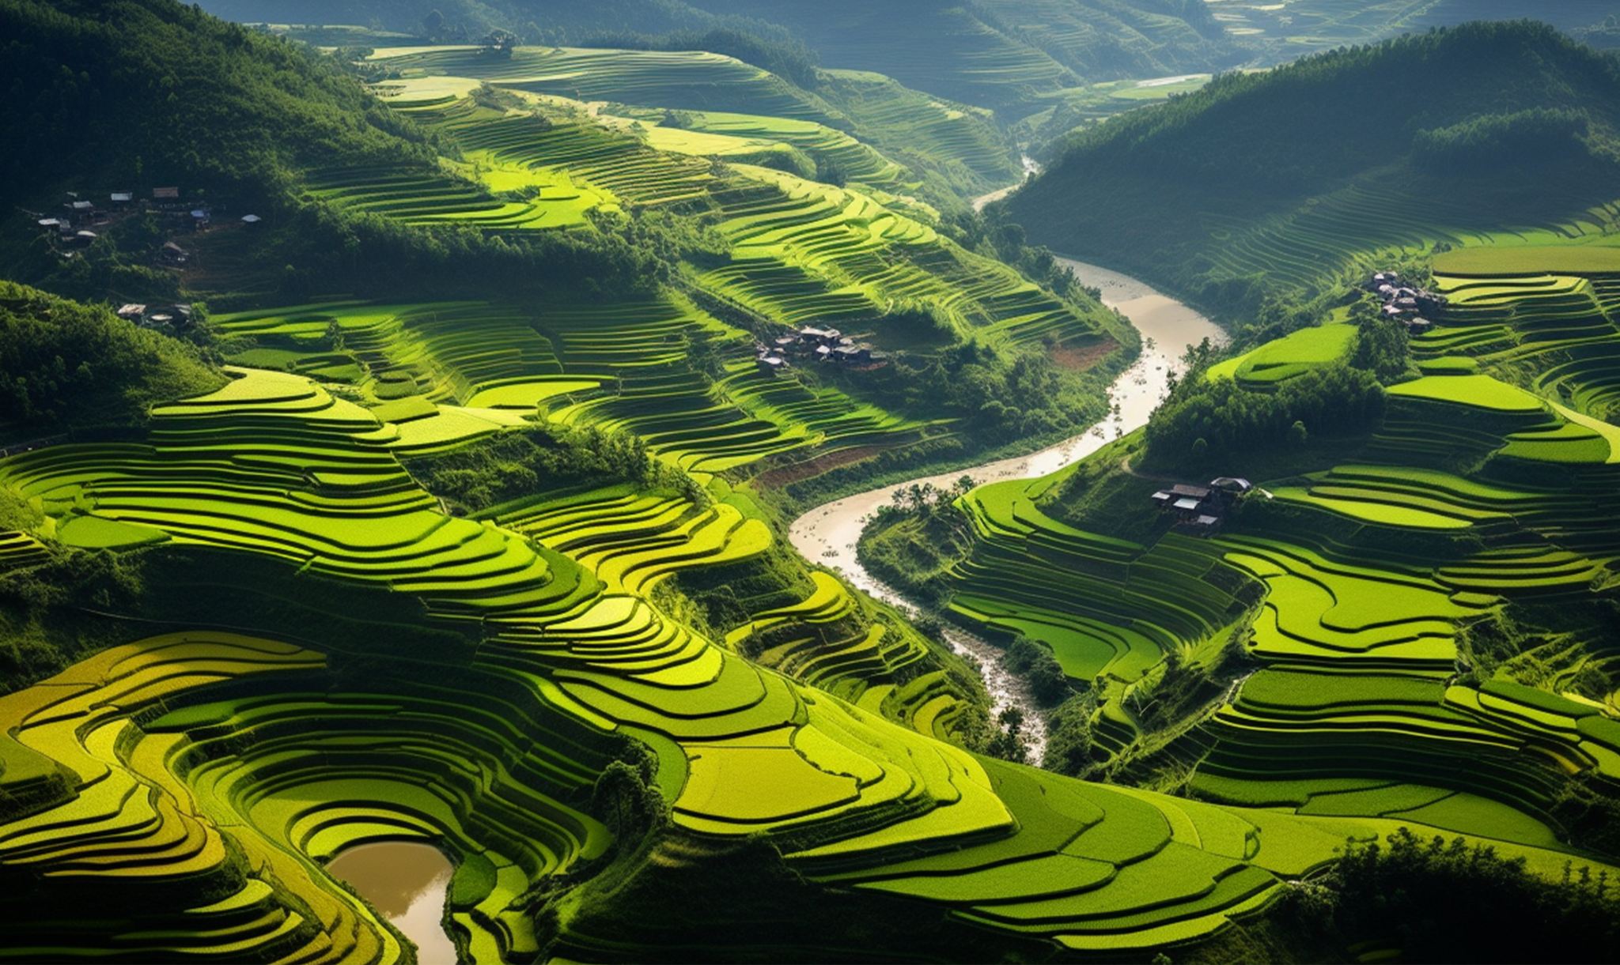
Volume 23, Issue 7
Global Science Digest Publications
July 2028
The World’s Vital Grain Under Threat from Climate Change
An aerial view of vibrant rice terraces in Vietnam, highlighting the beauty and the environmental by traditional farming.
An Expedition into the Heart of Melting Glaciers
Scientists and explorers trek across icy landscapes, documenting the rapid retreat of glaciers that have existed for thousands of years. Beneath the surface, ancient air bubbles and sediments hold clues about Earth’s climate history, offering insights into our future.
"The more we explore our planet's past, the better we understand its present, and the more prepared we become for its future."
— Dr. Eleanor Greene, Environmental Scientist
The team witnesses cascading meltwater, collapsing ice walls, and once-solid paths now transformed into rivers. Along the way, the expedition captures powerful visuals that highlight both the beauty and vulnerability of these frozen giants.

