Slide 1
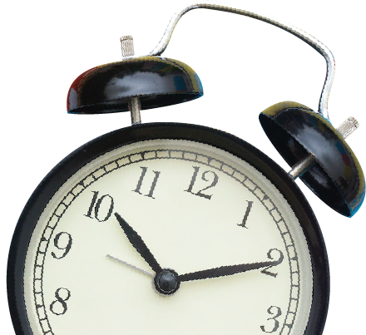
SCHOOL
MORNING
ANNOUNCEMENT
MAURIS SCHOOL
CLASSES
START
TOMORROW
AT 10 O'CLOCK
For details, visit the School’s
Official Page

