Slide 1
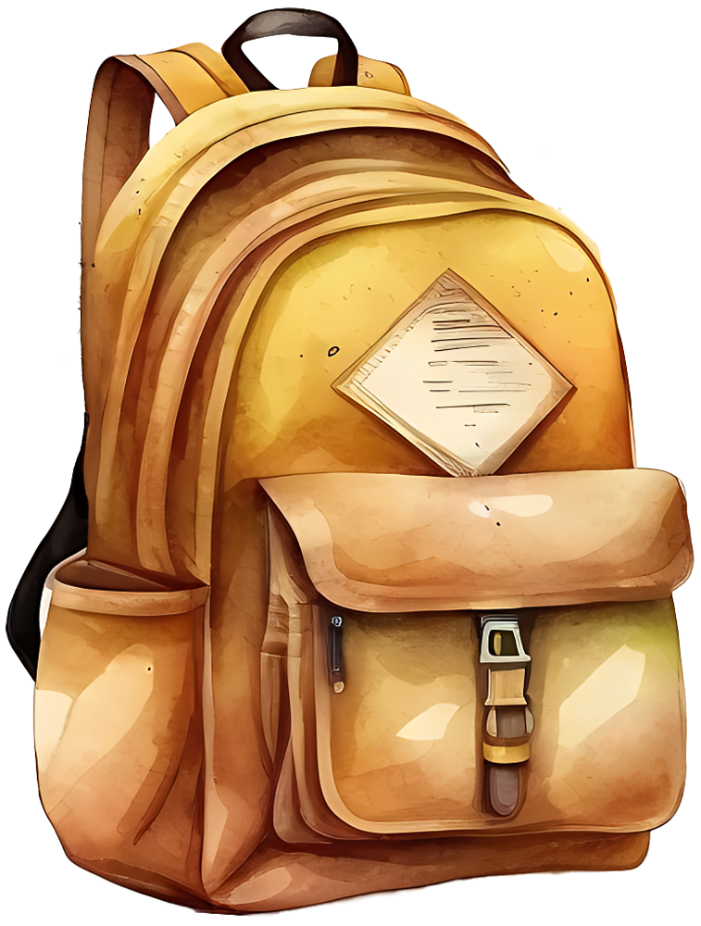
SCHOOL BUCKET LIST
Join a school club or organization that interests you.
Attend a school dance or prom.
Participate in a school play or musical.
Get a part-time job to earn some extra money.
Attend a school sports game or competition.
Participate in a community service project organized by your school.
Attend a school field trip to a place you've never been before.
Create a study group with classmates to help each other prepare for exams.
Take a class or elective that you've always been curious about.
Attend a school-sponsored talent show or open mic night.
Participate in a school debate or speech competition.
Get involved in student government and run for a position.
Attend a school-sponsored concert or music festival.
Try out for a school sports team, even if you've never played before.
Take a leadership role in a school club or organization.
Attend a school-sponsored cultural festival or event.
Organize a fundraising event for a charity or cause you care about.
Participate in a school-sponsored poetry or writing contest.
Volunteer as a tutor or mentor for younger students at your school.
Graduating with honors, academic or special recognition.

