Slide 1
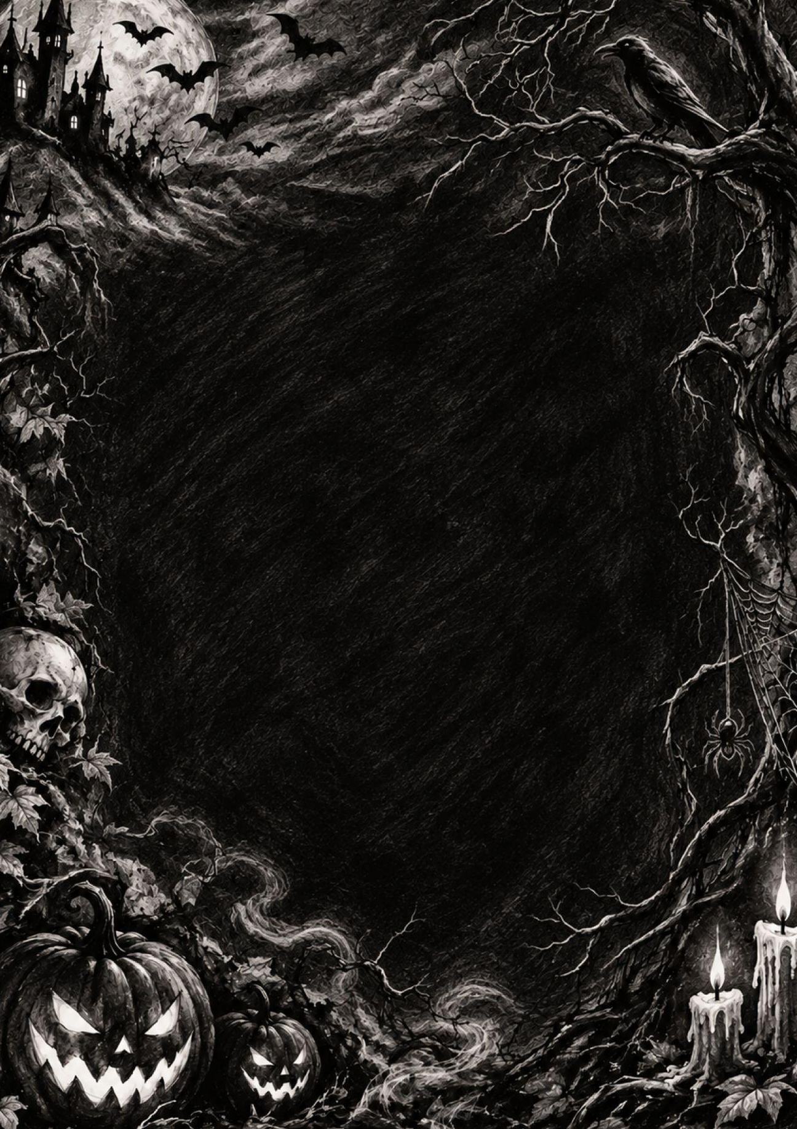
You’re Invited to
a Night of Fright
HALLOWEEN
PARTY
Enter if you dare! Join us for an evening filled with chilling surprises, creepy treats, wicked games, and spooky fun.
SATURDAY, OCTOBER 31
8:00 PM – MIDNIGHT
The Haunted Hollow
486 Ravenwood Lane
Salem, MA 01970

