Slide 1
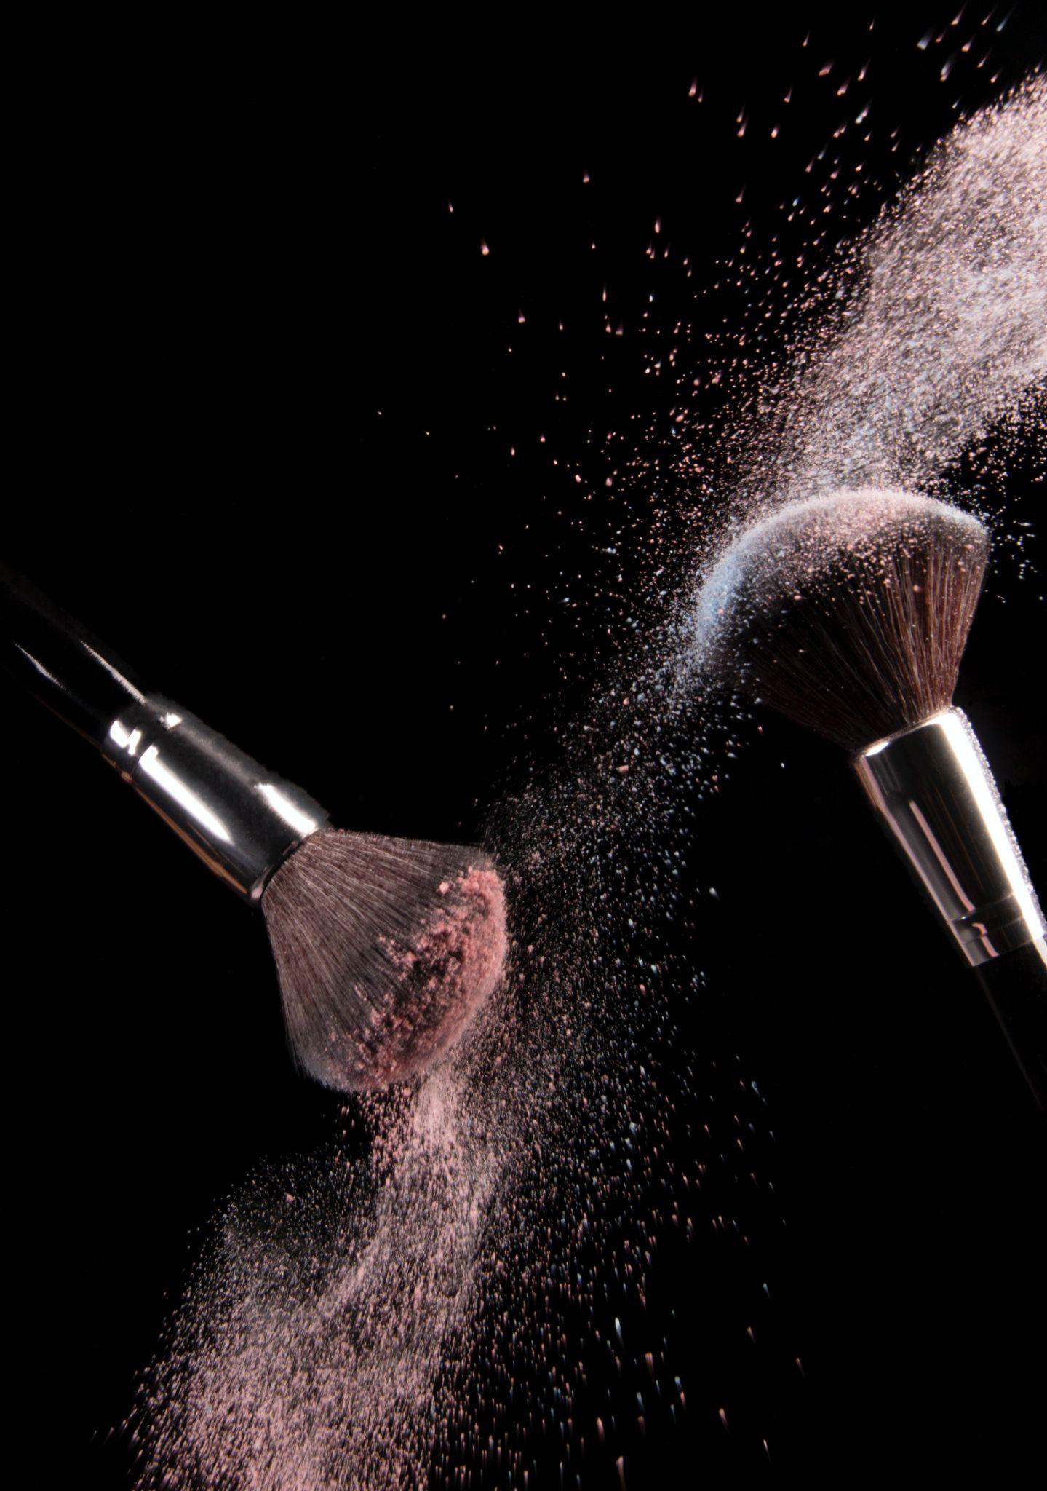
s a l o n
Price list
MAKE UP
WAXING
Make-up Lessons
$ 35.00
Lip
$ 35.00
Cleanse, Make-Up & Lashes
$ 50.00
Lip & Chin
$ 50.00
Cleanse & Make-Up
$ 80.00
Abdomen
$ 80.00
EYE CARE
WEDDING
Eyelash Tint
$ 15.00
Bridal Updo
$ 45.00
Full Set of Lashes
$ 10.00
Ultimate Bridal Entourage
$ 120.00
Eyebrow Tint
$ 10.00
Bridal Make-up Trial
$ 110.00
Eyebrow Wax & Shape
$ 20.00
Bridal Make-up Package
$ 95.00
LASHES
TREATMENTS
Classic Full Set
$ 15.00
Filler
$ 45.00
Volume Full Set
$ 10.00
Treatments
$ 120.00
2 - Week Fill
$ 10.00
Botox
$ 110.00
4 - Week Fill
$ 20.00
Massage Scrub & Mask
$ 95.00
Removal
$ 20.00
Facial massage
$ 95.00

