Slide 1
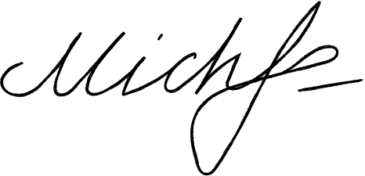
MICHELLE
LINDON
Resignation Letter
March 19, 2024
Ms Jannet Tom
General manager
Morbi porttitor company
10132 Dach Streets, West Georgette
+012-345-67890
To Ms. Tom
Kindly accept this letter as my formal resignation as a staff member of Salem Court Industries. My last day is expected to be on January 19, 2025, two weeks from today.
I am incredibly grateful for the opportunities that I have been given in this post. I value the insights that I have learned, and I expect them to help me in my future endeavors.
I would also like to thank you for being supportive of my professional growth. I have enjoyed working with you and the rest of the team.
Let me know how I can help in making the transition of responsibilities as seamless
as possible for everyone involved. Thank you.
Best wishes,
Michelle Lindon
+012-345-67890
@gdoc.io
best@gdoc.io

