Slide 1
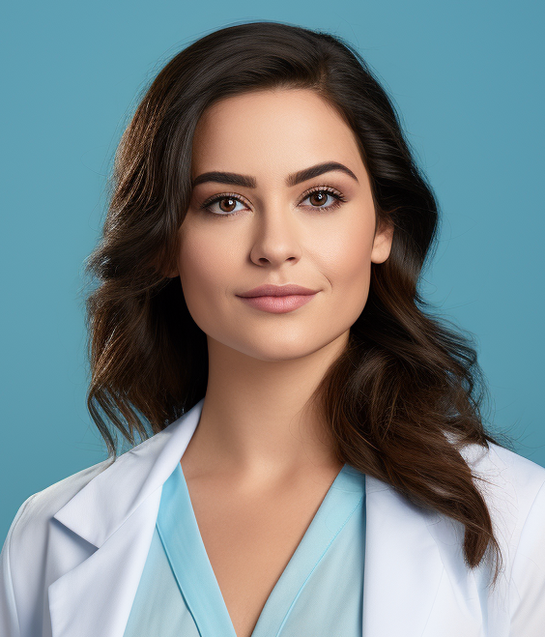
EMILY PARKER, RN
Registered Nurse
I am a licensed and compassionate registered nurse with over 10 years of clinical experience across hospital and outpatient settings. My approach focuses on delivering patient-centered care with empathy and precision. I have a strong foundation in critical care, emergency response, and chronic illness management. Known for my collaborative spirit, I thrive in fast-paced environments while maintaining patient safety and dignity as top priorities.
CONTACT
WORK EXPERIENCE
+44-7896-321654
Senior Registered Nurse
2018 – Present
emily.parker@mail.ltd
Manchester Royal Infirmary, Manchester
Manchester, UK
Manage acute care for patients in medical-surgical units and high-dependency wards.
Mentor staff and coordinate shifts for teams of up to 12.
Monitor, administer medications, and assist in patient recovery plans.
Provide emotional support and clear communication.
EDUCATION
Bachelor of Science in
Nursing (BSN)
Staff Nurse – Emergency Department
2013 – 2018
St. George’s Hospital, London
University of Birmingham
2007 – 2011
Responded to high-priority emergencies, stabilizing patients and initiating life-saving treatment.
Participated in mass casualty drills and real-life critical incidents.
Maintained accurate documentation in high-pressure settings.
CERTIFICATIONS
Nursing Intern
2010 – 2011
Registered Nurse License
– UK NMC
Queen Elizabeth Hospital, Birmingham
Basic Life Support (BLS) –
valid until 2026
Gained hands-on training in general medicine and postoperative care.
Worked closely with senior nurses to understand proper protocols and
safety procedures.
Maintained high standards in hygiene and charting.
Maintained accurate documentation in high-pressure settings.
RELEVANT SKILLS
Volunteer Nurse Assistant
2006 – 2010
Mental Health Support
Wound Care
Infection Control
Intravenous Therapy
Patient Education
Symptom Management
Age UK Community Clinic, Birmingham
Supported elderly patients in community health routine check-ups.
Assisted with scheduling, record-keeping, and health campaigns.
Hands-on experience in general, orthopedic, and postoperative care.
Worked closely with senior nurses to understand proper protocols and
safety procedures.

