Slide 1
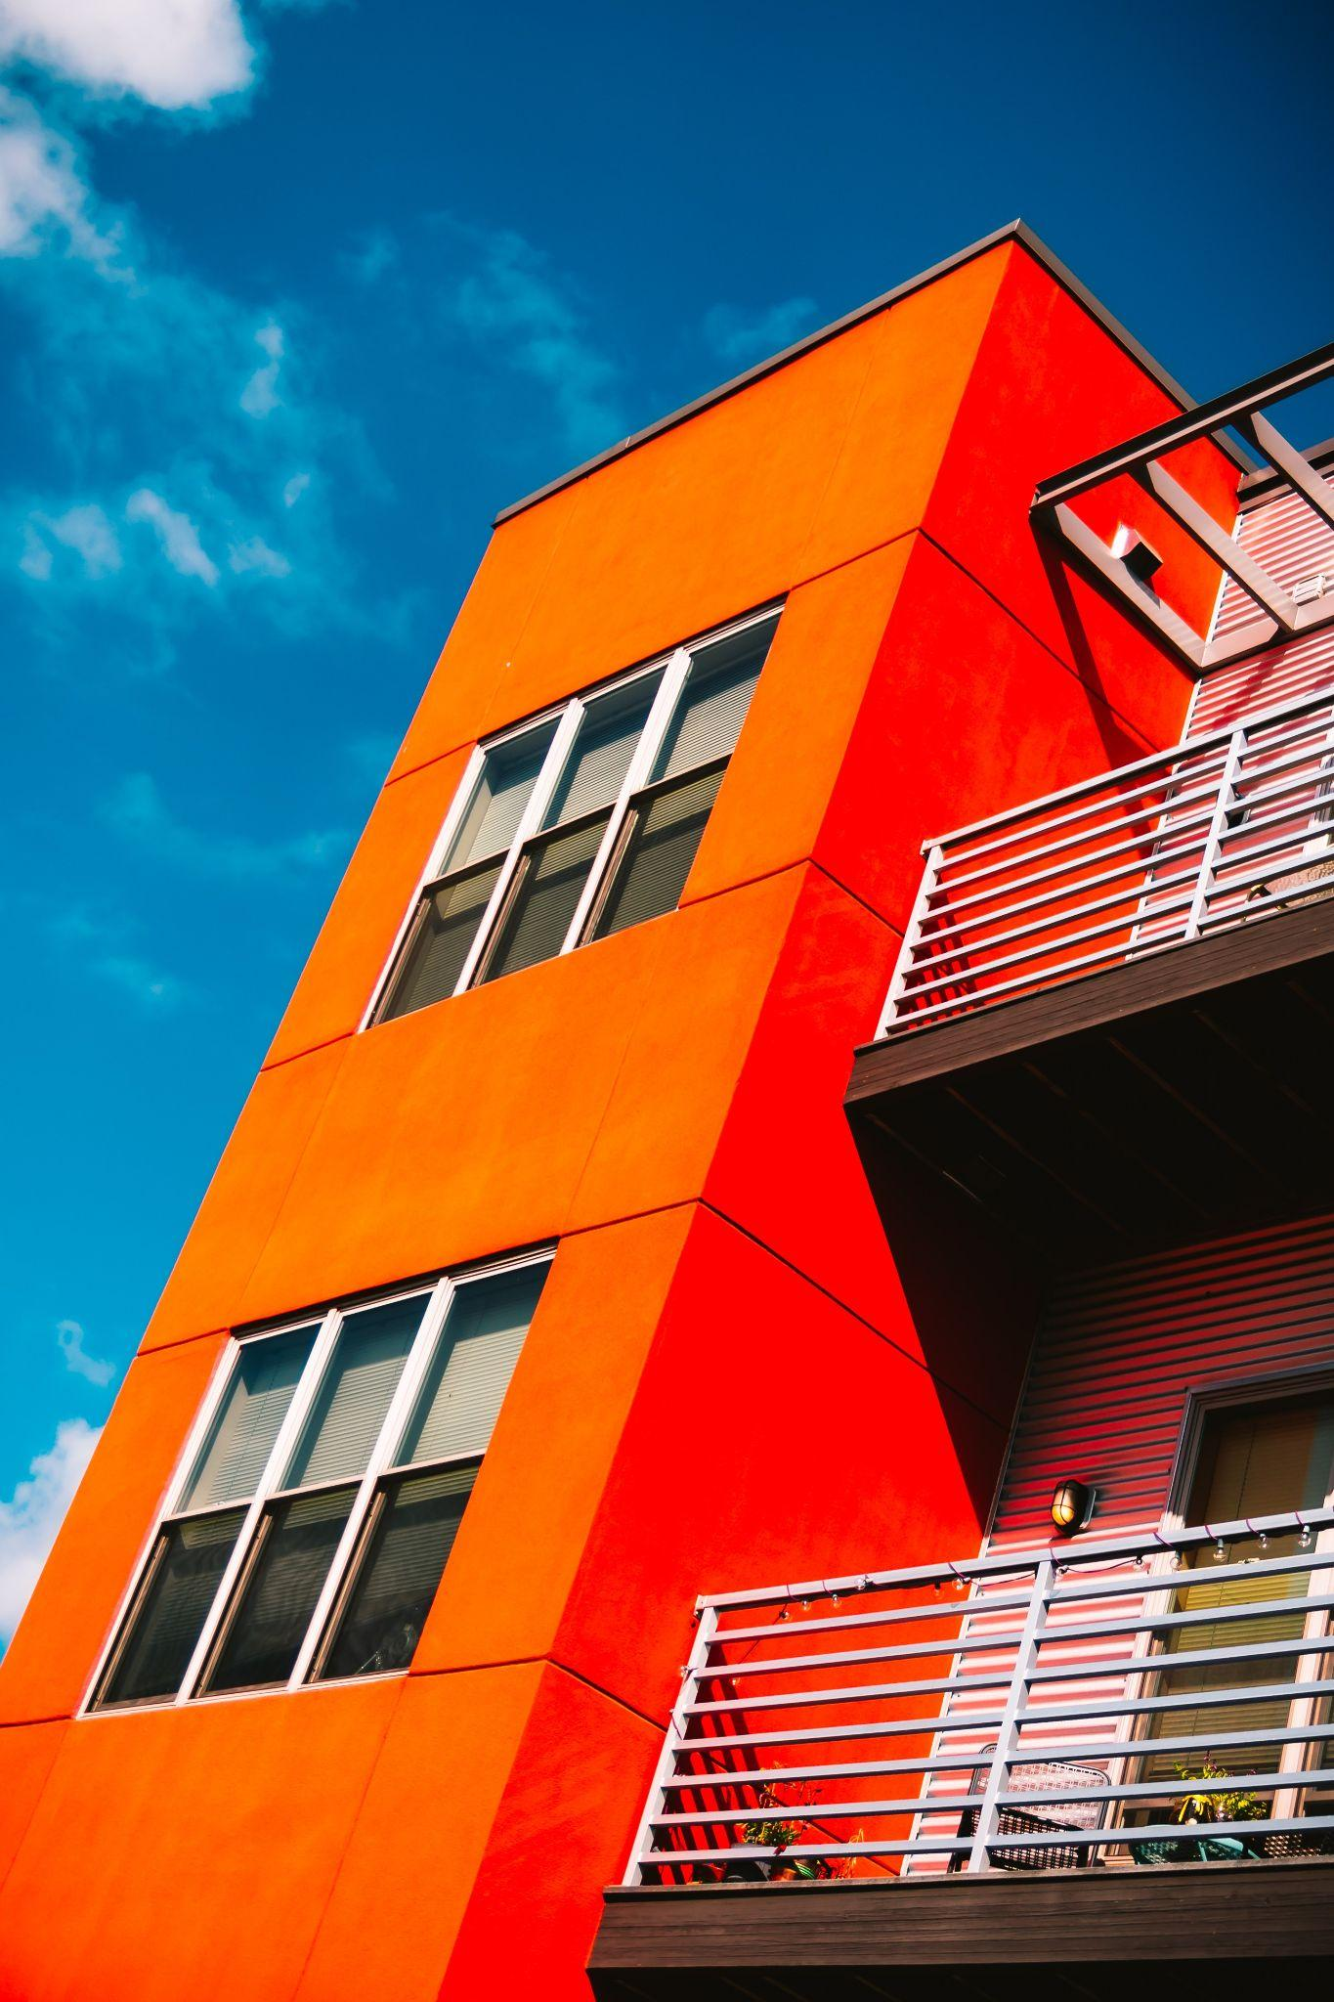
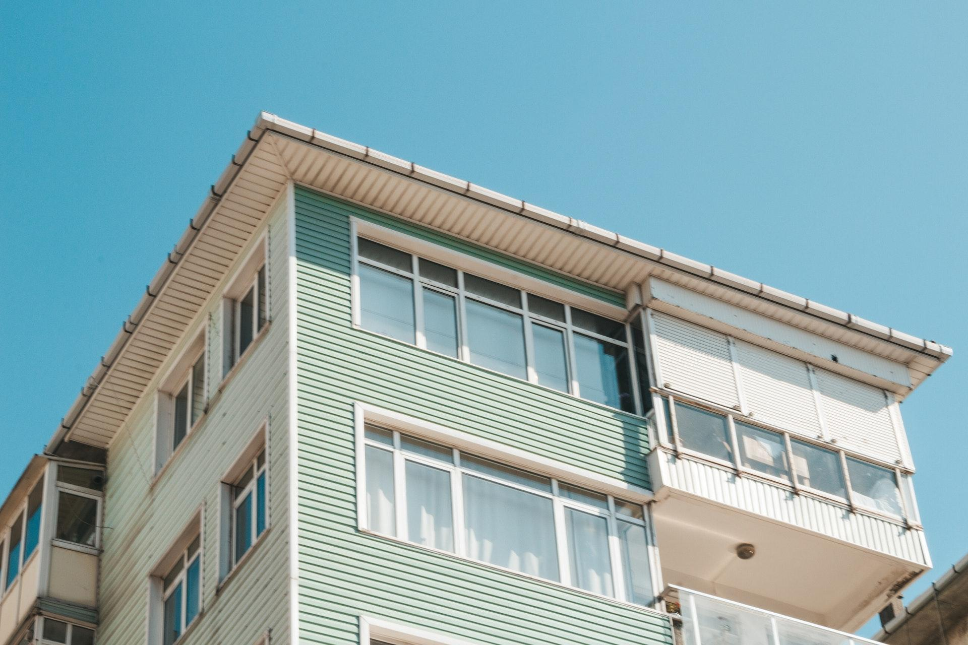
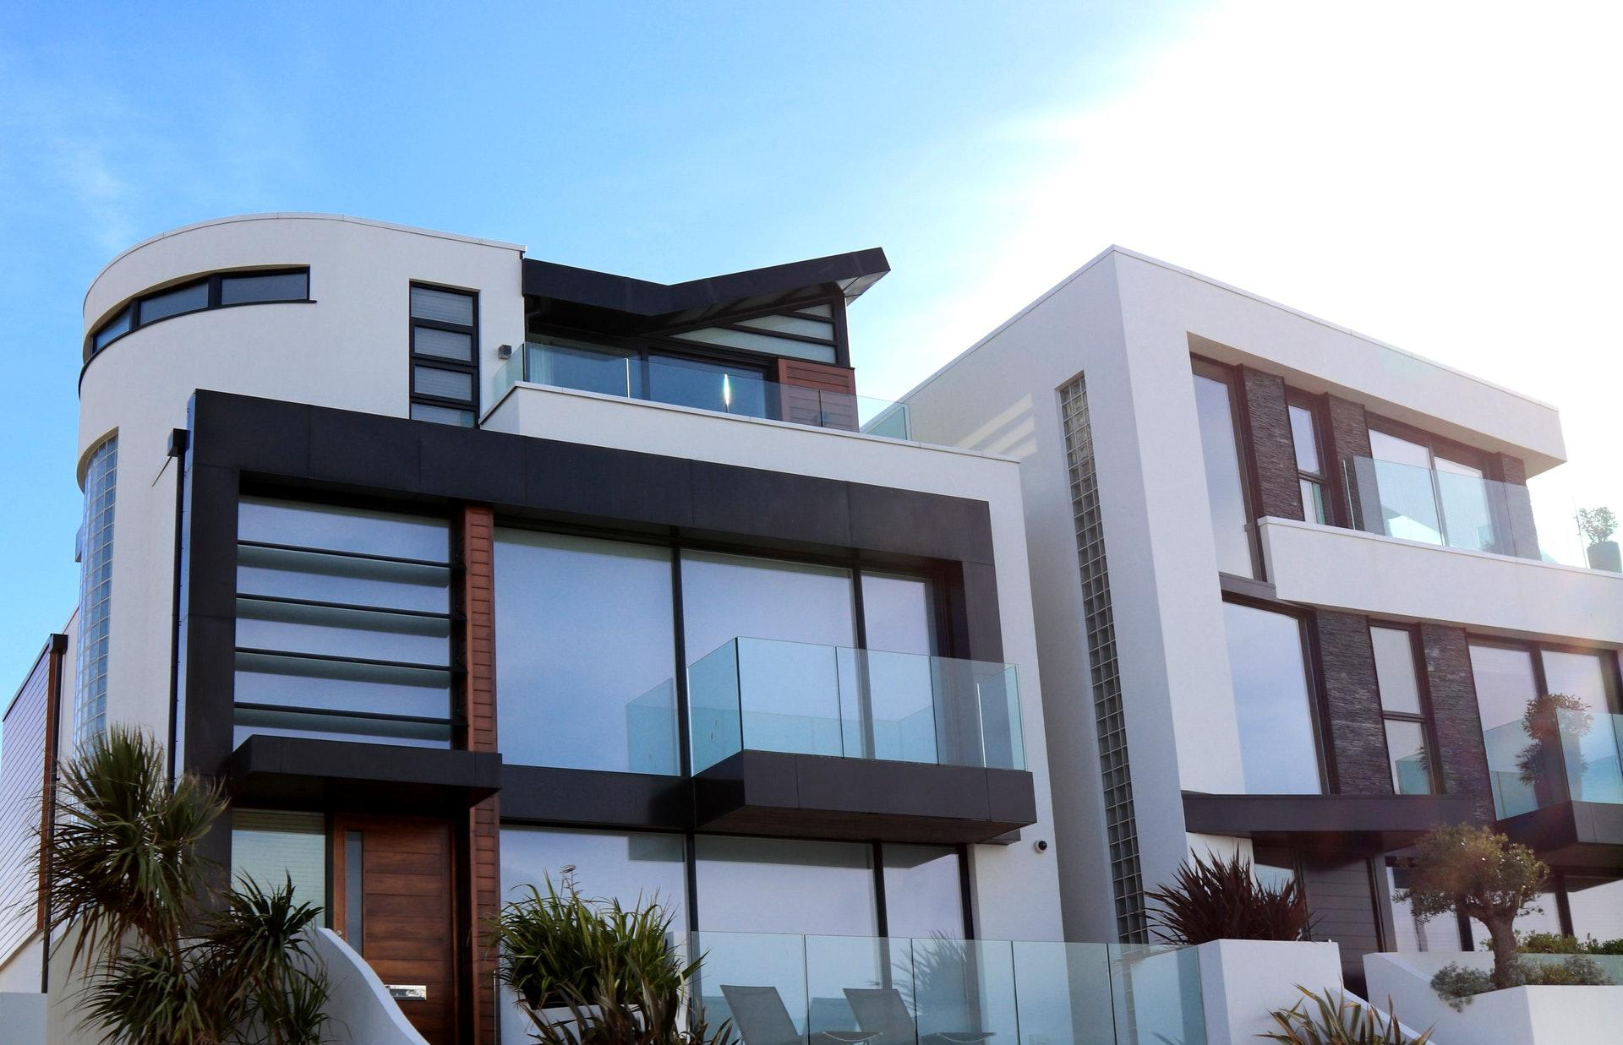
Real
estate
newsletter
FEATURES
SUNNY AREA
15%
OFF SALE
TENNIS COURTS
SWIMMING POOLS
LUXURY INFRASTRUCTURE
ALL HOUSES ARE SMART
WONDERFUL LOCATION
SUSPENDISSE
BRIGHT HOUSE IN A CLEAN AREA
Nam turpis leo, sodales porttitor suscipit non, fermentum a arcu. Nam sit amet pretium libero. Vestibulum tempor venenatis auctor.
$80,000
PHASELLUS
MODERN REAL ESTATE
Vestibulum commodo, mi ac condimentum imperdiet, leo ante pretium velit, eget lobortis lacus diam quis odio. Aenean mollis sed tellus ac auctor.
$90,860
123-456-7890 | example@mail.com | example.com

