Slide 1
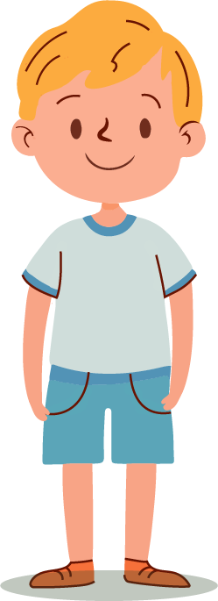
QUIZ
FOR KIDS
Let's Have Fun

Slide 2
RULES OF THE GAME
The game consists of one round.
Players take turns choosing a category and a number of points.
The host reads a clue, and the first player to buzz gets a chance to answer.
The answer must be in the form of a question (for example, "What is Paris?").
If correct, the player earns points and chooses the next clue.
If incorrect, points are deducted and other players can try
the answer.
The game continues until all the clues have been answered.
The player with the most points at the end wins!

Slide 3
PLAYERS SCOREBOARD
50
100
80
Emma
William
Isabella

Slide 4
GAME BOARD
History
Science
Animals
Fairy Tales
10
Points
10
Points
10
Points
10
Points
20
Points
20
Points
20
Points
20
Points
30
Points
30
Points
30
Points
30
Points
50
Points
50
Points
50
Points
50
Points

Slide 5
William
100
WINNER!

Slide 6
History
Category
General Clue on US
and World History

Slide 7
History
10 - Points
This Document Was
Signed in 1776, Declaring
Independence from Britain.
Game Board
Scoreboard

Slide 8
History
10 - Points
What is the Declaration of Independence?
Game Board
Scoreboard

Slide 9
History
20 - Points
He Was the
First President
of the United States.
Game Board
Scoreboard

Slide 10
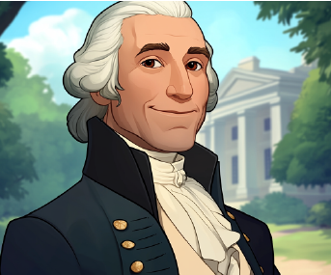
History
20 - Points
Who is
George Washington?
Game Board
Scoreboard

Slide 11
History
30 - Points
This Famous Ship
Carried the Pilgrims to
America in 1620.
Game Board
Scoreboard

Slide 12
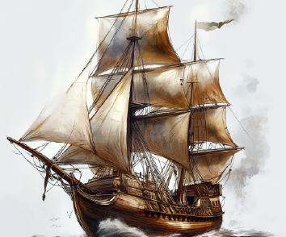
History
30 - Points
What is the
Mayflower?
Game Board
Scoreboard

Slide 13
History
50 - Points
The Great Wall
Was Built to Protect
This Country.
Game Board
Scoreboard

Slide 14
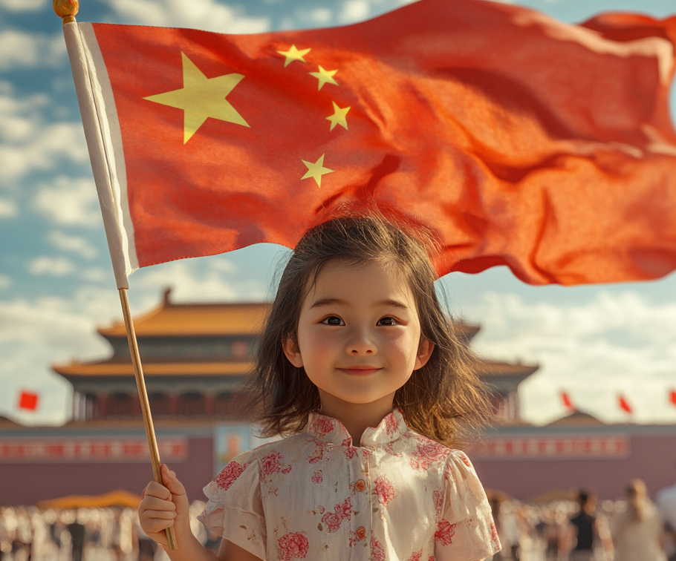
History
50 - Points
What is
China?
Game Board
Scoreboard

Slide 15
Science
Category
The Clues Focus on Fundamental
Scientific Facts, Nature, and Space.

Slide 16
Science
10 - Points
This is the
Closest Star
to Earth.
Game Board
Scoreboard

Slide 17
Science
10 - Points
What is
the Sun?
Game Board
Scoreboard

Slide 18
Science
20 - Points
This Planet
is Known as
the Red Planet.
Game Board
Scoreboard

Slide 19
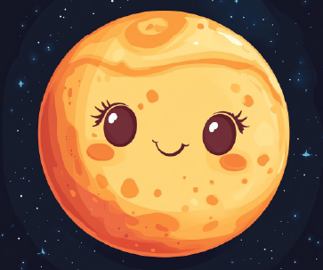
Science
20 - Points
What
is Mars?
Game Board
Scoreboard

Slide 20
Science
30 - Points
Water Turns
Into This
When it Freezes.
Game Board
Scoreboard

Slide 21
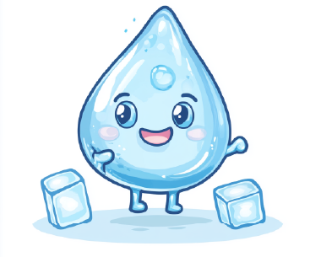
Science
30 - Points
What is
Ice?
Game Board
Scoreboard

Slide 22
Science
50 - Points
This Gas is Essential
For Humans
to Breathe.
Game Board
Scoreboard

Slide 23
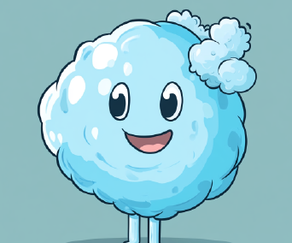
Science
50 - Points
What is
Oxygen?
Game Board
Scoreboard

Slide 24
Animals
Category
The Clues in This Category Feature Different Animals,
Their Characteristics, and Habitats.

Slide 25
Animals
10 - Points
This Animal is
Known as
the King of the Jungle.
Game Board
Scoreboard

Slide 26
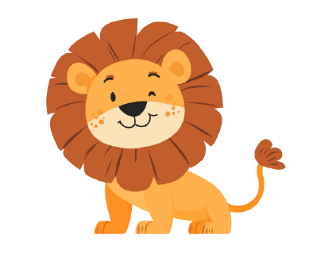
Animals
10 - Points
What is
a Lion?
Game Board
Scoreboard

Slide 27
Animals
20 - Points
This Black and
White Bear
Eats Bamboo.
Game Board
Scoreboard

Slide 28
Animals
20 - Points
What is
a Panda?
Game Board
Scoreboard

Slide 29
Animals
30 - Points
This Large Mammal
Has a Trunk and
Big Ears.
Game Board
Scoreboard

Slide 30
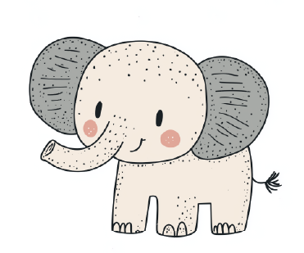
Animals
30 - Points
What is an
Elephant?
Game Board
Scoreboard

Slide 31
Animals
50 - Points
This Bird is Known For Its Colorful Feathers and Ability
to Mimic Sounds.
Game Board
Scoreboard

Slide 32
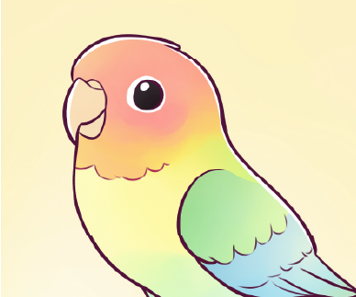
Animals
50 - Points
What is
a Parrot?
Game Board
Scoreboard

Slide 33
Fairy Tales
Category
The Clues Contain Famous Fairy Tales
and Their Characters

Slide 34
Fairy Tales
10 - Points
This Girl Had to
Leave the Ball Before
Midnight.
Game Board
Scoreboard

Slide 35
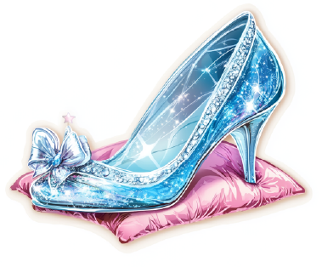
Fairy Tales
10 - Points
Who is
Cinderella?
Game Board
Scoreboard

Slide 36
Fairy Tales
20 - Points
This Fairy Tale Character
Had Very Long Hair and
Was Trapped in a Tower.
Game Board
Scoreboard

Slide 37
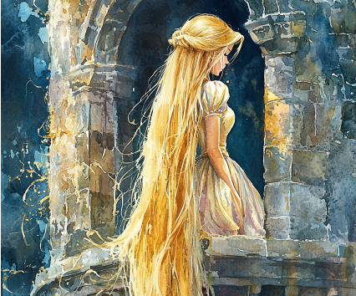
Fairy Tales
20 - Points
Who is
Rapunzel?
Game Board
Scoreboard

Slide 38
Fairy Tales
30 - Points
A Little Girl Met a Big
Bad Wolf on Her Way
to Visit Her Grandmother.
Game Board
Scoreboard

Slide 39
Fairy Tales
30 - Points
Who is Little
Red Riding Hood?
Game Board
Scoreboard

Slide 40
Fairy Tales
50 - Points
This Boy Refused to
Grow Up and Lived
in Neverland
Game Board
Scoreboard

Slide 41
Fairy Tales
50 - Points
Who is
Peter Pan?
Game Board
Scoreboard

