Slide 1
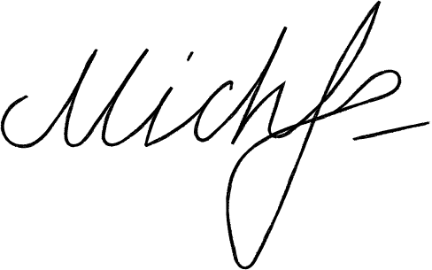
Michelle Lindon
Registration Letter
Ms Jannet Tom
Department Head
+012-345-67890
Salem Court Industries, 408 Byers Lane Sacramento, CA 94260
January 3, 2030
Dear Ms. Tom
Kindly accept this letter as my formal resignation as a staff member of Simon Corporation. My last day is expected to be on January 11, 2030, two weeks from today.
I am incredibly grateful for the opportunities that I have been given in this post. I value the insights that I have learned, and I expect them to help me in my future endeavors. I would also like to thank you for being supportive of my professional growth. I have enjoyed working with you and the rest of the team.
Let me know how I can help in making the transition of responsibilities as seamless as possible for everyone involved. Thank you.
Best wishes, and thank you for everything.
Michelle Lindon
Michelle Lindon
+012-345-67890
hello@gdoc.io
123 Anywhere St., Any City, ST 1234

