Slide 1
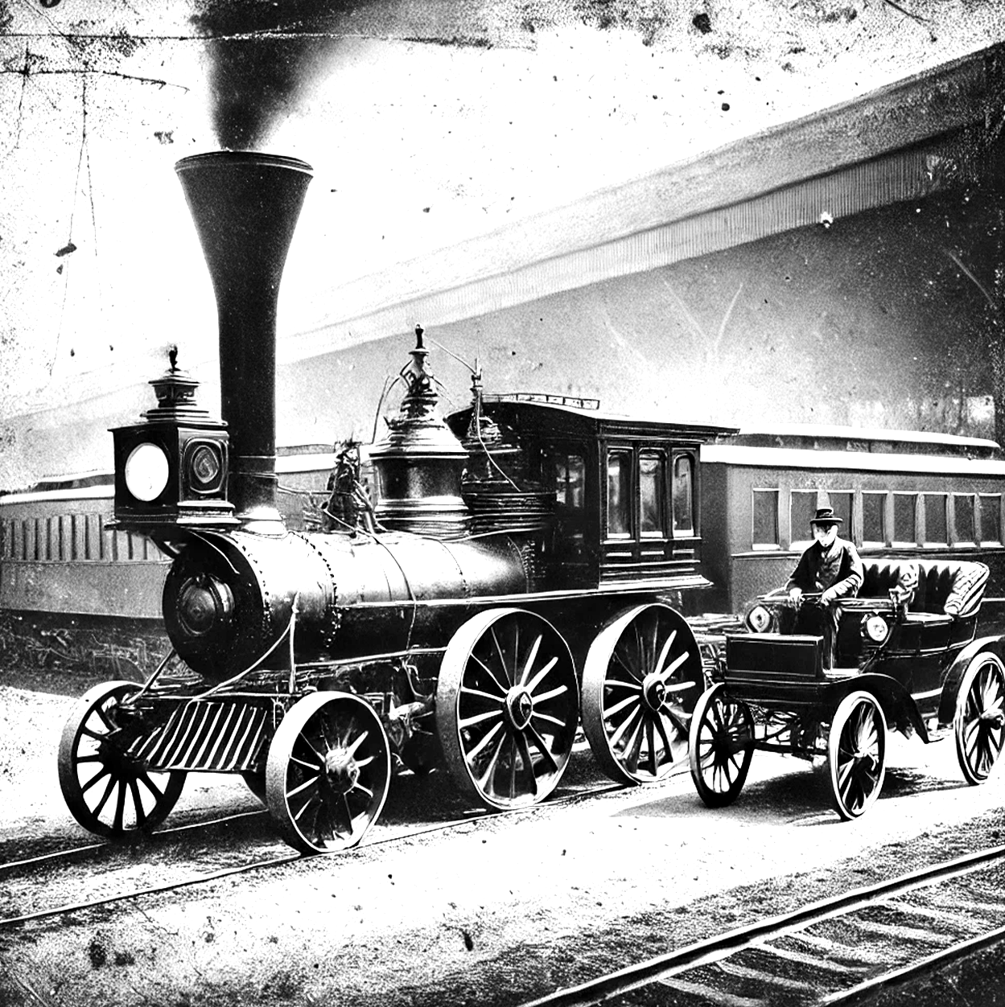
Published on March 12, 1892
Circulation: 10,000 Copies
THE GRAND CHRONICLE
The World Witnesses
Unparalleled Progress
The industrial world is experiencing a remarkable transformation as inventors push the boundaries of human ingenuity. From Thomas Edison's electrical advancements to Karl Benz's motorized vehicles, society is moving toward an age of mechanization and efficiency. Horse-drawn carriages, once promising a future, no longer dominate transportation.
The streets of London and New York are now seeing the first motorized carriages, a future where horses may no longer dominate transportation.
A steam-powered locomotive alongside an early motor carriage
The World Witnesses Unparalleled Progress
The industrial world
The industrial world is experiencing a remarkable transformation as inventors push the boundaries of human ingenuity. From Thomas Edison's electrical advancements to Karl Benz's motorized vehicles, society is moving toward an age of mechanization and efficiency.
The streets of London and New York are now seeing the first motorized carriages, promising a future where horses may no longer dominate transportation. The streets of London and New York are now seeing the first motorized carriages.
A remarkable transformation as inventors push the boundaries of human ingenuity. From Thomas Edison's electrical advancements to Karl Benz's motorized vehicles, society is moving toward an age of mechanization and efficiency. The streets of London and New York are now seeing the first motorized carriages, promising a future where horses may no longer dominate transportation.
The streets of London and New York are now seeing the first motorized carriages, promising a future where horses may no longer dominate transportation.
"The age of steam was only the beginning; now, we enter the age of electricity and machines."
– Professor Henry Clarkson
The streets of London and New York are now seeing the first motorized carriages, promising a future where horses may no longer dominate transportation. The streets of London and New York are now seeing the first motorized carriages, promising a future where horses may no longer dominate transportation.

Slide 2
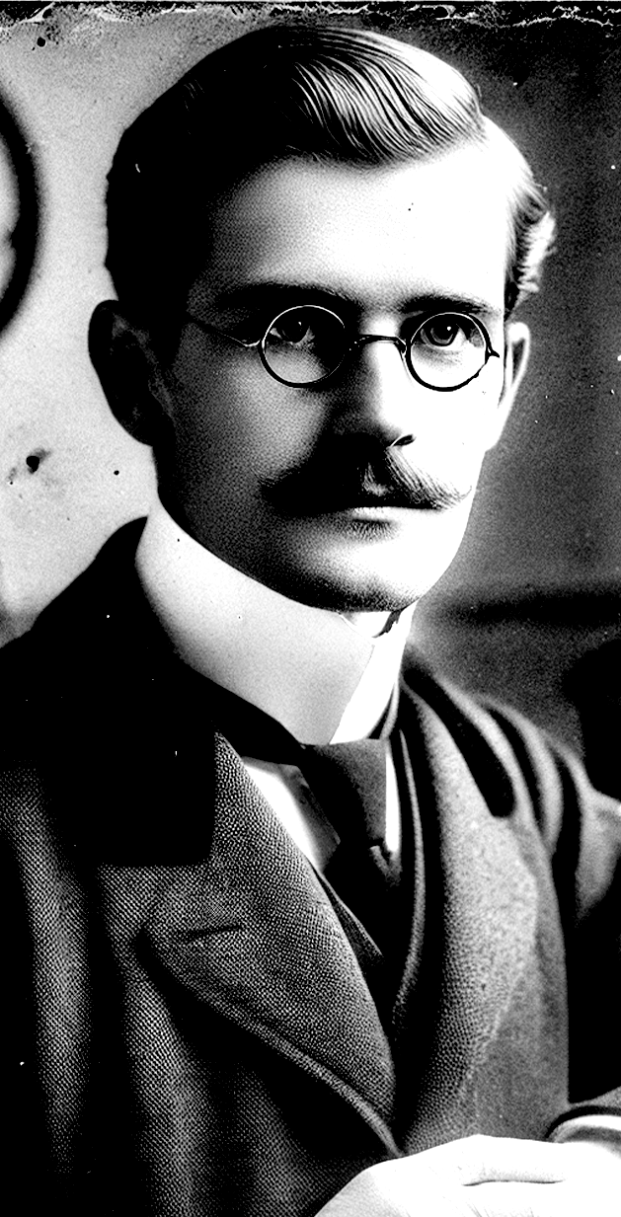
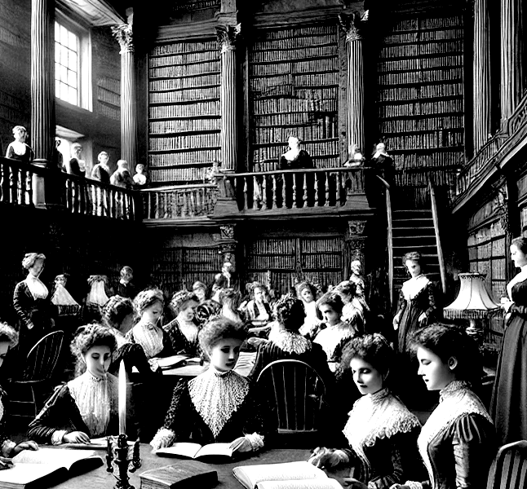
Published on March 12, 1892
Circulation: 10,000 Copies
Doctors Develop Safer Anesthesia Methods
Dr. William Harrow of Edinburgh Medical Academy has introduced a new form of ether-based anesthesia, significantly reducing surgical mortality rates. This innovation promises safer and less painful operations, offering hope to thousands. Dr. William Harrow of Edinburgh Medical Academy has introduced a new form of ether-based anesthesia, significantly reducing surgical mortality rates. This innovation promises safer and less painful operations, offering hope to thousands.
Dr. William Harrow of Edinburgh Medical Academy has introduced a new form of ether-based anesthesia, significantly reducing.
This innovation promises safer and less painful operations, offering hope to thousands. Dr. William Harrow of Edinburgh Medical Academy has introduced a new form of ether-based anesthesia, significantly reducing surgical mortality rates.
This innovation promises safer and less painful operations, offering hope to thousands. Dr. William Harrow of Edinburgh Medical of Edinburgh Medical Academy.
"For the first time, we can truly lessen the agony of the knife."
Dr. William Harrow
– Professor Henry Clarkson
College in Cambridge
With the establishment of institutions such as Girton College in Cambridge, women's access to higher education is expanding. Progressive scholars argue that educated women will contribute significantly to literature, science, and governance.
Lady Eleanor Pembroke
Lady Eleanor Pembroke
Progressive scholars argue that educated women will contribute significantly to literature, science, and governance. access to higher education is expanding. Progressive scholars argue that educated women will contribute significantly to literature.
With the establishment of institutions such as Girton College in Cambridge, women's access to higher education is expanding. Progressive scholars argue that educated women will contribute significantly to literature, science, and governance.
Access to higher education is expanding. Progressive scholars argue that educated women will contribute significantly to literature, science, and governance Progressive scholars argue that educated women will contribute.

Slide 3
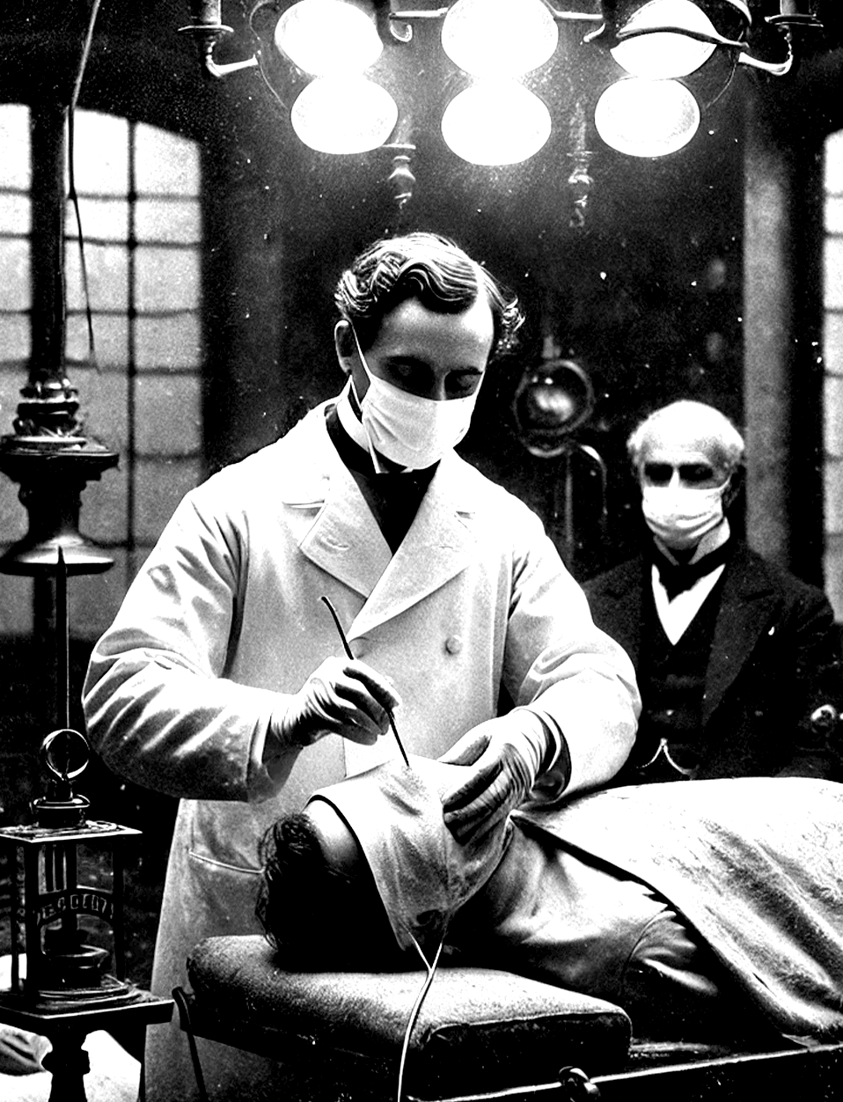
Published on March 12, 1892
Circulation: 10,000 Copies
Faster Trade
Faster Trade
With the continuous expansion of the railway network across the British Empire, journeys that once took weeks are now accomplished in days. The Trans-Siberian Railway and the Indian Rail Indian Rail Indian Rail Network promise unprecedented connectivity, bolstering commerce and military efficiency.
The Trans-Siberian Railway and the Rail Network promise bolstering commerce and military efficiency.
Railway network across the British Empire, journeys that once took weeks are now accomplished in days. The Trans-Siberian Railway and the Indian Rail Indian Rail Indian Rail Network promise unprecedented connectivity, bolstering commerce and military efficiency.
The Trans-Siberian Railway and the Rail Network promise unprecedented connectivity, unprecedented connectivity, bolstering commerce and military efficiency.
A steam-powered alongside an early motor carriage
Unidentified Glows Spark Speculation
The industrial world is experiencing a remarkable transformation as inventors push the boundaries of human ingenuity. From Thomas Edison's electrical advancements to Karl Benz's motorized vehicles, society is moving toward an age of mechanization and efficiency.
The streets of London and New York are now seeing the first motorized carriages, promising a future where horses may no longer dominate transportation. The streets of London and New York are now seeing the first motorized carriages, promising a future where horses may no longer dominate transportation.
The streets of London and New York are now seeing the first motorized carriages, promising a future where horses may no longer dominate transportation. The streets of London and New York are now seeing the first motorized carriages, promising a future where horses may no longer dominate transportation.The streets of London and New York are now seeing the first motorized carriages, promising a future where horses may no longer dominate transportation. The streets of London and New York are now seeing the first motorized carriages.
THE RISE OF WOMEN’S
EDUCATION
The industrial world is experiencing a remarkable transformation as inventors push the boundaries of human ingenuity. From Thomas Edison's electrical advancements to Karl Benz's motorized vehicles, society is moving toward an age of mechanization and efficiency. motorized carriages, promising a future no longer dominate transportation.
The streets of London and New York are now seeing the first motorized carriages, a future where horses may no longer dominate transportation.

Slide 4
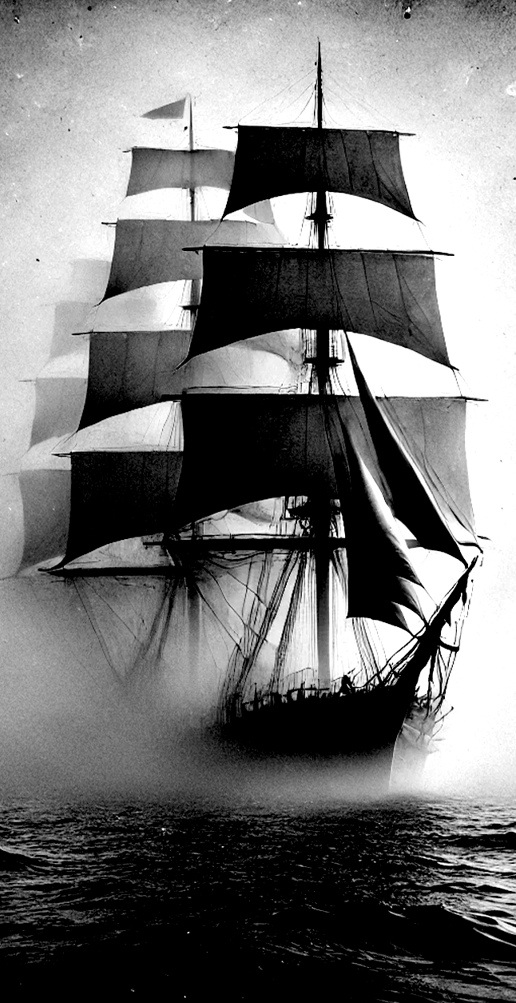
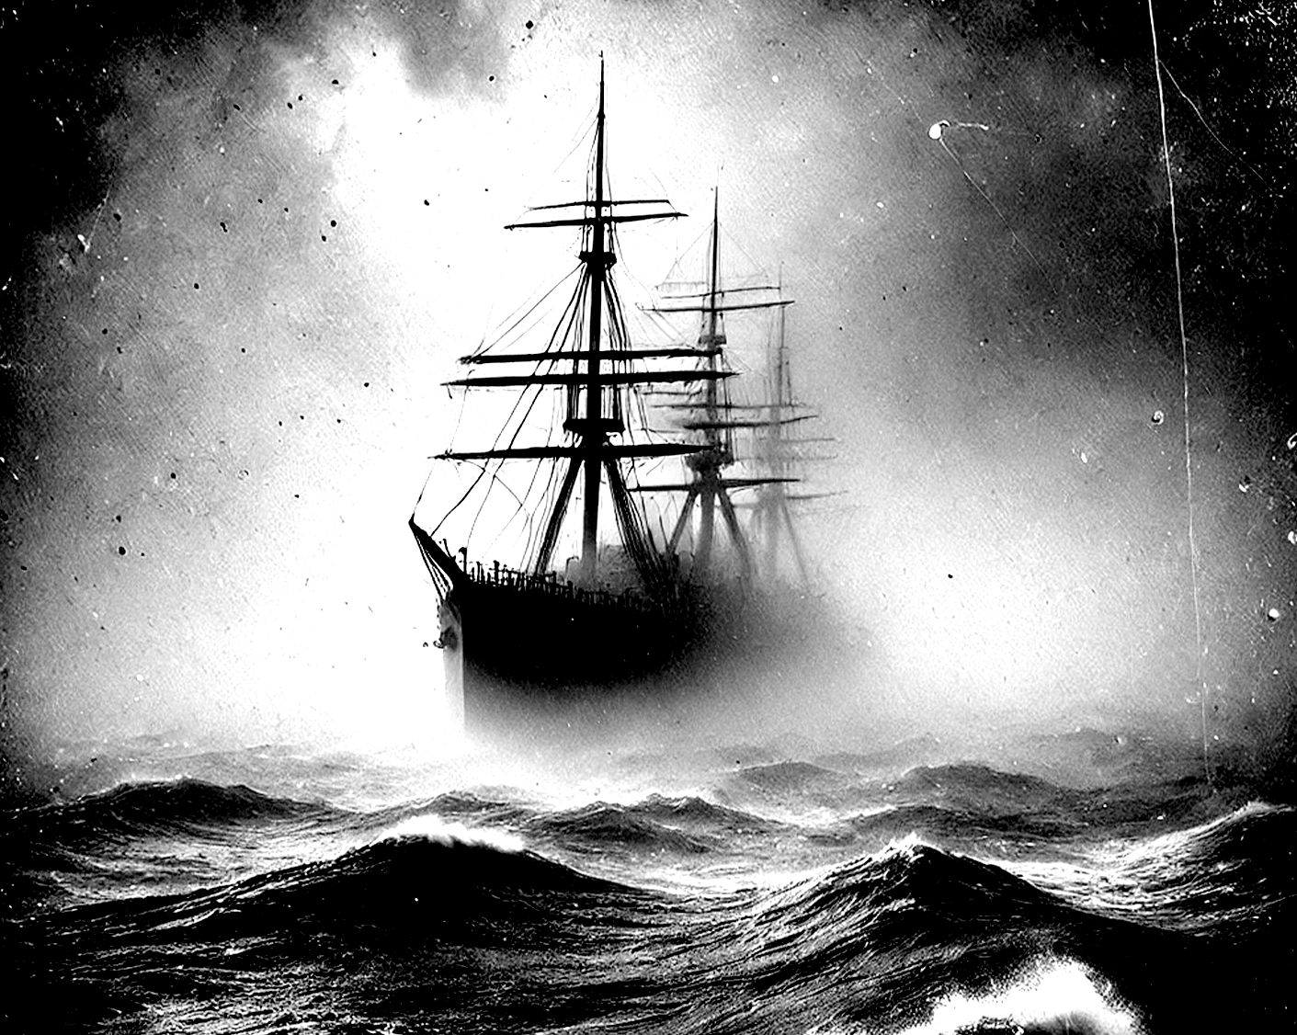
Published on March 12, 1892
Circulation: 10,000 Copies
The Fate of HMS Britannia Remains Unknown
The British naval vessel
The British naval vessel HMS Britannia set sail from Southampton three months ago and has yet to be seen again. No distress signals or debris have been found, leaving experts puzzled. Some seafarers fear supernatural forces at play, while officials suspect navigational error or piracy. The British naval vessel HMS Britannia set sail from Southampton three months ago and has yet to be seen again. No distress signals or debris have been found, leaving experts puzzled.
The British naval vessel HMS Britannia set sail from Southampton three months ago and has yet to be seen again.
No distress signals or debris have been found, leaving experts puzzled. Some seafarers fear supernatural forces at play, while officials suspect navigational error or piracy. No distress signals or debris have been found, leaving experts puzzled. Some seafarers fear supernatural.
No distress signals or debris have been found, leaving experts puzzled. Some seafarers fear supernatural forces at play, while officials suspect navigational error or piracy. No distress signals or debris have been found, leaving experts puzzled. Some seafarers fear supernatural forces at play, while officials suspect navigational error or piracy.
A ship disappearing into a misty
Faster Trade,
Faster Travel
With the continuous expansion of the railway network across the British Empire, journeys that once took weeks are now accomplished in days.
The Trans-Siberian Railway and the Indian Rail Indian Rail Indian Rail Network promise unprecedented connectivity, bolstering commerce and military efficiency.
HMS Britannia left Southampton three months ago and hasn’t been seen since.

