Slide 1
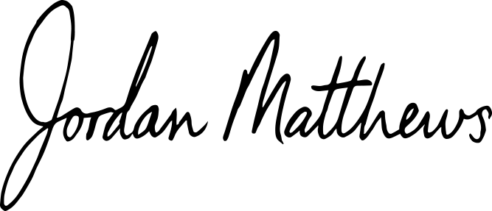
123 Oak Lane, Downtown City
+1 123-456-7890
contact@pinehillconsulting.ltd
PINEHILL
CONSULTING
LETTER OF RECOMMENDATION
June 5, 2028
To David Lane,
I am delighted to provide my full recommendation for Alex Johnson for the position of Senior Marketing Director. Over the past few years, I have had the pleasure of working closely with Alex at Pinehill Consulting, and I have consistently been impressed with his exceptional skills, commitment, and leadership in the marketing sector.
Alex has proven to be an indispensable member of our marketing team. His contributions have significantly influenced the success and growth of our business, particularly through his expertise in crafting and implementing both digital and traditional marketing strategies. His understanding of the market is profound, and he has consistently achieved outstanding results.
What stands out most about Alex is his remarkable ability to lead and inspire others. He creates an innovative, collaborative environment that encourages his team to perform at their highest potential. His problem-solving skills are exemplary, and he is highly regarded for his capacity to identify key opportunities and develop impactful, actionable solutions.
I have no doubt that Alex will thrive in any marketing role and continue to drive exceptional outcomes. His commitment to excellence, professionalism, and work ethic is unwavering. It is with great confidence that I highly recommend Alex Johnson for any marketing leadership position.
Should you require any further information or insight into Alex’s qualifications or performance, please do not hesitate to contact me at contact@pinehillconsulting.ltd.
Sincerely,
Jordan Matthews,
Managing Director Pinehill Consulting

