Slide 1




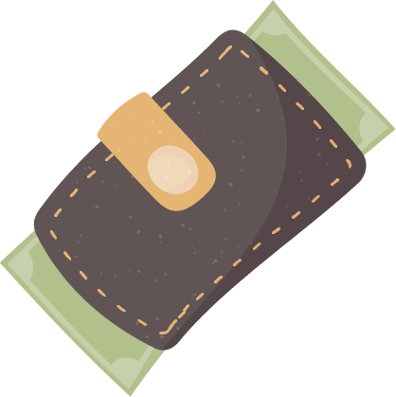



TRAVEL PACKING LIST
Technique
Documents
Toiletries
Clothing
Misc

