Slide 1
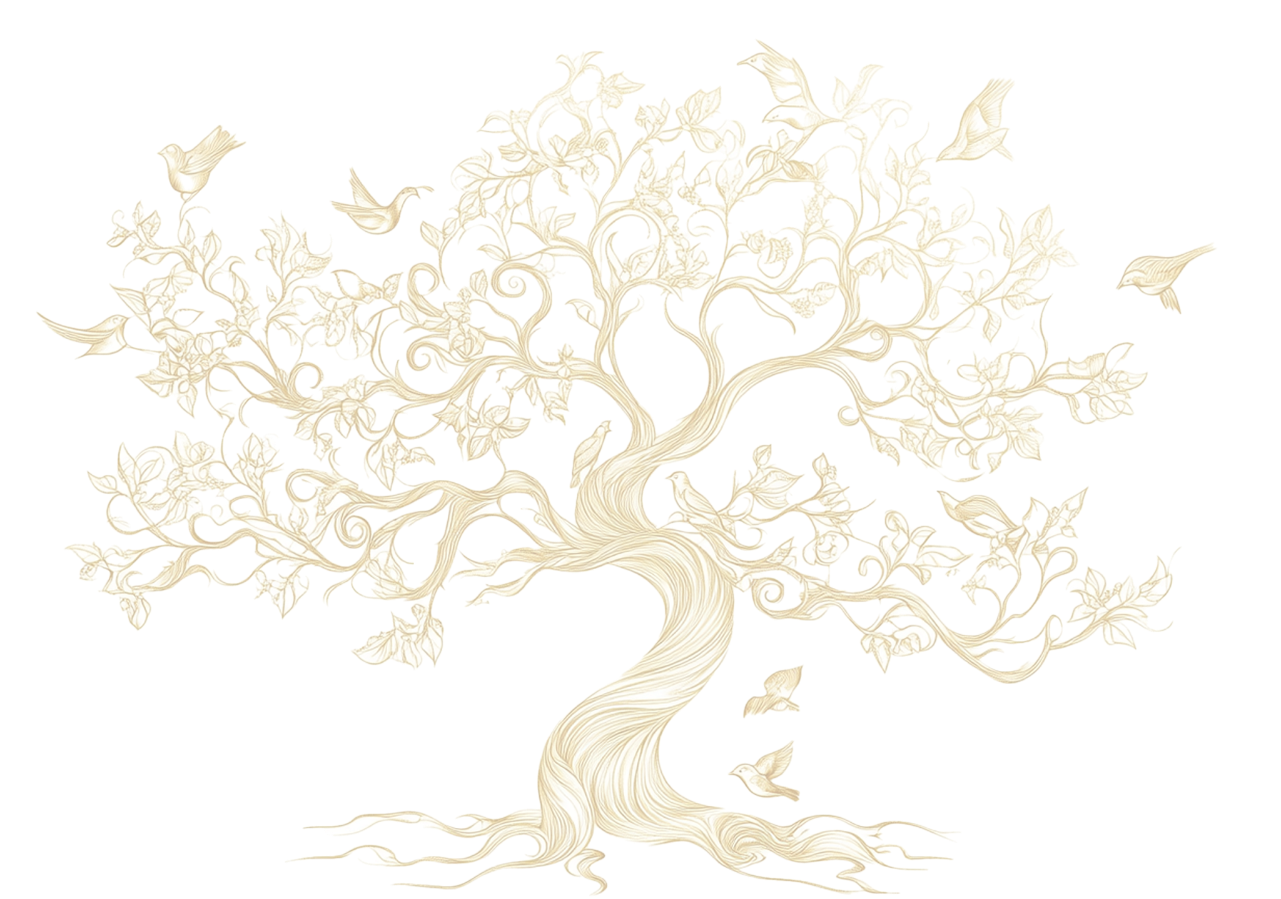
FAMILY TREE

