Slide 1
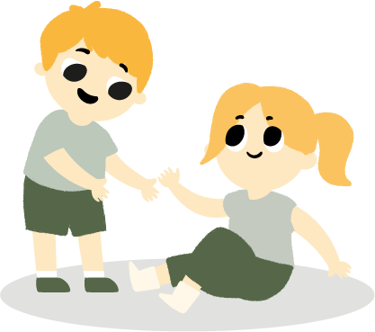
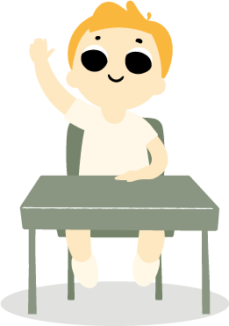
CLASSROOM
RULES
Keep our classroom clean
Let’s be helpful whenever we can
Put things back in their
proper shelves
Let’s all do our best!
Talk to the teacher if you have
a problem

