Slide 1
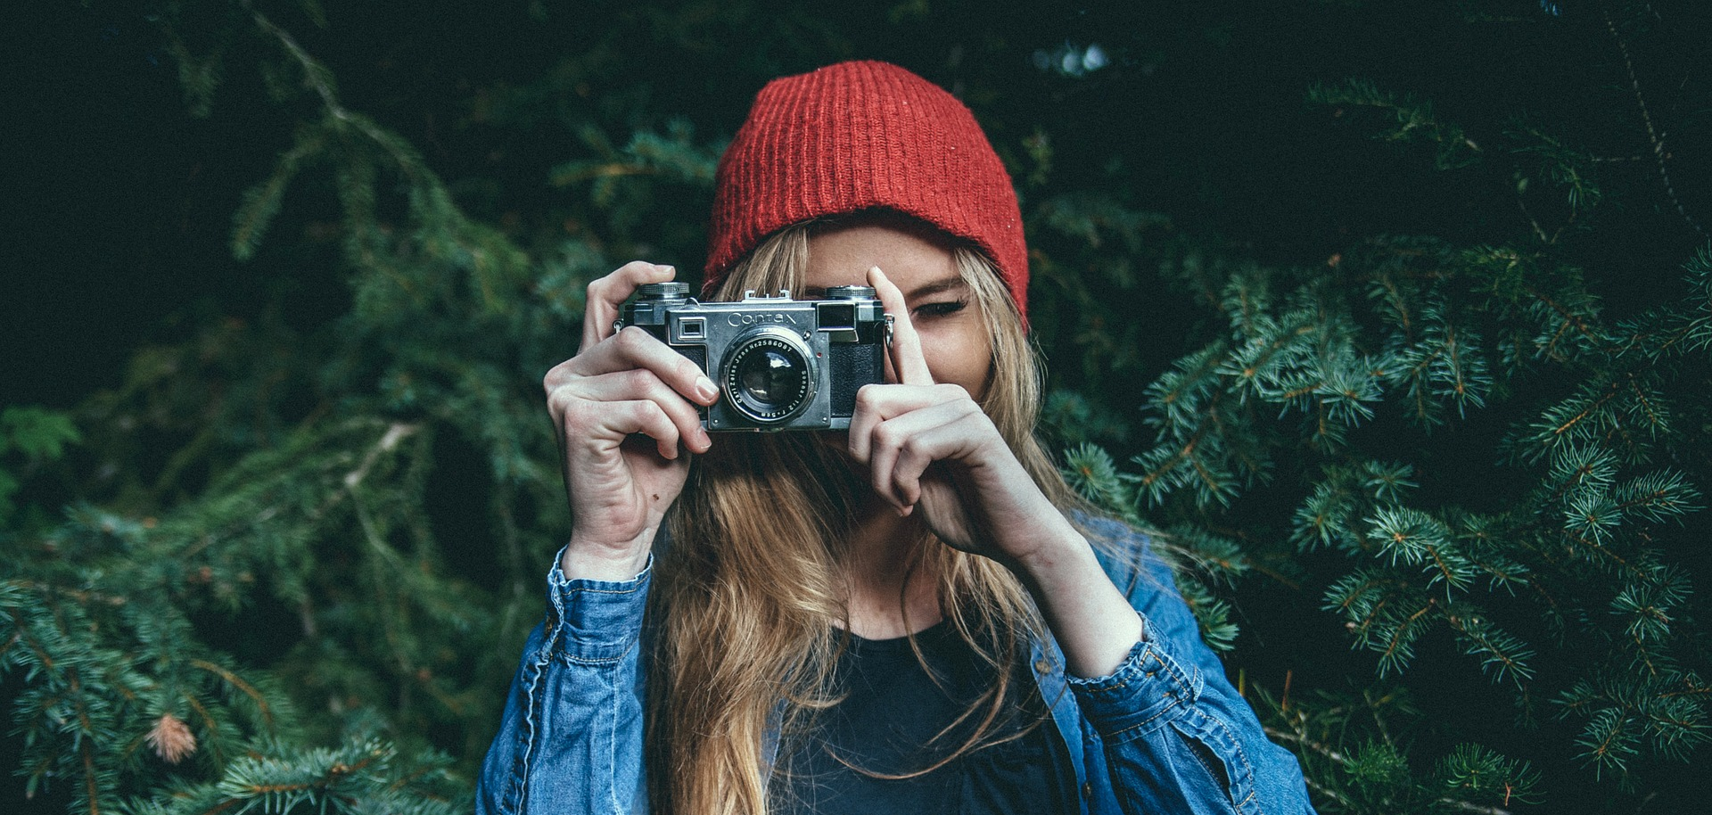
Julianne
Ruthv
PROFILE
Telecom Engineer with IT experience. Worked in the most important telecom company in Peru across different areas. Got experience managing servers, application servers and cloud tools
Photo Editor
behance.net
pinterest.com
facebook.com
EDUCATION
WORK EXPERIENCE
Photography
Virginia Commonwealth University
2008 - 2010
Chesapeake Police Department
Police Photographer
2010 - 2017
Bachelor of Fine Arts
Freelance Photography
Photographer
2012 - 2018
AWARDS
Working on Self Published Book
Photographer
2018 - 2020
Chief's Award of Excellence,
US Department of Justice
Chesapeake Police Department
SKILLS
TYPOGRAPHY
GRAPHIC DESIGN
NSTALLATION DESIGN
PORTRAITURE
PHOTOJOURNALISM
FORENSIC PHOTO
EVENT PHOTOGRAPHY
COMPUTER
ADOBE PHOTOSHOP
ADOBE LIGHTROOM
ADOBE BRIDGE
ADOBE ILLUSTRATOR
MICROSOFT WORD
MICROSOFT EXCEL
CERTIFICATIONS
Photography Course
2008 - 2010

