Slide 1
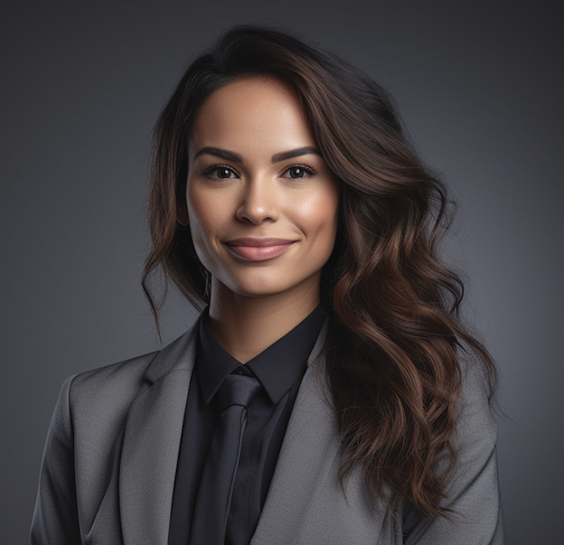
EMILY
HARRINGTON
Chief Executive Officer (CEO)
To: Alex Mitchell
Director of Partnerships
Dear Alex Mitchell,
I hope this letter finds you well. We are excited to reach out to you on behalf of [Your Company Name]. As a respected leader in the [your industry or field], we are dedicated to delivering innovative solutions and exceptional service.
At [Your Company Name], we are driven by our commitment to [briefly describe your company's mission or core values]. With a talented team of professionals and a track record of success, we have consistently [mention any notable achievements, projects, or partnerships]. Our overarching goal is to [describe your company's overarching objective or vision].
Your company's focus on mention a specific quality or accomplishment] strongly resonates with our values and aspirations.
We would be honored to schedule a meeting at your convenience.
Whether it involves [outline potential collaborative areas such as joint projects, strategic partnerships, or product development], we are enthusiastic about the opportunity to leverage our collective expertise for mutual success.
We would greatly appreciate the opportunity to further explore these possibilities and discuss how we can create value together. Please don't hesitate to contact us via email at. We would be honored to schedule a meeting at your convenience.
Thank you for considering this collaboration. We look forward to the prospect of working together and achieving new heights.
Mitchell@nexustech.com
+1 (555) 987-6543
Linkville, Techland, ZIP161
+1 (555) 123-4567
collins@innovatehub.com
www.innovatehub.com
01 September 2024
Best regards, Jessica Collins

