Slide 1
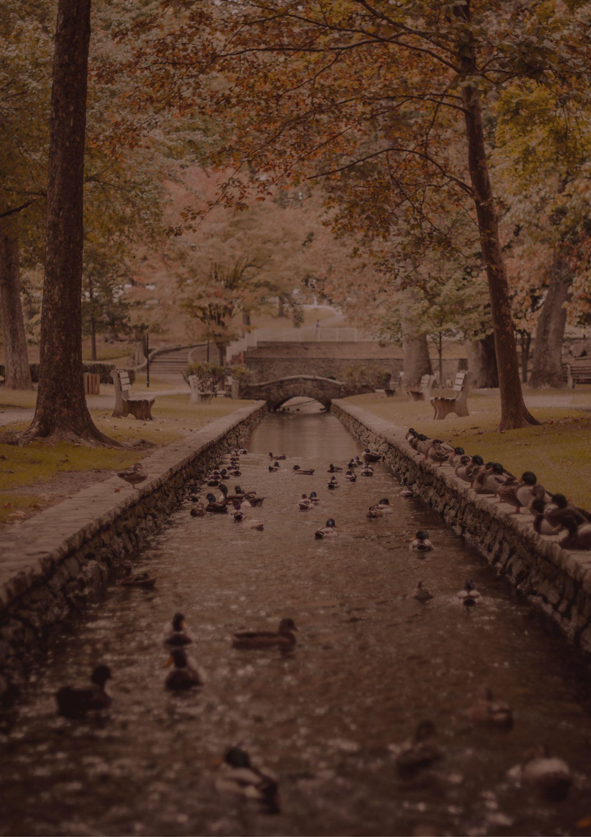
Travel bucket list
PENNSYLVANIA
Independence Park
Valley Forge Park
Hershey Park
Intercourse
Gettysburg National Park
Andy Warhol Museum
Presque Isle State Park
Longwood Gardens
Philadelphia Museum of Art
Flight 93 National Memorial
Fallingwater
Phipps Conservancy
Harrisburg
Ohiopyle State Park
Phipps Conservatory
Pine Creek Gorge, Wellsboro
Carnegie Museum
Knoebels, Elysburg
Eastern State Penitentiary
Philadelphia
Strasburg
Hershey
The Philadelphia Zoo
Jim Thorpe
Pennsylvania State Capitol
Reading Terminal Market

