Slide 1
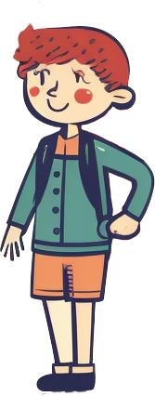
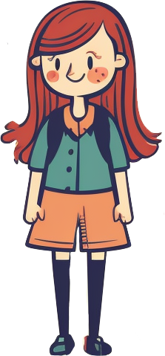
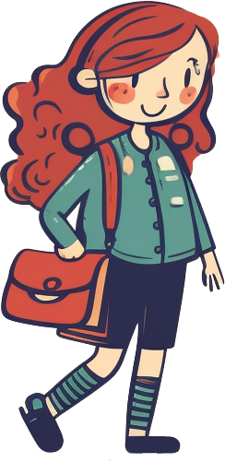
OCTOBER NEWS
A NOTE FROM YOUR TEACHER
Type here...
IMPORTANT DATES
CLASS WORK
Type here...
Type here...
FRIENDLY REMINDERS
Type here...

