Slide 1
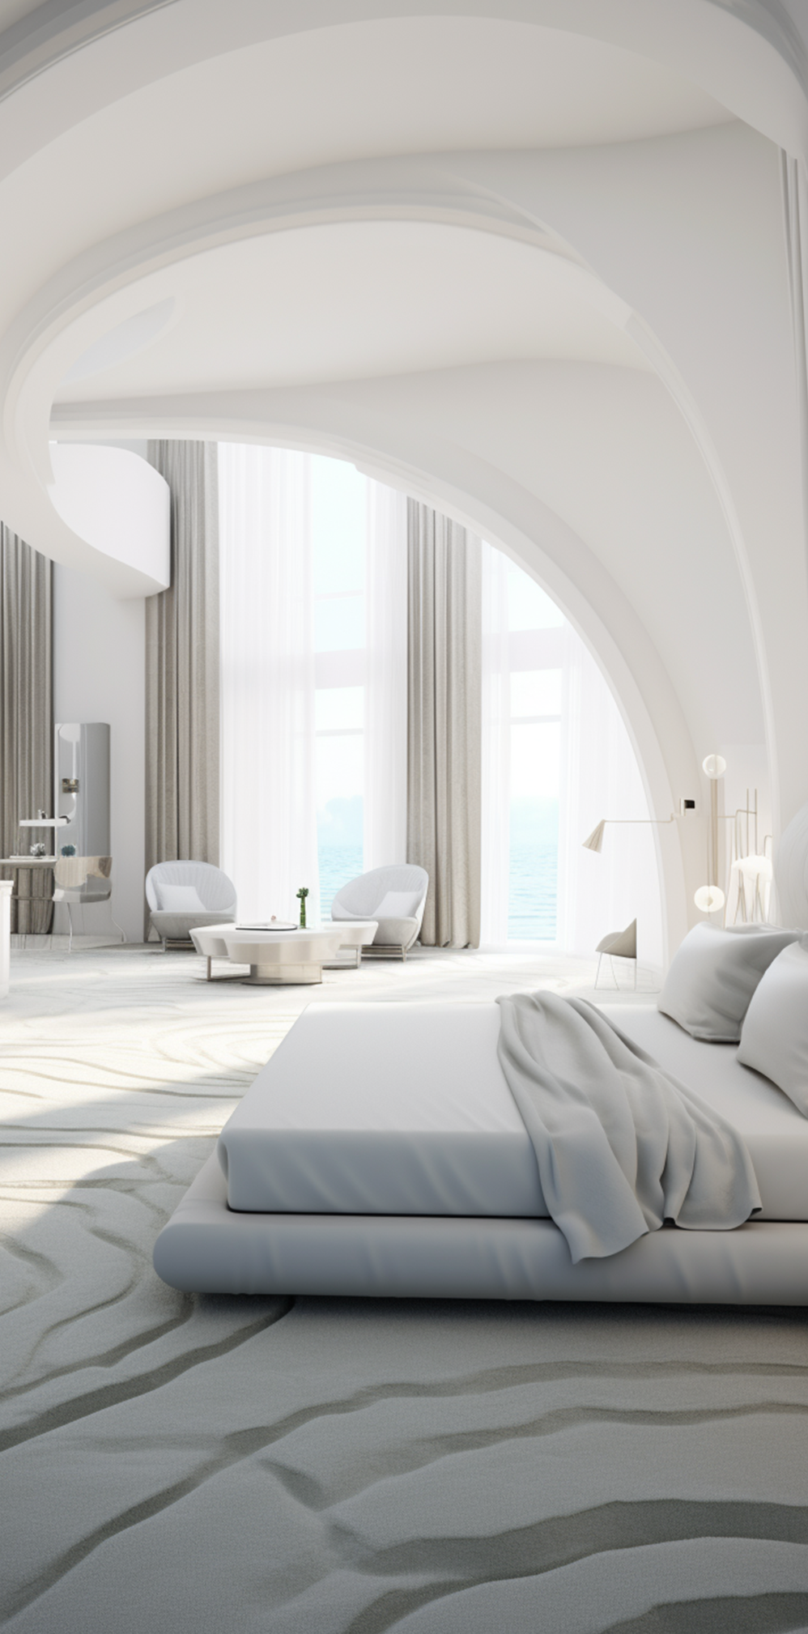
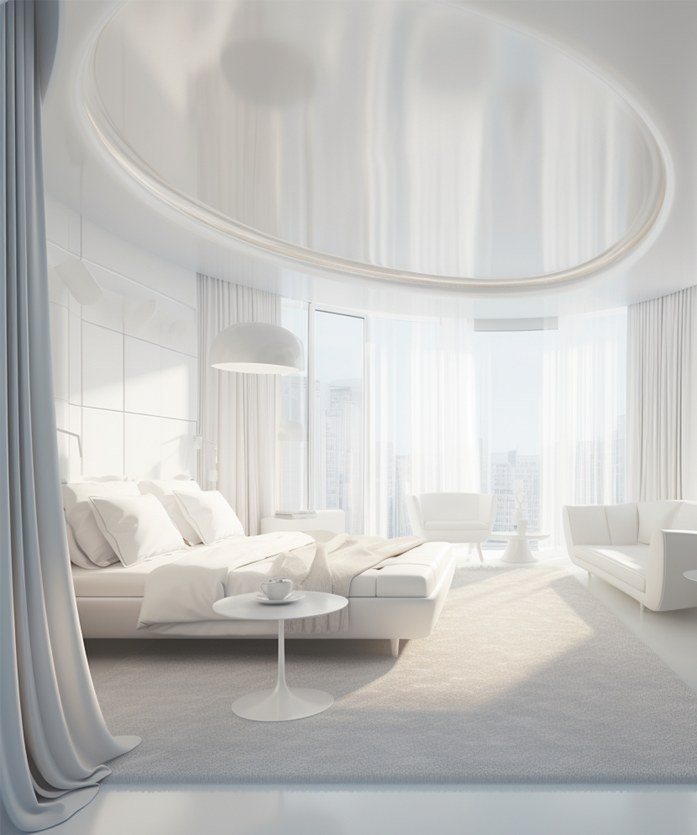
WHY
CHOOSE US?
PAMPHLET
for a Hotel
UNPARALLELED COMFORT
BOOK YOUR STAY TODAY
Our rooms are designed with your comfort in mind, featuring plush bedding, modern amenities, and breathtaking views.
Ready to escape the ordinary? Let us welcome you to Hotel Name.
EXCEPTIONAL DINING
Savor culinary delights at our on-site restaurants, offering a wide range of local
and international cuisine.
CONTACT US:
WEBSITE:
PRIME LOCATION
www.hotelname.ltd
Nestled in the heart of [City/Region], our
hotel offers easy access to popular attractions, shopping, and cultural landmarks.
EMAIL:
reservations@hotelname.ltd
PHONE:
+1 123 456 7890
DISCOVER YOUR
PERFECT GETAWAY

Slide 2
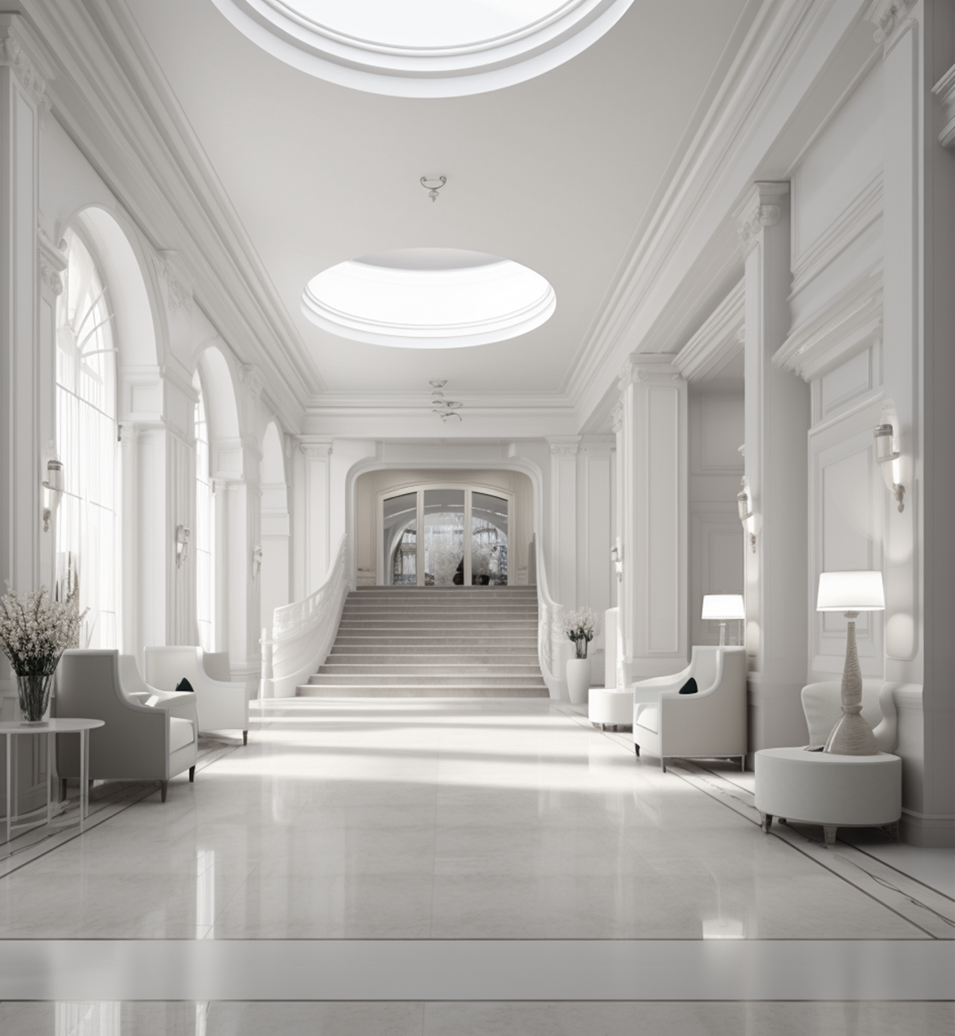
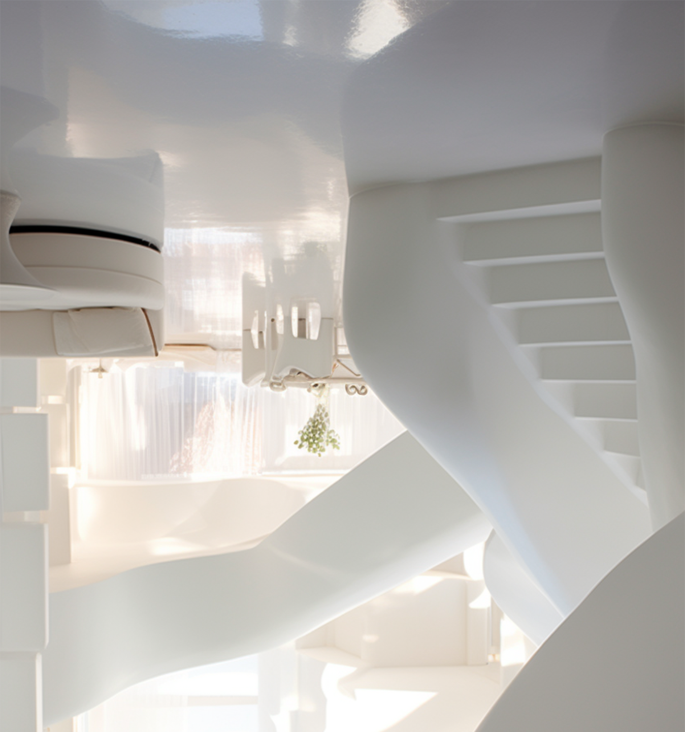
ABOUT US
CHOOSE
THE PERFECT STAY
At Hotel Name, we pride ourselves on offering more than just a place to stay – we deliver an unforgettable experience.
Nestled in the heart of City and Region, our hotel combines modern luxury with warm hospitality to make every guest feel at home.
ROOMS TAILORED TO YOUR NEEDS
Choose the Perfect Stay:
Deluxe Rooms: Cozy, stylish, and ideal for couples or solo travelers.
Family Rooms: Designed for families, with extra space and kid-friendly amenities.
Every room is equipped with high-speed Wi-Fi, premium toiletries, and 24/7 room service.
OUR MISSION:
ACTIVITIES & EXPERIENCES
OUR
SERVICES
To create a sanctuary where travelers can relax, recharge, and explore, with every detail designed to enhance your journey.
Explore More with Us:
Guided Tours: Discover local landmarks and hidden gems with expert guides.
Adventure Activities: From hiking to water sports, we offer something for every thrill-seeker.
Luxurious Rooms & Suites:
Spacious, elegant, and fully equipped for a memorable stay.
OUR VISION:
To be your trusted destination for exceptional service, comfort, and memorable moments, whether you’re visiting for business or leisure.
Create unforgettable memories during your stay.
Pool & Spa:
Relax and rejuvenate in our serene spa or
enjoy a refreshing swim in the pool.
DINING EXPERIENCES
Event Spaces:
WHAT SETS US APART?
Host your events in our state-of-the-art conference rooms or banquet halls.
A dedicated team committed to your
satisfaction.
Savor Every Bite:
Rooftop Bar: Sip on signature cocktails while enjoying panoramic views of the city or ocean.
Concierge Service:
A perfect blend of contemporary design and
local culture.
Special dietary options are available upon
request.
Let our team help you plan your
perfect itinerary.

