Slide 1
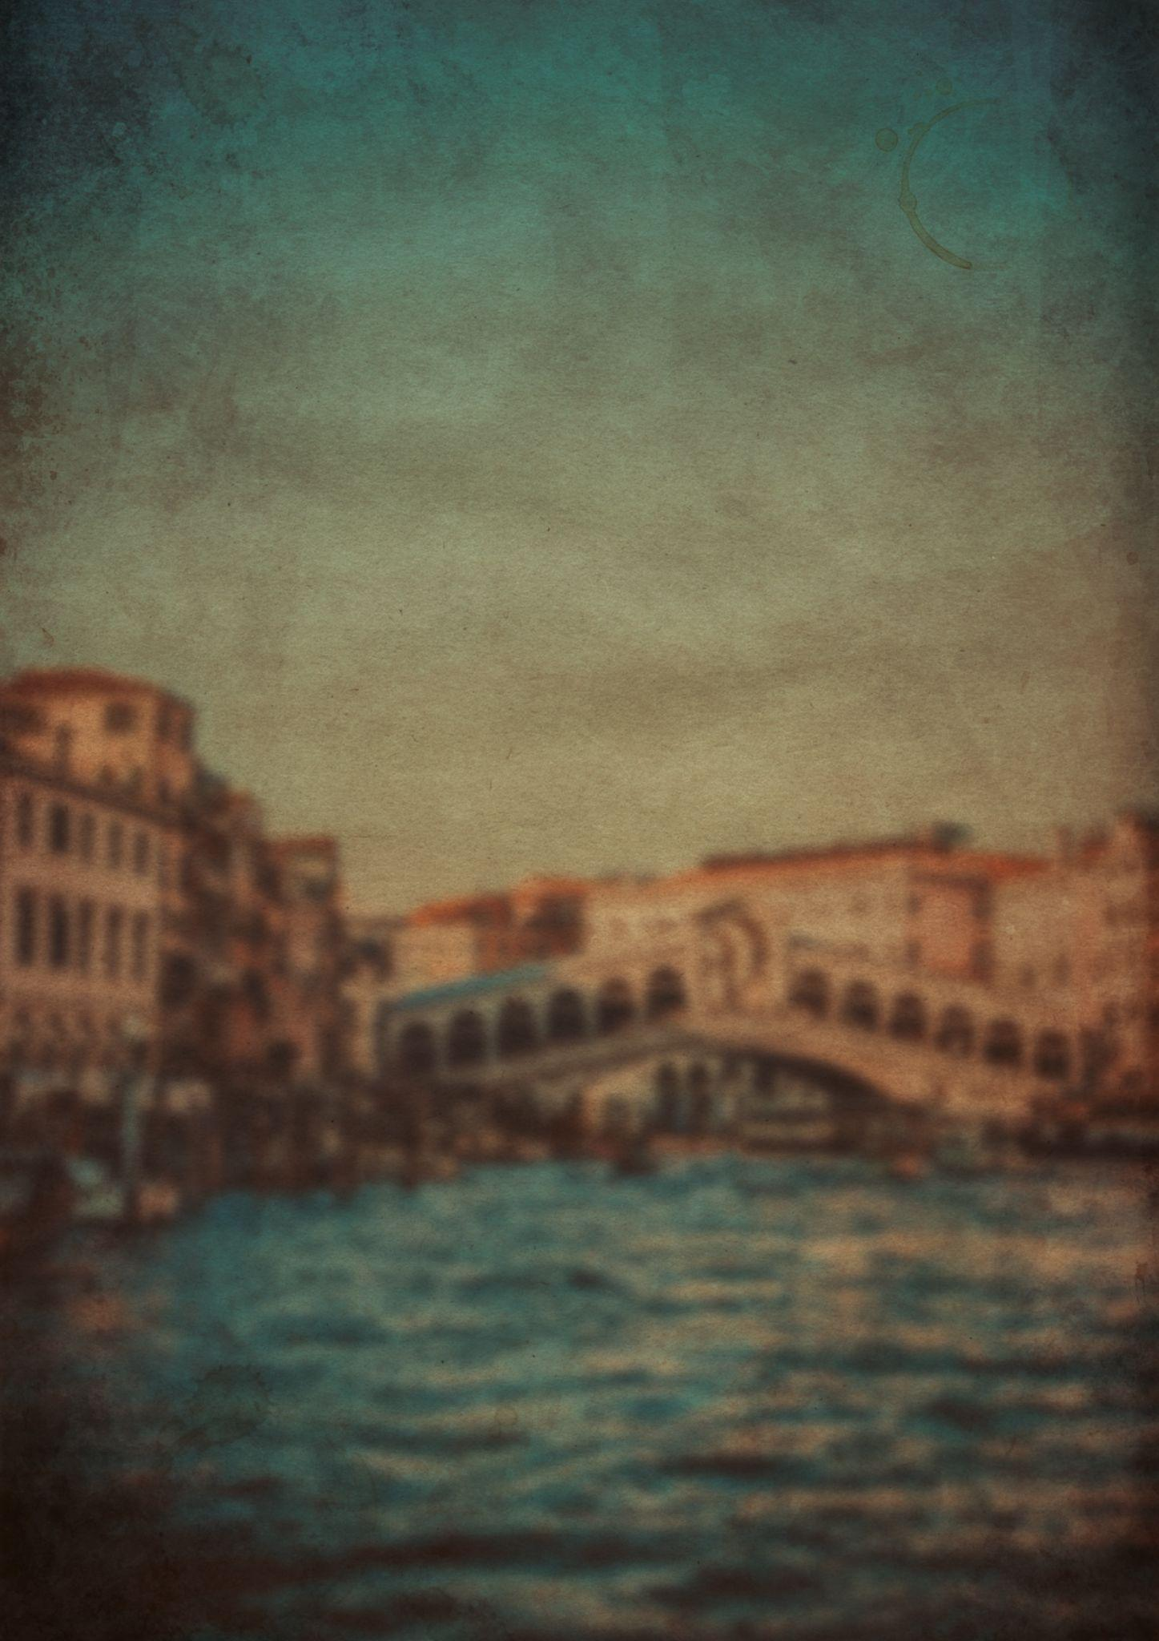
Packing
For
Vacation List
Beach Gear:
Food:
Umbrella
Cooler
Beach Chair
Snacks
Waterproof Blanket
Water
Beach Cart
Ice cream
Umbrella
Hooded Towel
Clothes:
Fun:
Swimsuits
Shirt
Water wings
Hats
Mask
Sandals
Water Toys
Water shoes
Beach toys or games
Kites
Baby:
Bubbles
Baby Powder
Face Wipes
Toiletries:
Life Jacket
Shampoo
Spare Clothes
Conditioner
Covid-19 Protection:
Bug spray
SPF Lip Balm
Mask
Anti-Itch Cream
Hand sanitizer

