Slide 1

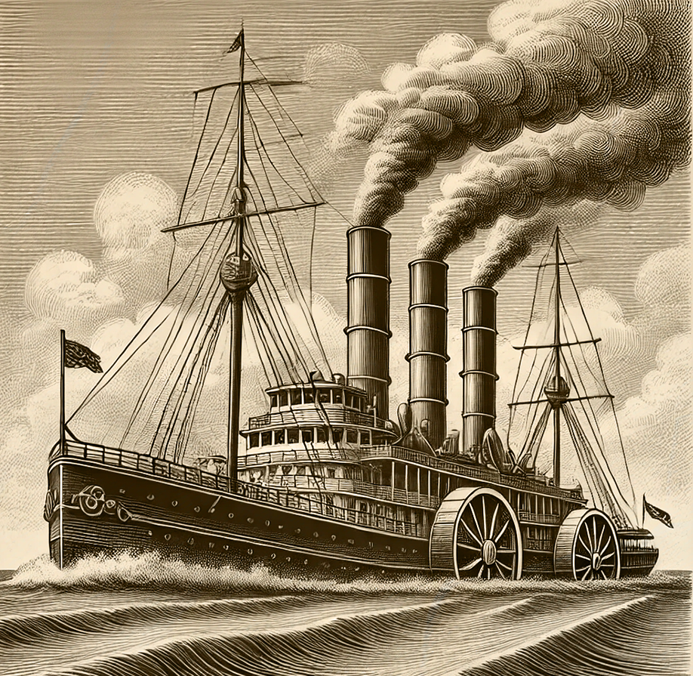
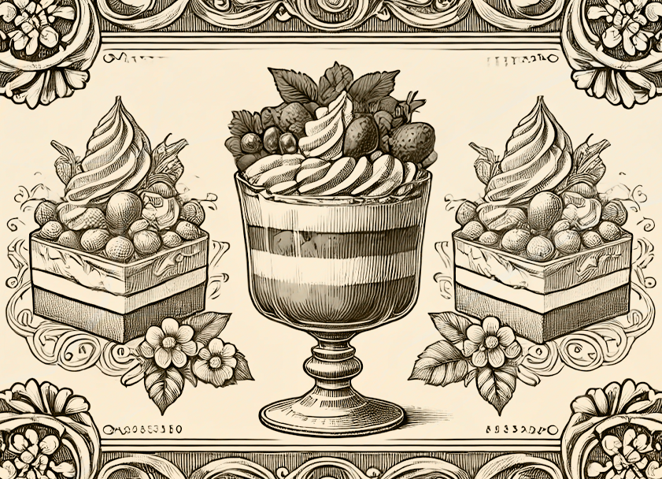
Established: 1878
Location: London, England Frequency: Weekly Circulation: 15,000 copies
VICTORIAN OBSERVER ESTABLISHED
The Heritage Gazette
VICTORIAN OBSERVER ESTABLISHED
Name: The Victorian Observer Established: 1878
Location: London, England Frequency: Weekly
Circulation: 15,000 copies (at peak distribution in the early 1900s)
Name: The Victorian Observer Established: 1878
Location: London, England Frequency: Weekly
Circulation: 15,000 copies (at peak distribution in the early 1900s)
CONNECTING CONTINENTS ACROSS THE WAVES
WHERE TIME STANDS STILL AND TRADITIONS ENDURE
A Marvel of Modern
Maritime Innovation
The steamship has become the heartbeat of global trade and travel, bridging the vast oceans that once separated continents. With their powerful engines and elegant designs, these vessels now dominate the seas, offering unparalleled speed and reliability compared to the sailing ships of old.
The innovation of the steam engine has revolutionized not only commerce but also the lives of travelers. Passengers aboard these majestic vessels enjoy.
Where Time Stands Still and Traditions Endure
As cities expand and industry roars ever louder, the village remains a haven of peace and simplicity. Here, life unfolds with the rhythms of nature, and every day brings the familiar comfort of routine. Farmers rise with the dawn to tend their fields, craftsmen hone their trades, and families gather at day’s end to share.
As cities expand and industry roars ever louder, the village remains a haven of peace and simplicity. Here, life unfolds with the rhythms of nature, and every day brings the familiar comfort of routine. Farmers rise with the dawn to tend their fields, craftsmen hone their trades, and families gather at day’s end to share stories by the hearth.
Villages are the keepers of tradition, celebrating the seasons with festivals, markets, and community gatherings. While modernity encroaches, bringing railways and roads to once-remote hamlets, the heart of the village remains unchanged. It is a place where neighbors support one another, and the land provides not only sustenance but also a deep sense of connection not only sustenance.
The world grows smaller with each voyage across the seas.
Villages are the keepers of tradition, celebrating the seasons with festivals, markets, and community gatherings. While modernity encroaches, bringing railways and roads to once-remote hamlets, the heart of the village remains unchanged. It is a place where neighbors support one another, and the land provides not only sustenance but also a deep sense of connection.
With their powerful engines and elegant designs, these vessels now dominate the seas, offering unparalleled speed and reliability compared to the sailing ships of old.
The innovation of the steam engine has revolutionized not only commerce but also the lives of travelers. Passengers aboard these majestic vessels enjoy the comfort of spacious cabins, fine dining, and the company of fellow adventurers. Meanwhile, merchants rely on steamships to transport goods and textiles.
The steamship has become the heartbeat of global trade and travel, bridging the vast oceans that once separated continents. With their powerful engines and elegant designs, these vessels now dominate the seas, offering unparalleled speed and reliability compared to the sailing ships of old.
The innovation of the steam engine has revolutionized not only commerce but also the lives of travelers. Passengers aboard these majestic vessels enjoy the comfort of spacious cabins,
The innovation of the steam engine has revolutionized not only commerce but also the lives of travelers. Passengers aboard these majestic vessels enjoy the comfort of spacious cabins, fine dining, and the company of fellow adventurers. Meanwhile, merchants rely on steamships to transport goods, from textiles to spices, with efficiency and precision.
The impact of steamships is undeniable. Ports have flourished into bustling hubs of activity, fueling the growth of industries.
ILLUSTRATOR: RUPERT COLE
As cities expand and industry roars ever louder, the village remains a haven of peace and simplicity. Here, life unfolds with the rhythms of nature, and every day brings the familiar comfort of routine. Farmers rise with the dawn to tend their fields, craftsmen hone their trades, and families gather at day’s end to share stories by the hearth.
Villages are the keepers of tradition, celebrating the seasons with festivals, markets, and community gatherings. While modernity encroaches, bringing railways and roads to once-remote hamlets, the heart of the village remains unchanged. It is a place where neighbors support one another, and the land provides not only sustenance but also a deep sense of connection. Villages are the keepers of tradition, celebrating the seasons with festivals, markets, and community gatherings. While modernity encroaches, bringing railways and roads modernity encroaches, bringing railways and roads to once-remote hamlets, the heart of the village remains unchanged. It is a place where neighbors support one another, and the land provides not only sustenance but also a deep sense of connection.
VICTORIAN
DESSERTS
In the grand dining rooms of Victorian society, no meal was complete without the crowning touch of a sumptuous dessert. From intricately layered trifles of confectioners who transformed simple ingredients into edible masterpieces.
Established: 1878
Location: London, England Frequency: Weekly Circulation: 15,000 copies

Slide 2
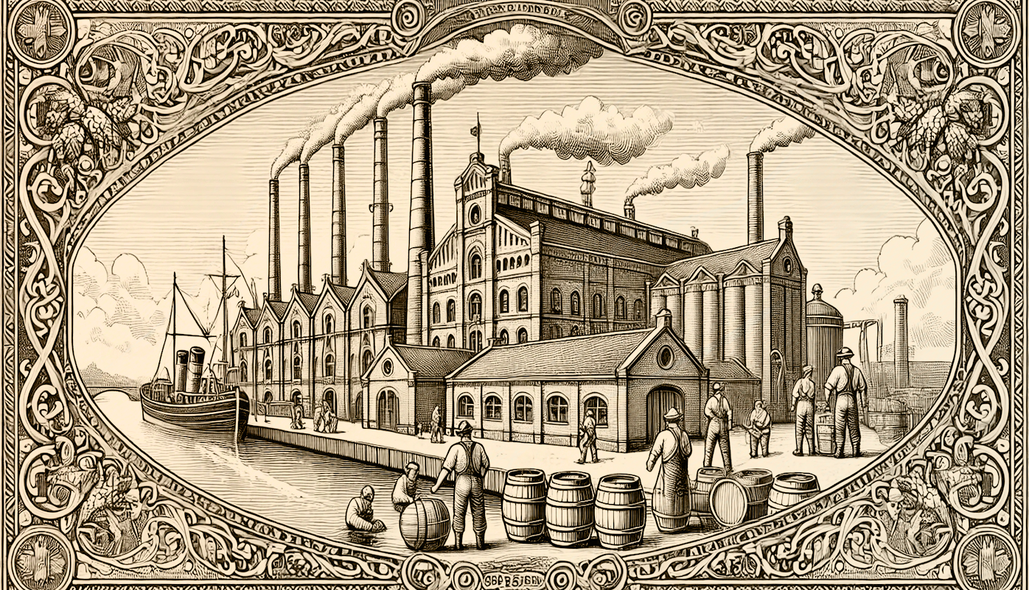
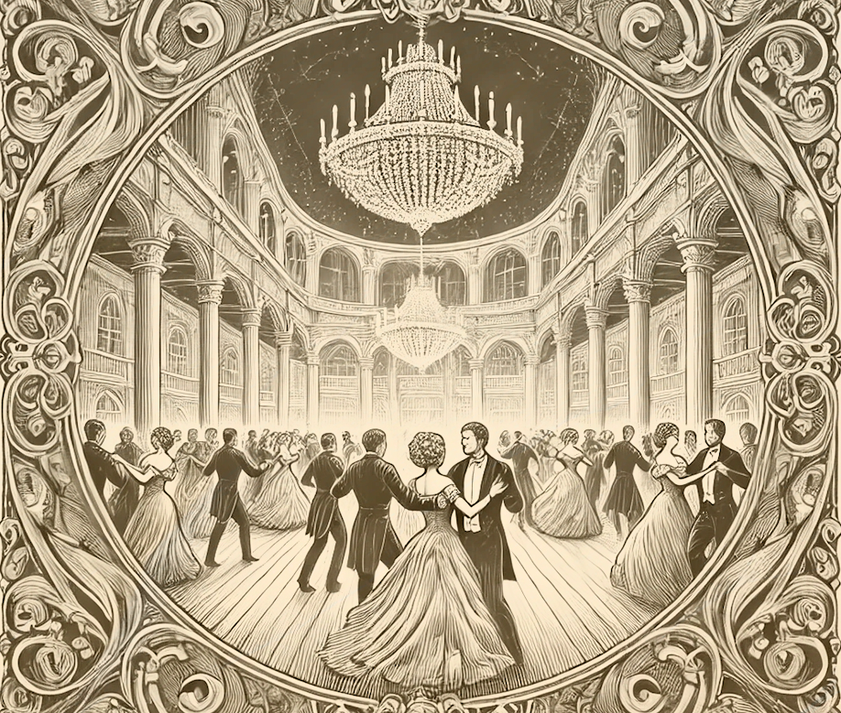
Established: 1878
Location: London, England Frequency: Weekly Circulation: 15,000 copies
THE CROWN JEWELS OF THE EMPIRE
WHERE TIME STANDS STILL AND TRADITIONS ENDURE
A Glimpse into Regal Elegance
The diadem is much more than an ornament; it is a symbol of prestige, tradition, and the enduring allure of royalty. Throughout history, these dazzling pieces have graced the heads of monarchs, marking significant occasions and representing the wealth and power of empires.
Modern jewelers craft these masterpieces with meticulous precision, combining the finest gemstones with intricate designs that reflect the tastes of the age. In Victorian society, diadems are not only worn at royal events but have also become coveted heirlooms among the nobility,
Modern jewelers craft these masterpieces with meticulous precision, combining the finest gemstones with intricate designs that reflect the tastes of the age. In Victorian society, diadems are not only worn at royal events but have also become coveted heirlooms among the nobility, passed down through generations as treasured symbols of legacy.
Whether displayed in a glass case or worn during grand ceremonies, the diadem continues ceremonies, the diadem continues ceremonies, the diadem continues to captivate the imagination, standing as a timeless
The diadem is much more than an ornament; it is a symbol of prestige, tradition, and the enduring allure of royalty. Throughout history, these dazzling pieces have graced the heads of monarchs, marking significant occasions and representing the wealth and power of empires.
Modern jewelers craft these masterpieces with meticulous precision, combining the finest gemstones with intricate designs that reflect the tastes of the age. In Victorian society, diadems are not only worn at royal events but have also become coveted heirlooms among the nobility,
The Village’s Embrace: A Retreat from the Frenzy of Progress
As cities expand and industry roars ever louder, the village remains a haven of peace and simplicity. Here, life unfolds with the rhythms of nature, and every day brings the familiar comfort of routine. Farmers rise with the dawn to tend their fields, craftsmen hone their trades, and families gather at day’s end to share stories by the hearth.
As cities expand and industry roars ever louder, the village remains a haven of peace and simplicity. Here, life unfolds with the rhythms of nature, and every day brings the familiar comfort of routine. Farmers rise with the dawn to tend their fields, craftsmen hone their trades, and families gather at day’s end to share stories by the hearth.
Villages are the keepers of tradition, celebrating the seasons with festivals, markets, and community gatherings. While modernity encroaches, bringing railways and roads to once-remote hamlets, the heart of the village remains unchanged. It is a place where neighbors support one another, and the land provides not only sustenance but also a deep sense of connection.
For those seeking respite from the pace of modern life, the village offers a reminder of what villages are the keepers,
Villages are the keepers of tradition, celebrating the seasons with festivals, markets, and community gathe While modernity encroaches, bringiays and roads to once-remote hamlets, the heart of the village remains unchange place where neighbors support one another, and the land provides not only sustenance but also a deep sense of connection. For those seeking respite from the pace of modern life, the village offers a reminder of what truly matters: harmony, simplicity, and the enduring ties between people and the land.
The world grows smaller with each voyage across the seas.
A HUB OF OPPORTUNITY AND CHANGE
Life Amidst the Energy of Urban Growth
The city, with its bustling streets and ever-growing skyline, stands as a testament to human ambition and progress. Here, life moves at a frenetic pace, with opportunities and challenges waiting around every corner. For many, the city represents a chance to carve out a new destiny, leaving behind the predictability of rural life for the excitement and promise of urban living.
At the heart of the city are its streets, alive with the energy of commerce and social interaction. Vendors call out to passersby, selling everything from fresh produce to the latest fashions, while carriages and omnibuses weave through the throngs of pedestrians. Gas lamps illuminate the throngs of pedestrian thoroughfares at night, casting a warm glow that beckons workers and revelers alike.
The diadem is much more than an ornament; it is a symbol of prestige, tradition, and the enduring allure of royalty. Throughout history, these dazzling pieces have graced the heads of monarchs, marking significant occasions and representing the wealth and power of empires.
Modern jewelers craft these masterpieces with meticulous precision,
The world grows smaller with each voyage across the
seas.
Established: 1878
Location: London, England Frequency: Weekly Circulation: 15,000 copies

Slide 3
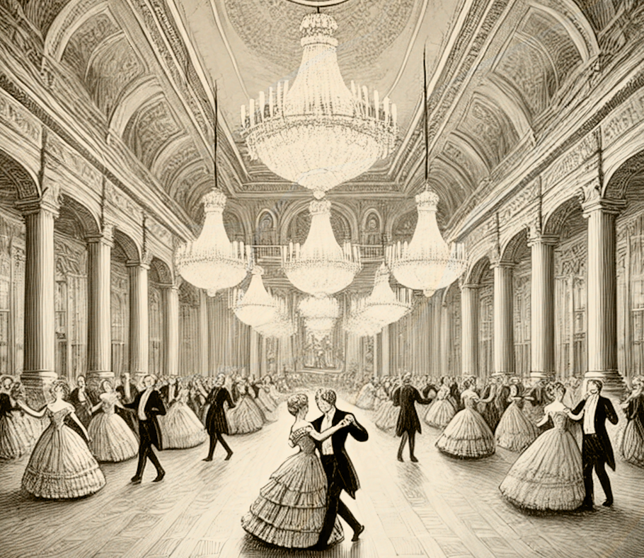
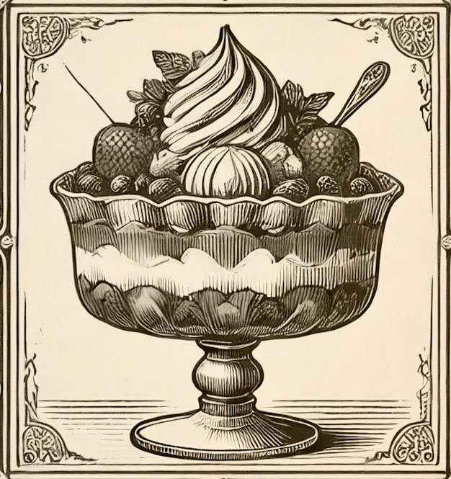
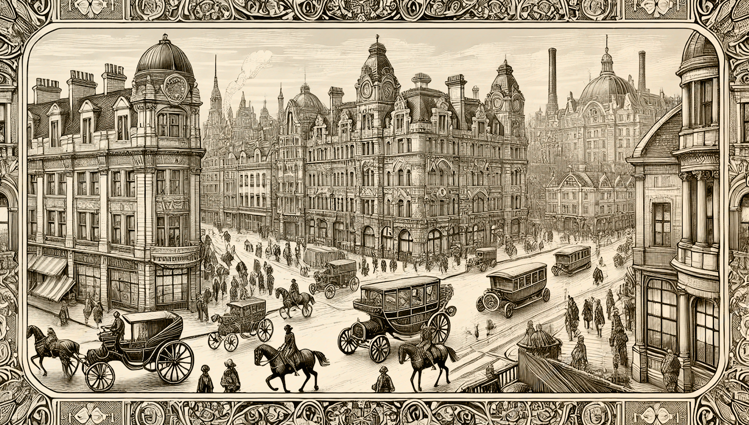

Established: 1878
Location: London, England Frequency: Weekly Circulation: 15,000 copies
DESSERTS
In the grand dining rooms of Victorian society, no meal was complete without the crowning touch of a sumptuous dessert. From intricately layered trifles of confectioners who transformed simple ingredients into edible masterpieces.
In the grand dining rooms of Victorian society, no meal was complete without the crowning touch of a sumptuous dessert intricately layeredintricately layered trifles of confectioners who transformed simple ingredients.
THE VILLAGE’S EMBRACE: A RETREAT FROM THE FRENZY OF PROGRESS
Where Time Stands Still and Traditions Endure
As cities expand and industry roars ever louder, the village remains a haven of peace and simplicity. Here, life unfolds with the rhythms of nature, and every day brings the familiar comfort of routine. Farmers rise with the dawn to tend their fields, craftsmen hone their trades, and families gather at day’s end to share stories by the hearth.
Villages are the keepers of tradition, celebrating the seasons with festivals, markets, and community gatherings. While modernity encroaches, bringing railways and roads to once-remote hamlets, the heart of the village remains unchanged. It is a place where neighbors support.
As cities expand and industry roars ever louder, the village remains a haven of peace and simplicity. Here, life unfolds with the rhythms of nature, and every day brings the familiar comfort of routine. Farmers rise with the dawn to tend their fields, craftsmen hone their trades, and families gather at day’s end to share stories by the hearth. Villages are the keepers of tradition, celebrating the seasons with festivals, markets, and community gatherings. While modernity encroaches, bringing railways and roads to once-remote hamlets, the heart of the village remains unchanged. It is a place where neighbors support one another, and the land
Here, life unfolds with the rhythms of nature, and every day brings the familiar comfort of routine. Farmers
As cities expand and industry roars ever louder, the village remains a haven of peace and simplicity.
roars ever louder, the village remains a haven of peace and simplicity. Here, life unfolds.
The world grows smaller with each voyage across the seas.
THE BUSTLING CITY: A HUB OF OPPORTUNITY AND CHANGE
For all its chaos, the city is a place of innovation and creativity. Theatres, galleries, and cafés offer spaces where ideas flourish, and inventions take shape. Factories hum with activity, producing goods that fuel both local markets and global trade. Schools and libraries provide access to knowledge, nurturing the minds of future leaders and thinkers.
Yet, life in the city is not without its hardships. Crowded tenements and the constant din of activity can wear on the spirit. Still, for
Yet, life in the city is not without its hardships. Crowded tenements and the constant din of activity can wear on the spirit. Still, for those who dream big, the city remains an irresistible magnet, a place where possibilities seem as endless as the avenues that stretch out before them
As one observer aptly noted, "To walk the streets of the city is to walk amidst the pulse of progress." It is a place where dreams are born, fortunes are made, and history is written with every step.
As cities expand and industry roars ever louder, the village remains a haven of peace and simplicity. Here, life unfolds with the rhythms of nature, and every day brings the familiar comfort of routine. Farmers rise.
Life Amidst the Energy of Urban Growth
The city, with its bustling streets and ever-growing skyline, stands as a testament to human ambition and progress. Here, life moves at a frenetic pace, with opportunities and challenges waiting around every corner. For many, the city represents a chance to carve out a new destiny, leaving behind.
At the heart of the city are its streets, alive with the energy of commerce and social interaction. Vendors call out to passersby, selling everything from fresh produce to the latest fashions, while carriages and omnibuses weave through the throngs of pedestrians. Gas lamps illuminate the thoroughfares.
Illustrator: Eleanor Harding
Established: 1878
Location: London, England Frequency: Weekly Circulation: 15,000 copies

Slide 4
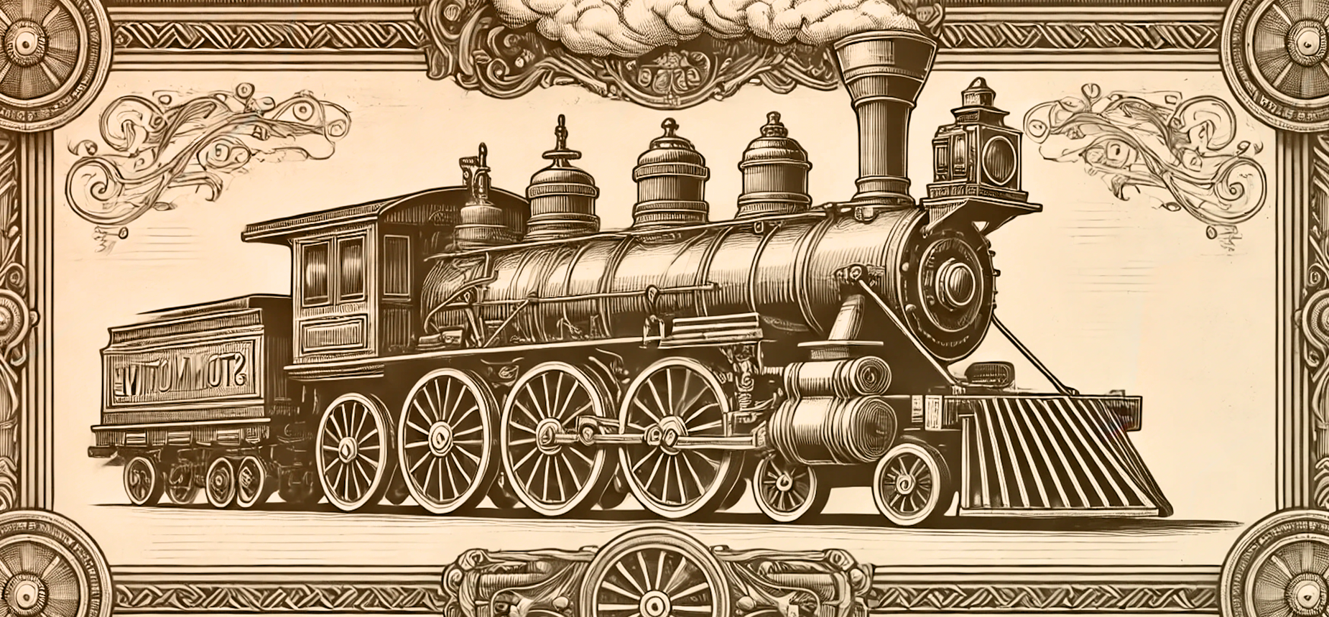

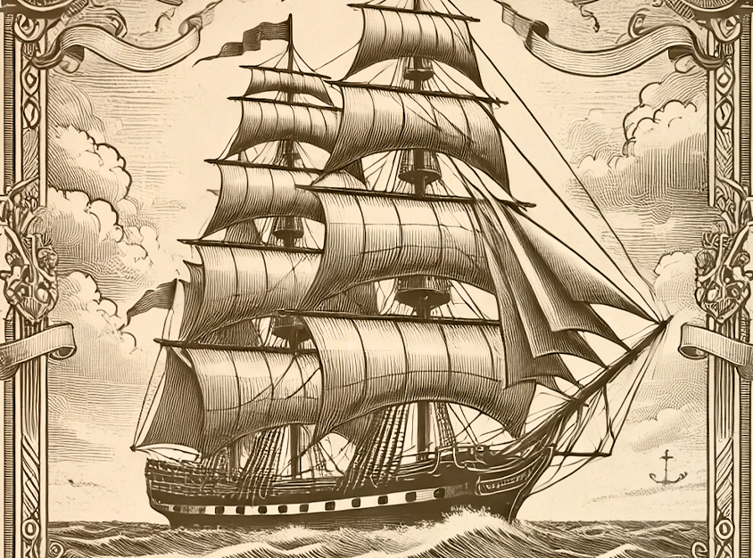
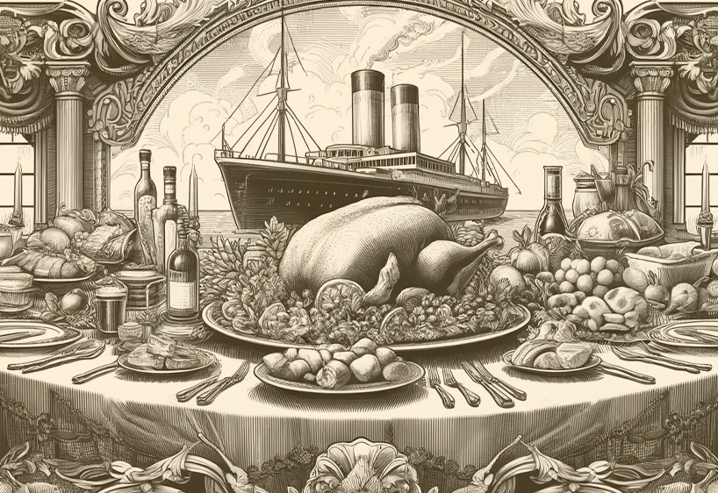
Established: 1878
Location: London, England Frequency: Weekly Circulation: 15,000 copies
"Every mile of track laid is a mile conquered for humanity."
— An industrialist
Railways have redefined the very concept of distance, connecting cities, towns, and villages like never before. The once arduous journey between far-off places has been transformed into a swift and efficient affair, making travel accessible to all and opening new avenues for trade and exploration.
Here is the vintage-style horizontal illustration of a steam locomotive in a decorative frame
THE SPIRIT OF INNOVATION: RAILWAYS THE MAP OF CIVILIZATION
Tracks of Progress Spanning the Globe
Railways have redefined the very concept of distance, connecting cities, towns, and villages like never before. The once arduous journey between
has been transformed into a swift and efficient affair, making travel accessible to all and opening new avenues for trade and exploration.
The locomotive, powered by the relentless force of steam, has become a symbol of human ingenuity. With each new railway line constructed, industries grow, communities flourish, and opportunities multiply. Farmers now send their goods to market with ease, and city dwellers escape to the countryside in search of tranquility.
Despite occasional criticism from those who mourn the passing of quieter times, the railway is celebrated as a triumph of progress. It is the iron thread that weaves the fabric of modern civilization.
Railways have redefined the very concept of distance, connecting cities, towns, and villages like never before. The once arduous journey between far-off places has been transformed into a swift and efficient affair, making travel accessible to all and opening new avenues for trade and exploration.
The locomotive, powered by the relentless force of steam, has become a symbol of human ingenuity. With each new railway line constructed, industries grow, communities flourish, and opportunities multiply. Farmers now send their goods to market with ease, and city dwellers escape to the countryside in search of tranquility.
Illustrator: Eleanor Harding
THE CAPTAIN’S HELM
The life of a ship’s captain is one of immense responsibility and endless adventure. Standing at the helm of a grand vessel, the captain is both a leader and a navigator, entrusted with the safety of the crew and passengers, as well as the success of the voyage.
THE STEAMSHIP’S GLORY: CONNECTING CONTINENTS ACROSS THE WAVES
A Marvel of Modern Maritime Innovation
The steamship has become the heartbeat of global trade and travel, bridging the vast oceans that once separated continents. With their powerful engines and elegant designs, these vessels now dominate the seas, offering unparalleled speed and reliability compared to the sailing ships of old. The innovation of the steam engine has revolutionized not only commerce but also the lives of travelers. Passengers aboard these majestic vessels enjoy the comfort of spacious cabins, fine dining, and the company of fellow adventurers. Meanwhile, merchants rely on steamships to transport goods, from textiles to spices, with efficiency and precision.
The innovation of the steam engine has revolutionized not only commerce but also the lives of travelers. Passengers aboard these majestic vessels enjoy the comfort of spacious cabins,
The world grows smaller with each voyage across the
seas.
Established: 1878
Location: London, England Frequency: Weekly Circulation: 15,000 copies

