Slide 1
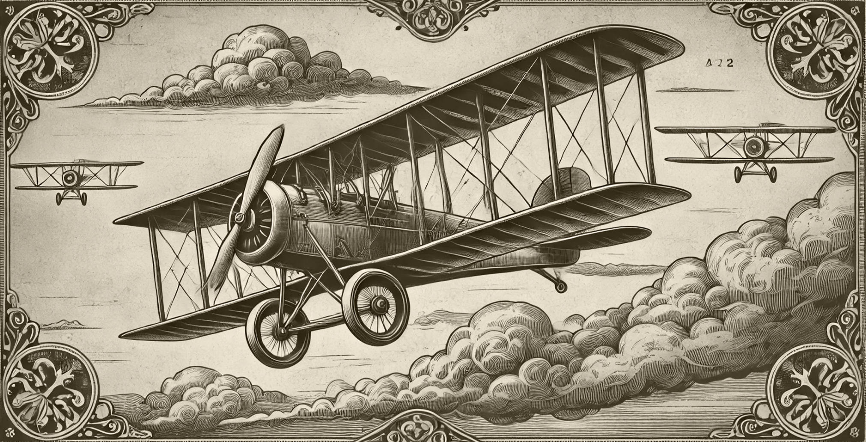
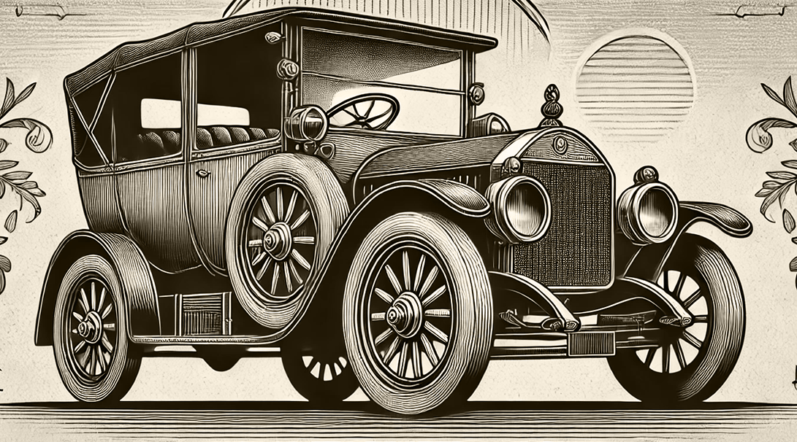
Circulation: 15,000 copies (at peak distribution in the early 1900s).
Established: 1878. Location: London, England. Frequency: Weekly.
THE VICTORIAN OBSERVER
An artistic sketch of the Wright Flyer soaring above the dunes of Kitty Hawk, with observers watching in awe.
THE MYSTERY OF FLIGHT:
MAN’S DREAM OF THE SKIES
The Wright Brothers and Their Historic Achievement
In a groundbreaking achievement that has captured the imagination of all who hear of it, the Wright brothers, Wilbur and Orville, have taken humanity one step closer to the dream of flight. On a brisk December morning at Kitty Hawk, North Carolina, the duo successfully launched their flying machine, the Wright Flyer, into the air, achieving a controlled, powered flight. The Flyer, constructed primarily of wood and fabric, may appear fragile to the untrained eye. Yet, its ingenious design and the brothers' relentless determination have proven that manned flight is not merely a fantasy but an attainable reality. The first flight lasted a mere 12 seconds and covered just 120 feet, but it signified the dawn of a new era.
Skeptics have long doubted humanity’s ability to take to the skies, citing the tyranny of gravity as an insurmountable obstacle. However, the Wright brothers' meticulous approach—studying aerodynamics, testing gliders, and perfecting their engine—has silenced many critics.
"To conquer the sky is to embrace the impossible."
— An aviation enthusiast
A MARVEL OF MODERN MECHANIZATION
Skeptics have long doubted humanity’s ability to take to the skies, citing the tyranny of gravity as an insurmountable obstacle. However, the Wright brothers' meticulous approach—studying aerodynamics, testing gliders, and perfecting their engine—has silenced many critics.
The potential implications of this achievement are staggering. Imagine a future where travel by air becomes as commonplace as rail journeys. Goods could be transported across continents in hours rather than weeks, and the dream of exploring uncharted territories may soon be within reach. Goods could be transported across continents in hours rather than weeks, and the dream of exploring uncharted territories may soon be within reach.
Horseless Carriages Paving the Way to the Future
In a remarkable feat that has captured the attention of all who hear of it, Henry and his team have brought humanity one step closer to revolutionizing transportation. On a brisk autumn morning in Detroit, Michigan, Henry successfully unveiled his Model T, a reliable, affordable automobile that promises to change the way the world moves. The Model T, constructed of steel and reinforced with the latest mechanical innovations, may appear modest to the untrained eye. Yet, its clever design and relentless drive have proven that the automobile is not merely a luxury but a practical solution for the masses. The first test drive, though brief, demonstrated the car’s ability to navigate rough roads and paved the way for mass production.
Critics once doubted whether a machine could replace the horse and carriage, dismissing the automobile as impractical for everyday use. However, Henry's meticulous attention to detail—developing the assembly line, perfecting the engine, and ensuring affordability—has silenced many of the doubters.

Slide 2
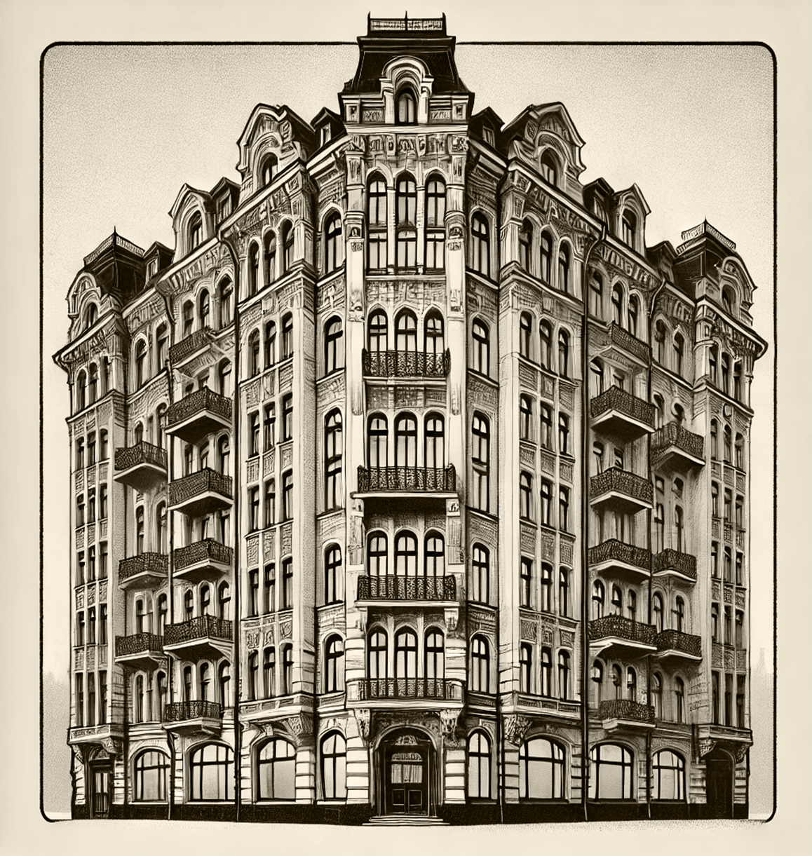
URBAN INNOVATION AND THE RISE OF TALL BUILDINGS
The Birth of the Skyscraper: Reaching for the Heavens
The skyline of modern cities is changing forever, as towering skyscrapers redefine what is possible in urban architecture. These extraordinary structures, constructed with steel frames and rising far above their neighbors, are reshaping the way people live, work, and dream.
At the heart of this revolution is the use of steel and innovations in construction methods. Where traditional buildings relied on thick masonry walls for support, the skyscraper’s steel skeleton allows for
The Park Row Building in New York City, a shining example of this new era, stands 20 stories tall and is considered a marvel of engineering. Inside, offices teem with workers, each benefiting from abundant natural light thanks to the innovative use of glass. Elevators, another modern marvel, make accessing these lofty floors effortless and practical.
While some critics fear that these buildings will cast oppressive shadows or overwhelm the streets below, others see them as a symbol of human
The implications for urban living are profound. As cities grow more crowded, skyscrapers promise to provide housing and workplaces without sprawling outward into the countryside. They represent not just physical elevation but a societal shift, as the skyline itself becomes a testament to modernity and aspiration.
In the coming years, taller and even more daring structures are already being imagined. The skyscraper is not a building; it is a bold innovation!
The factory, once a curiosity of innovation, has become the cornerstone of modern industry. These vast buildings, filled with intricate machinery.
"To conquer the sky is to embrace the impossible."
— A prominent industrialist
RAILWAYS
CHARLES WINTHROP
Railways Unite Distant Lands
Few inventions have reshaped the world as profoundly as the locomotive. With its iron rails stretching across continents, the railway has bridged vast distances, making the farthest corners of the land accessible to all.
For travelers, the locomotive represents freedom. No longer bound by the slow pace of horse-drawn carriages or the limited reach of canals, people can now journey from bustling cities to remote villages in a matter of hours. The railway’s speed and efficiency have revolutionized both personal travel and commerce.
Showcasing Innovation,
Art, and Industry
The grand exhibition halls of our era are not merely buildings; they are cathedrals of progress, where nations come together to celebrate the triumphs of human creativity and innovation.
From the Great Exhibition at London’s Crystal Palace to the World’s Columbian Exposition in Chicago, these gatherings have become spectacles that inspire and educate.
Inside these sprawling halls, visitors encounter a kaleidoscope of wonders. Exhibits range from cutting-edge machinery and industrial tools to artistic masterpieces and artifacts from distant lands. For inventors, artisans, and visionaries, these exhibitions provide an unparalleled platform to showcase their achievements to the world.
"To conquer the sky is to embrace the impossible."
— A prominent industrialist
The Rise of the Modern Factory: Engines of Progress
Illustrator: Harold Whitman
A TASTE OF ADVENTURE IN EVERY SIP
REVOLUTION
powerful boilers, have rendered the clippers of yesteryear all but obsolete. The rise of steamships has revolutionized trade and travel, allowing goods and passengers to traverse vast distances in a fraction of the time it once took. Where sailing vessels relied on capricious winds, the modern steamship ensures predictable and efficient voyages.
Steel Hulls and Steam
Power Redefine the High Seas
The Golden Spirit of the Caribbean: The Timeless
Allure of Rum
From the sun-drenched shores of the Caribbean to the refined parlors of England, rum has secured its place as one of the world’s most celebrated spirits. Distilled from the sweet juice of sugarcane and aged to perfection in wooden barrels, rum carries with it the essence of adventure, trade, and the exotic allure of tropical isles.
For centuries, rum has been more than a mere drink; it is a symbol of exploration and commerce. Sailors once toasted their voyages with it, pirates famously prized it, and merchants built fortunes upon its trade. Today, this golden spirit continues to enchant, offering a variety of styles and flavors to suit every palate. Among the most prized varieties are dark, aged rums, known for their complex flavors of caramel, vanilla, and spices. These are perfect.
In the age of steam and steel, the ship has undergone a transformation that has redefined humanity’s relationship with the sea. No longer beholden to the whims of wind and weather, the modern vessel harnesses the power of steam engines, carving paths across the oceans with unprecedented speed and reliability.
These marvels of engineering, with their steel hulls and powerful boilers,
"In the roar of the machines lies the heartbeat of a new age."
— A prominent industrialist

Slide 3
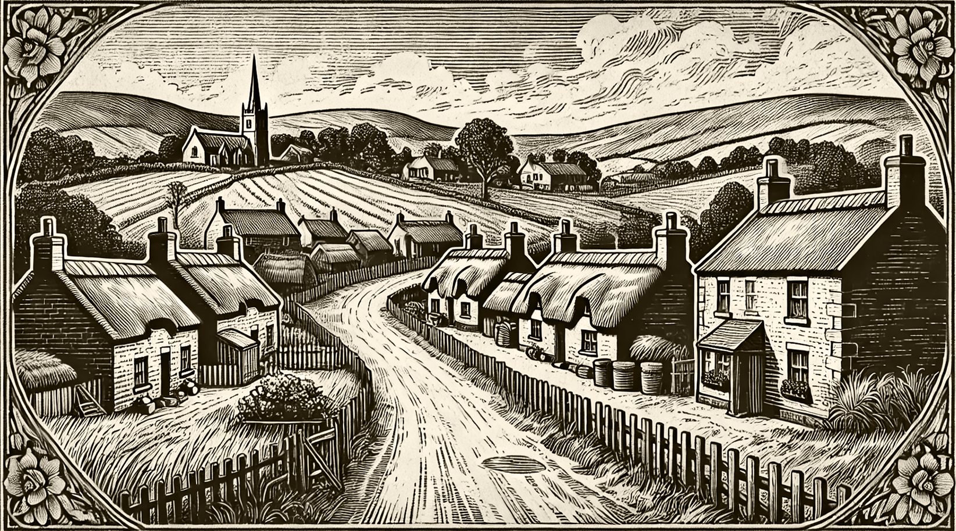
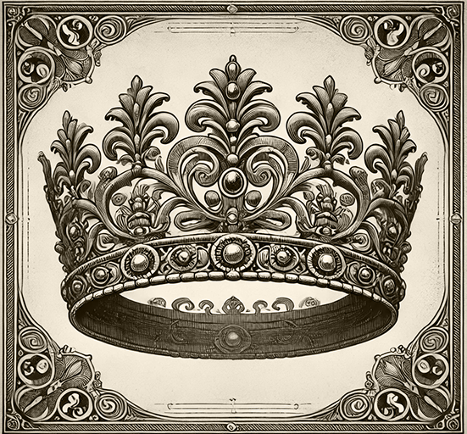
THE GLITTERING CROWN
A Symbol of Grace and Royalty
Few accessories capture the imagination quite like the diadem, a symbol of elegance, grace, and power that has adorned the heads of queens and noblewomen for centuries. With its glittering gems and intricate designs, the diadem is more than an ornament—it is a statement of dignity and refinement.
The origins of the diadem trace back to ancient civilizations, where rulers wore golden bands to signify divine authority. Over time, these simple designs evolved into the elaborate masterpieces we recognize today, adorned with diamonds, rubies, emeralds, and sapphires. Each stone and motif tells a story, often reflecting the wearer's status, heritage, or personal taste.
In Victorian society, the diadem has become a coveted accessory for grand occasions. From royal coronations to glittering balls, these dazzling pieces are worn to convey both wealth and sophistication. Jewelers, skilled in the delicate art of crafting these treasures, employ techniques passed down through generations to ensure each diadem is a unique work of art. One such masterpiece, recently unveiled at a society gala, features over 300 diamonds set in platinum, arranged in a floral pattern reminiscent of spring blooms. The jeweler behind this creation described it.
THE TIMELESS CHARM OF THE VILLAGE: LIFE IN THE COUNTRYSIDE
A Haven of Simplicity and Tradition
Far from the clamor of the city and the roar of industry lies the village—a sanctuary of peace, tradition, and timeless beauty. These small communities, dotted across the countryside, embody the rhythms of a simpler life, where each day is woven with the seasons and every face is familiar.
Villages are the backbone of the nation, providing much of the food and resources that sustain urban centers. Farmers rise with the sun, tending to their fields and livestock, while craftsmen ply their trades in workshops steeped in history. The
The marketplace, often the heart of the village, buzzes with life as neighbors barter and share news.
The charm of village life lies not only in its idyllic landscapes but also in its sense of community. Here, bonds between families run deep, and festivals bring neighbors together in joyous celebration. From the harvest festival to the ringing of church bells on Sunday morning, traditions bind the past to the present, offering a sense of continuity in a rapidly changing world. Yet, the village is not untouched by progress. Railways and roads now connect these rural havens
"In the quiet hum
of the village lies
the true heartbeat
of a nation."
— A countryside poet
Despite these shifts, the essence of the village endures. It remains a place where life moves at a gentler pace, where nature's beauty is cherished, and where the values of hard work and community thrive. As one villager aptly said, “The village is not just.
Illustrator:
Harold Whitman
DR.
BLACKWELL
As the chill of winter grips the nation, coughs and colds become unwelcome visitors in many homes. But fear not, for modern medicine offers a remedy that is both soothing and effective: Dr. Blackwell’s Cough Syrup. Carefully crafted with a blend of natural botanicals and the latest pharmaceutical advancements, this elixir promises relief from the most stubborn of coughs.
At the heart of Dr. Blackwell’s formula lies a harmonious blend of honey, licorice root, and peppermint, known for their soothing properties. These ingredients coat the throat, easing irritation and reducing the urge to cough. Combined with carefully measured extracts of opium and camphor, the syrup not only alleviates discomfort but also promotes restful sleep—essential for recovery.
The syrup has garnered praise from physicians and patients alike. Families across the country report.
"To conquer the sky is to embrace the impossible."
Showcasing Innovation,
Art, and Industry
As the chill of winter grips the nation, coughs and colds become unwelcome visitors in many homes. But fear not, for modern medicine offers a remedy that is both soothing and effective: Dr. Blackwell’s Cough Syrup. Carefully crafted with a blend of natural botanicals and the latest pharmaceutical advancements, this elixir promises relief from the most stubborn of coughs.
At the heart of Dr. Blackwell’s formula lies a harmonious blend of honey, licorice root, and peppermint, known for their soothing properties. These ingredients coat the throat, easing irritation and reducing.
— An aviation enthusiast
Illustrator:
Harold Whitman

Slide 4
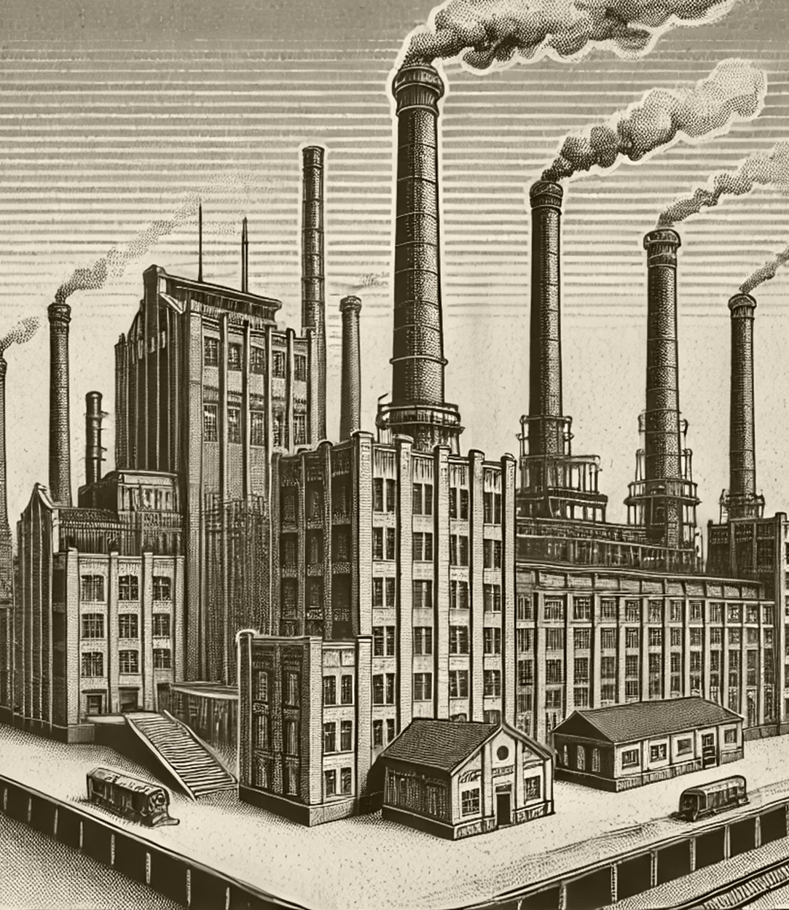
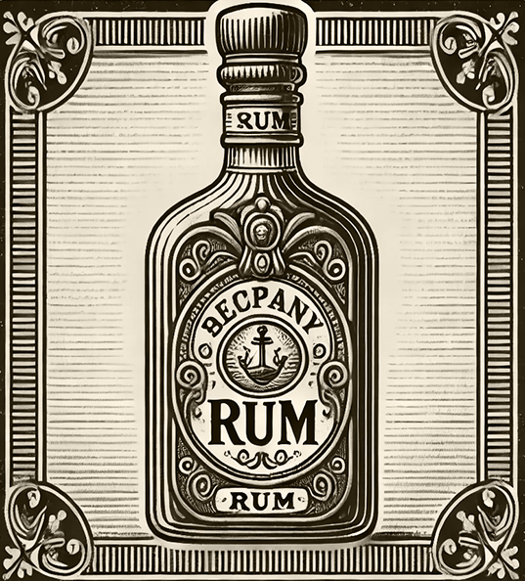
THE
MAJESTY OF THE MODERN SHIP
THE
TIMELESS ALLURE OF RUM
Steel Hulls and Steam Power Redefine the High Seas
A Taste of Adventure in Every Sip
In the age of steam and steel, the ship has undergone a transformation that has redefined humanity’s relationship with the sea. No longer beholden to the whims of wind and weather, the modern vessel harnesses the power of steam engines, carving paths across the oceans with unprecedented speed and reliability.
These marvels of engineering, with their steel hulls and powerful boilers, have rendered the clippers of yesteryear all but obsolete. The rise of steamships has revolutionized trade and travel, allowing goods and passengers to traverse vast distances in a fraction of the time it once took. Where sailing vessels relied on capricious winds, the modern steamship ensures predictable and efficient voyages.
From the sun-drenched shores of the Caribbean to the refined parlors of England, rum has secured its place as one of the world’s most celebrated spirits. Distilled from the sweet juice of sugarcane and aged to perfection in wooden barrels, rum carries with it the essence of adventure, trade, and the exotic allure of tropical isles. For centuries, rum has been more than a mere drink; it is a symbol of exploration and commerce. Sailors once toasted their voyages with it, pirates famously prized it, and merchants built fortunes upon its trade. Today, this golden spirit continues to enchant, offering a variety of styles and flavors to suit every palate.
Among the most prized varieties are dark, aged rums, known for their complex flavors of caramel, vanilla,
The Rise of the Modern Factory: Engines of Progress
Illustrator: Harold Whitman
THE RISE OF THE MODERN
FACTORY
These marvels of engineering, with their steel hulls and powerful boilers, have rendered the clippers of yesteryear all but obsolete. The rise of steamships has revolutionized trade and travel, allowing goods and passengers to traverse vast distances in a fraction of the time it once took. Where sailing vessels relied on capricious winds, the modern steamship ensures predictable and efficient voyages. Where sailing vessels relied on capricious winds, the modern steamship ensures predictable and efficient voyages.
Where sailing vessels relied on capricious winds, the modern and efficient voyages.
Transforming Industry, Society, and the Future
The factory, once a curiosity of innovation, has become the cornerstone of modern industry. These vast buildings, filled with intricate machinery, have revolutionized the way goods are produced, ushering in an era of unprecedented efficiency and economic growth.
Factories stand as symbols of progress, representing humanity's ability to harness technology to meet ever-growing demands. From textiles to steel, the assembly lines within these industrial behemoths have made it possible to produce in days what once took months. As one observer remarked, “The factory transforms labor into abundance, time into wealth.”
Yet, this transformation is not without its challenges. Critics lament the loss of artisanal craftsmanship, replaced by uniformity and mass production. The lives of workers have also been radically altered. For many, the factory whistle has become a new master, dictating long hours in conditions that are often harsh and unforgiving. There are migrant workers who are drawn from rural areas to cities.
Despite these concerns, the benefits of the factory system are undeniable. Cities have grown into hubs of innovation and commerce, with goods once scarce now accessible to a wider population. The expansion of railroads and shipping networks, fueled by factory output, has connected nations and fostered global trade on an unprecedented scale.
Looking ahead, the question remains: how will society adapt to this rapid industrialization? Will workers' conditions improve, or will unrest grow as they demand fair treatment? Will factories evolve to become not just engines of production but also places of human progress? Will factories evolve to become not just engines of production but also places of human progress?
Illustrator:
Harold Whitman
These are perfect for sipping by a crackling fire, evoking tales of high seas and far-off lands. On the other hand, light, unaged rums are ideal for mixing into cocktails, their crisp, clean profile adding a tropical flair to any gathering.
Whether enjoyed neat, in a punch, or as part of a festive cocktail, rum invites you to savor the spirit of the Caribbean. As the world continues to change, rum remains a timeless companion, its golden glow a reminder of simpler, more adventurous times.Raise your glass and toast to this enduring spirit, a true treasure of the tropics. Perience, a memory, a taste of the extraordinary.
Illustrator:
Harold Whitman
"In the roar of the machines lies the heartbeat of a new age."
— A prominent industrialist

