Slide 1
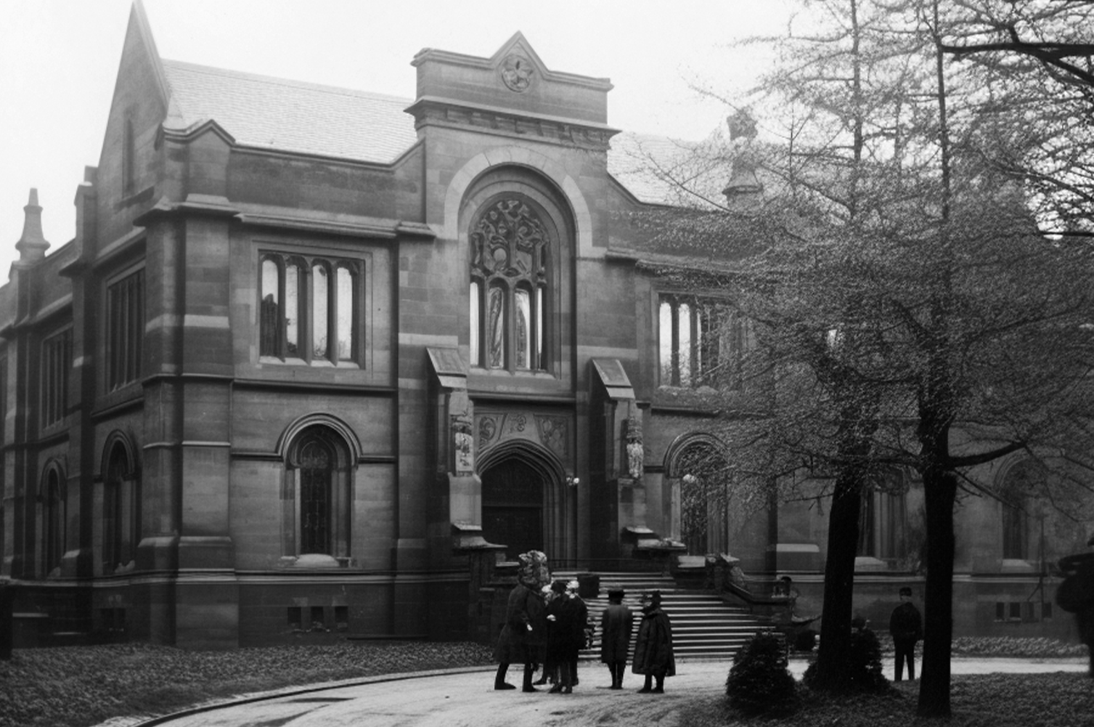
The Daily News
ABOUT HERITAGE HERALD
ESTABLISHED IN 1890
As we continue to evolve with the times, our mission remains unchanged: to inform, inspire, and connect our community through the power of storytelling. Join us as we embark on this journey together, celebrating the past.
Our commitment to quality journalism and unwavering dedication to serving our readers have made us a trusted source of information and a vital part
of community life. From investigative
CHRONICLING THE PAST, PRESENT, AND FUTURE
NEW TOWN LIBRARY GRAND OPENING
THE LIBRARY, WHICH TOOK NEARLY TWO YEARS
Yesterday marked a significant day for our town as the new public library officially opened its doors to the community. The ceremony was attended by Mayor John H. Whitaker, along with other distinguished guests and a large crowd.
The library, which took nearly two years to complete, is a testament to the town’s commitment to education and culture. Mayor Whitaker, in his opening speech, emphasized the importance of such an institution, stating, "This library will be a cornerstone for the intellectual and cultural growth of our town.
The library boasts a collection of over 10,000 volumes, including rare editions and contemporary works. The spacious and dedicated children’s section.
Residents gather at the grand opening of the new town library, a state-of-the-art facility that promises to be a hub of knowledge and community activities for years to come.
LOCAL BASEBALL TEAM TRIUMPHS
HERITAGE
HERALD
THE SPRINGFIELD TIGERS CELEBRATE THEIR VICTORY OVER THE RIVERTON EAGLES, LED BY GEORGE "SLUGGER" MARTIN'S
In a game that will be remembered for years to come, the Springfield Tigers clinched a dramatic victory against the Riverton Eagles yesterday, with a final score of 5-4. The thrilling match took place at the town’s main stadium, drawing a record number of spectators who were treated to an unforgettable display of skill, perseverance, and sportsmanship. The game was a nail-biter from the start, with both teams showcasing their best talents
The game was a nail-biter from the start, with both teams showcasing their best talents and trading leads multiple times. The tension was palpable as each inning progressed, keeping the audience on the edge of their seats. By the time the final inning arrived, the score was tied, and the atmosphere was electric with anticipation.
The hero of the day was undoubtedly George "Slugger" Martin, whose powerful batting and unyielding determination proved decisive. With two outs and a runner on base, Martin stepped up to the plate and delivered a phenomenal home run that sent the crowd into a frenzy. His decisive hit not only secured the victory for the Tigers but also cemented his status as a local legend.
Coach William Thompson could not have been prouder of his team. "Our boys played with heart and determination," he said in a post-game interview. "This win is a testament to their hard work and team spirit. Each their all, and it’s moments like these that show what we are capable of when we come together as a team."
ESTABLISHED IN 1890
Established in 1890, Heritage Herald has been a cornerstone of community journalism for over a century. With a rich history rooted in integrity and excellence, our newspaper is dedicated to providing comprehensive coverage of local events, national news, cultural highlights, and sporting triumphs.
Our commitment to quality journalism and unwavering dedication to serving our readers have made us a trusted source of information and a vital part of community life. From investigative reporting to insightful features, Heritage Herald delivers stories that resonate with our diverse readership, preserving the essence of our shared heritage while embracing the challenges and opportunities of the modern world.
As we continue to evolve with the times, our mission remains unchanged: to inform, inspire, and connect our community through the power of storytelling. Join us as we embark on this.
Springfield Tigers celebrate their victory over the Riverton Eagles.

Slide 2
№09
CHRONICLING THE PAST, PRESENT, AND FUTURE
JULY, 1910
ECONOMIC
GROWTH
ON THE RISE
RECENT REPORTS FROM THE DEPARTMENT OF COMMERCE.
Recent reports from the Department of Commerce reveal a positive trend in the national economy. Industrial production has increased steadily, and unemployment rates have begun to decline, driven by technological advancements and increased consumer spending.
Secretary of Commerce Herbert Hoover commented, "The economic policies we have implemented are showing results. We are confident this upward trend will continue, leading to greater prosperity for all Americans."
Lindbergh, piloting the custom-built aircraft "Spirit of St. Louis," covered the distance in just under 10 hours.
HISTORIC AVIATION
MILESTONE
PILOTING THE CUSTOM-BUILT AIRCRAFT "SPIRIT OF ST. LOUIS," COVERED THE DISTANCE IN JUST UNDER 10 HOURS.
In a groundbreaking achievement, aviator Charles A. Lindbergh has successfully completed a non-stop flight from New York to Chicago. This historic journey marks a new era in aviation, showcasing the potential for long-distance air travel.
Lindbergh, piloting the custom-built aircraft "Spirit of St. Louis," covered the distance in just under 10 hours. Speaking to the press after landing, he expressed his optimism for the future of aviation, predicting that "air travel will soon become a common mode of transportation for
In a groundbreaking achievement, aviator Charles A. Lindbergh has successfully completed a non-stop flight from New York to Chicago. This historic journey marks a new era in aviation, showcasing the potential for long-distance air travel. Lindbergh, piloting the custom-built aircraft "Spirit of St. Louis," covered the distance in just under 10 hours. Speaking to the press after landing, after landing, he expressed his optimism for the future of aviation, predicting that "air travel will soon become a common mode of transportation for people across the nation."
Renowned boxing champion Jack "The Hammer" Johnson is scheduled to visit our town.
BOXING
CHAMPION
IN A TOWN
RENOWNED BOXING CHAMPION JACK "THE HAMMER"
BREAKTHROUGH IN MEDICAL RESEARCH
DR. JONATHAN HALE, LEAD RESEARCHER, HIGHLIGHTED THE IMPACT OF THIS DISCOVERY
Renowned boxing champion Jack "The Hammer" Johnson is scheduled to visit our town next week for an exhibition match and training session with local boxers. The event, to be held at the Civic Center, promises to be an exciting opportunity for fans to meet the champion and watch him in action. Event organizer Thomas Lee said, "This is a rare chance for our community for our community to see a world-class athlete up close. We are thrilled to host Jack Johnson and look forward to an inspiring event."
In a significant advancement, scientists at the National Health Institute have announced a breakthrough in the treatment of tuberculosis. The new drug, developed after years of rigorous research, has shown promising results in clinical trials, reducing symptoms and speeding up recovery times for patients.
Dr. Jonathan Hale, lead researcher, highlighted the impact of this discovery, saying.
Dr. Jonathan Hale, lead researcher, highlighted the impact of this discovery, saying, "This new treatment has the potential to save countless lives and significantly reduce the global burden of tuberculosis. We are hopeful that it will soon be available to patients to save countless lives worldwide." The drug to save countless lives is currently undergoing final approval stages and is expected to be released within. We make great discoveries in the name of humanity!

Slide 3
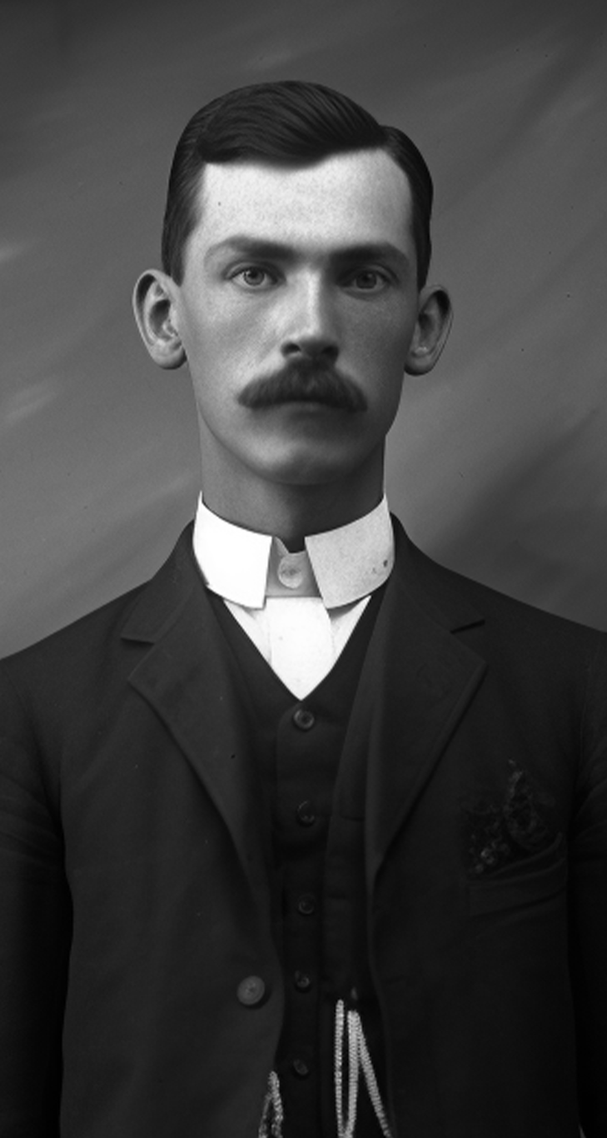
№09
CHRONICLING THE PAST, PRESENT, AND FUTURE
JULY, 1910
LOCAL SWIMMERS EXCEL
IN STATE MEET
SWIMMERS FROM THE SPRINGFIELD AQUATIC CLUB MADE WAVES AT THE STATE SWIMMING MEET
Swimmers from the Springfield Aquatic Club made waves at the state swimming meet, bringing home numerous medals and setting personal bests. The team's strong performance highlights the depth of talent in our local swim program. Head coach Michael Thompson commended the swimmers, saying, "Our team has shown remarkable improvement and determination. Their hard work in training has translated into success in the pool, and we are very proud of their accomplishments". The club is now preparing for the national competition, where they hope to achieve even greater success.
Head coach Michael Thompson commended the swimmers, saying, "Our team has shown remarkable improvement and determination. Their hard work in training has translated into success in the pool, and we are very proud of them.
Head coach Michael Thompson commended the swimmers, saying, "Our team has shown remarkable improvement and determination. Their hard work in training has translated into success in the pool, and we are very proud of their accomplishments." The club is now preparing for the national competition, where they hope to achieve even greater success.
Swimmers from the Springfield Aquatic Club made waves at the state swimming meet, bringing home numerous medals and setting personal bests. The team's strong performance highlights the depth of talent in our local swim program.
Head coach Michael Thompson commended the swimmers, saying, "Our team has shown remarkable improvement and determination. Their hard work in training has translated into success.
"Our team has shown remarkable improvement and determination”.
LOCAL THEATER COMPANY PREMIERES NEW PLAY
"THE DANCING SHADOWS" THE LATEST SENSATION.
The Riverside Theater Company premiered its new play, "Whispers in the Wind," to an enthusiastic audience last night. Written by local playwright Anna Reed, the play delves into themes of love, loss, and redemption, set against the backdrop of a small town.
Director James Porter praised the cast and crew for their dedication and hard work, noting, "This play is a true labor of love. The performances are heartfelt, and the story is deeply moving. We are excited to share it with our community."
"The Dancing Shadows" - the Latest Sensation.
The Riverside Theater Company premiered its new play, "Whispers in the Wind," to an enthusiastic audience last night. Written by local playwright Anna Reed, the play delves into themes of love, loss, and redemption, set against the backdrop of a small town.
Director James Porter praised the cast and crew for their dedication and hard work,
Director James Porter praised the cast and crew for their dedication and hard work, noting, "This play is a true labor of love. The performances are heartfelt, and the story is deeply moving. We are excited to share it with our community."
The play will run for the next three weekends, with tickets available at the theater box office.

Slide 4
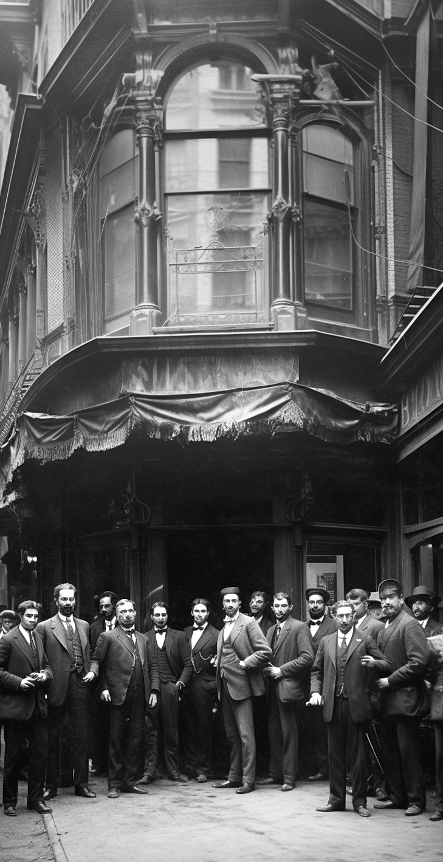
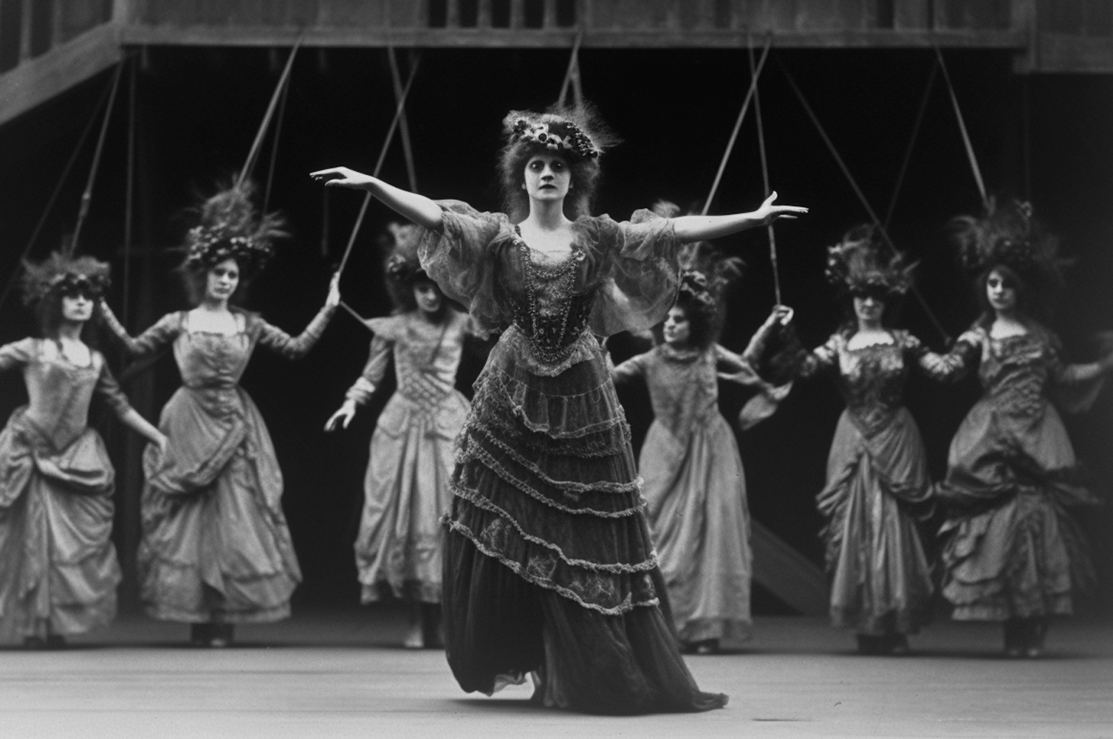
№09
CHRONICLING THE PAST, PRESENT, AND FUTURE
JULY, 1910
NEW JAZZ CLUB OPENS
DOWNTOWN
CLUB OWNER FRANK REYNOLDS EXPRESSED HIS EXCITEMENT ABOUT THE OPENING
A new jazz club, "The Blue Note," opened its doors downtown last night, offering a fresh venue for music lovers. The club features live performances from renowned jazz musicians and up-and-coming talent, creating a vibrant atmosphere for patrons to enjoy. Club owner Frank Reynolds expressed his excitement about the opening, saying, "We aim to make 'The Blue Note' a staple of the local music scene, providing a space for jazz enthusiasts to gather and appreciate great music."
A new jazz club, "The Blue Note," opened its doors downtown last night, offering a fresh venue for music lovers. The club features live performances from renowned jazz musicians and up-and-coming talent, creating a vibrant atmosphere for patrons to enjoy. Club owner Frank Reynolds expressed his excitement about the opening, saying.
The club features live performances from renowned jazz musicians and up-and-coming talent, creating a vibrant atmosphere for patrons to enjoy. Club owner Frank Reynolds expressed his excitement about the opening, saying, "We aim to make 'The Blue Note' a staple of the local music scene, providing a space for jazz enthusiasts to gather and appreciate great music."
The club features live performances from renowned jazz musicians and up-and-coming talent, creating a vibrant atmosphere for patrons to enjoy.
Club owner Frank Reynolds expressed his excitement about the opening, saying Club owner expressed his excitement about the opening, saying, "We aim to make 'The Blue Note' a staple of the local music scene, providing a space for jazz enthusiasts to gather and appreciate.
A new jazz club "The Blue Note".
BROADWAY HIT 'THE DANCING SHADOWS' ENTHRALLS AUDIENCES
"THE DANCING SHADOWS" THE LATEST SENSATION.
The show is expected to run for several months, drawing large crowds to the historic Broadway Theatre.
The show is expected to run for several months, drawing large crowds to the historic Broadway Theatre. "The Dancing Shadows," the latest sensation on Broadway, has captivated New York City audiences with its stunning performances and innovative choreography. Critics have heaped praise on lead actress Evelyn Hart, whose portrayal of the protagonist has set a new standard in theatrical arts. expected to run for several months.
"The Dancing Shadows," the latest sensation on Broadway, has captivated New York City audiences with its stunning performances and innovative choreography. Critics have heaped praise on lead actress Evelyn Hart, whose portrayal of the protagonist has set a new standard in theatrical arts. The show is expected to run for several months, drawing large crowds to the historic
The show is expected to run for several months, drawing large crowds to the historic Broadway Theatre.
The club features live performances from renowned jazz musicians and up-and-coming talent, creating a vibrant atmosphere for patrons to enjoy.
Club owner Frank Reynolds expressed his excitement about the opening, saying.

