Slide 1
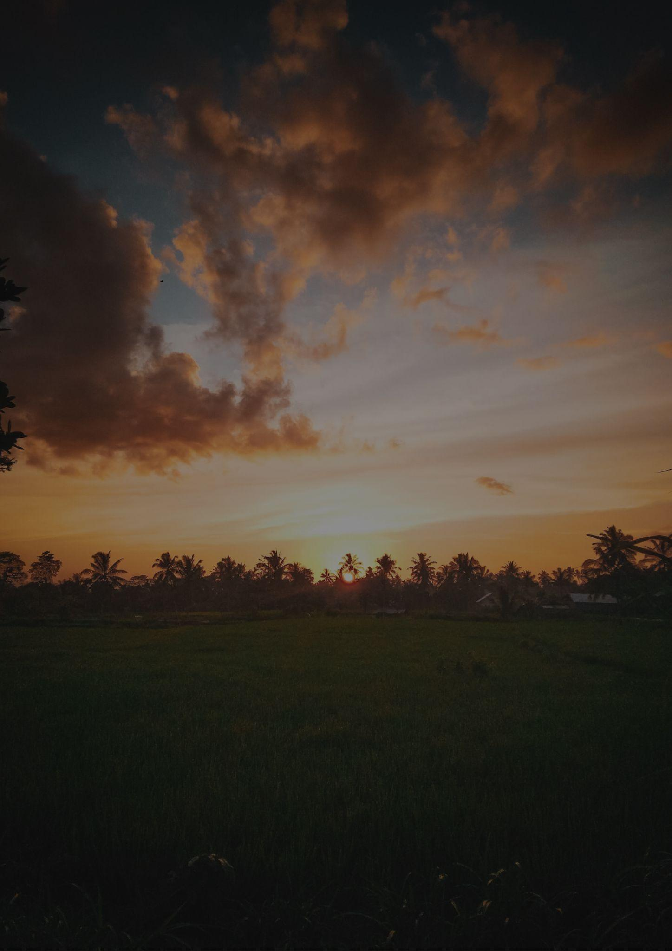
Travel bucket list
OKLAHOMA
Oklahoma City Memorial
Oklahoma City Zoo
Oklahoma Route 66 Museum
Marland Estate Mansion
Myriad Botanical Gardens
Museum of the Great Plains
Woolaroc Museum
Oklahoma Aquarium
Woolaroc Wildlife Preserve
National Weather Center
Sam Noble Oklahoma Museum
Lawton
Gilcrease Museum
National Cowboy Museum
Turner Falls Park
Myriad Botanical Gardens
JM Davis Arms
Great Salt Plains State Park
Philbrook Museum of Art
Natural Falls State Park
Oklahoma City Zoo
Myriad Botanical Gardens
Science Museum Oklahoma
Bartlesville
University of Oklahoma
Beavers Bend State Park

