Slide 1
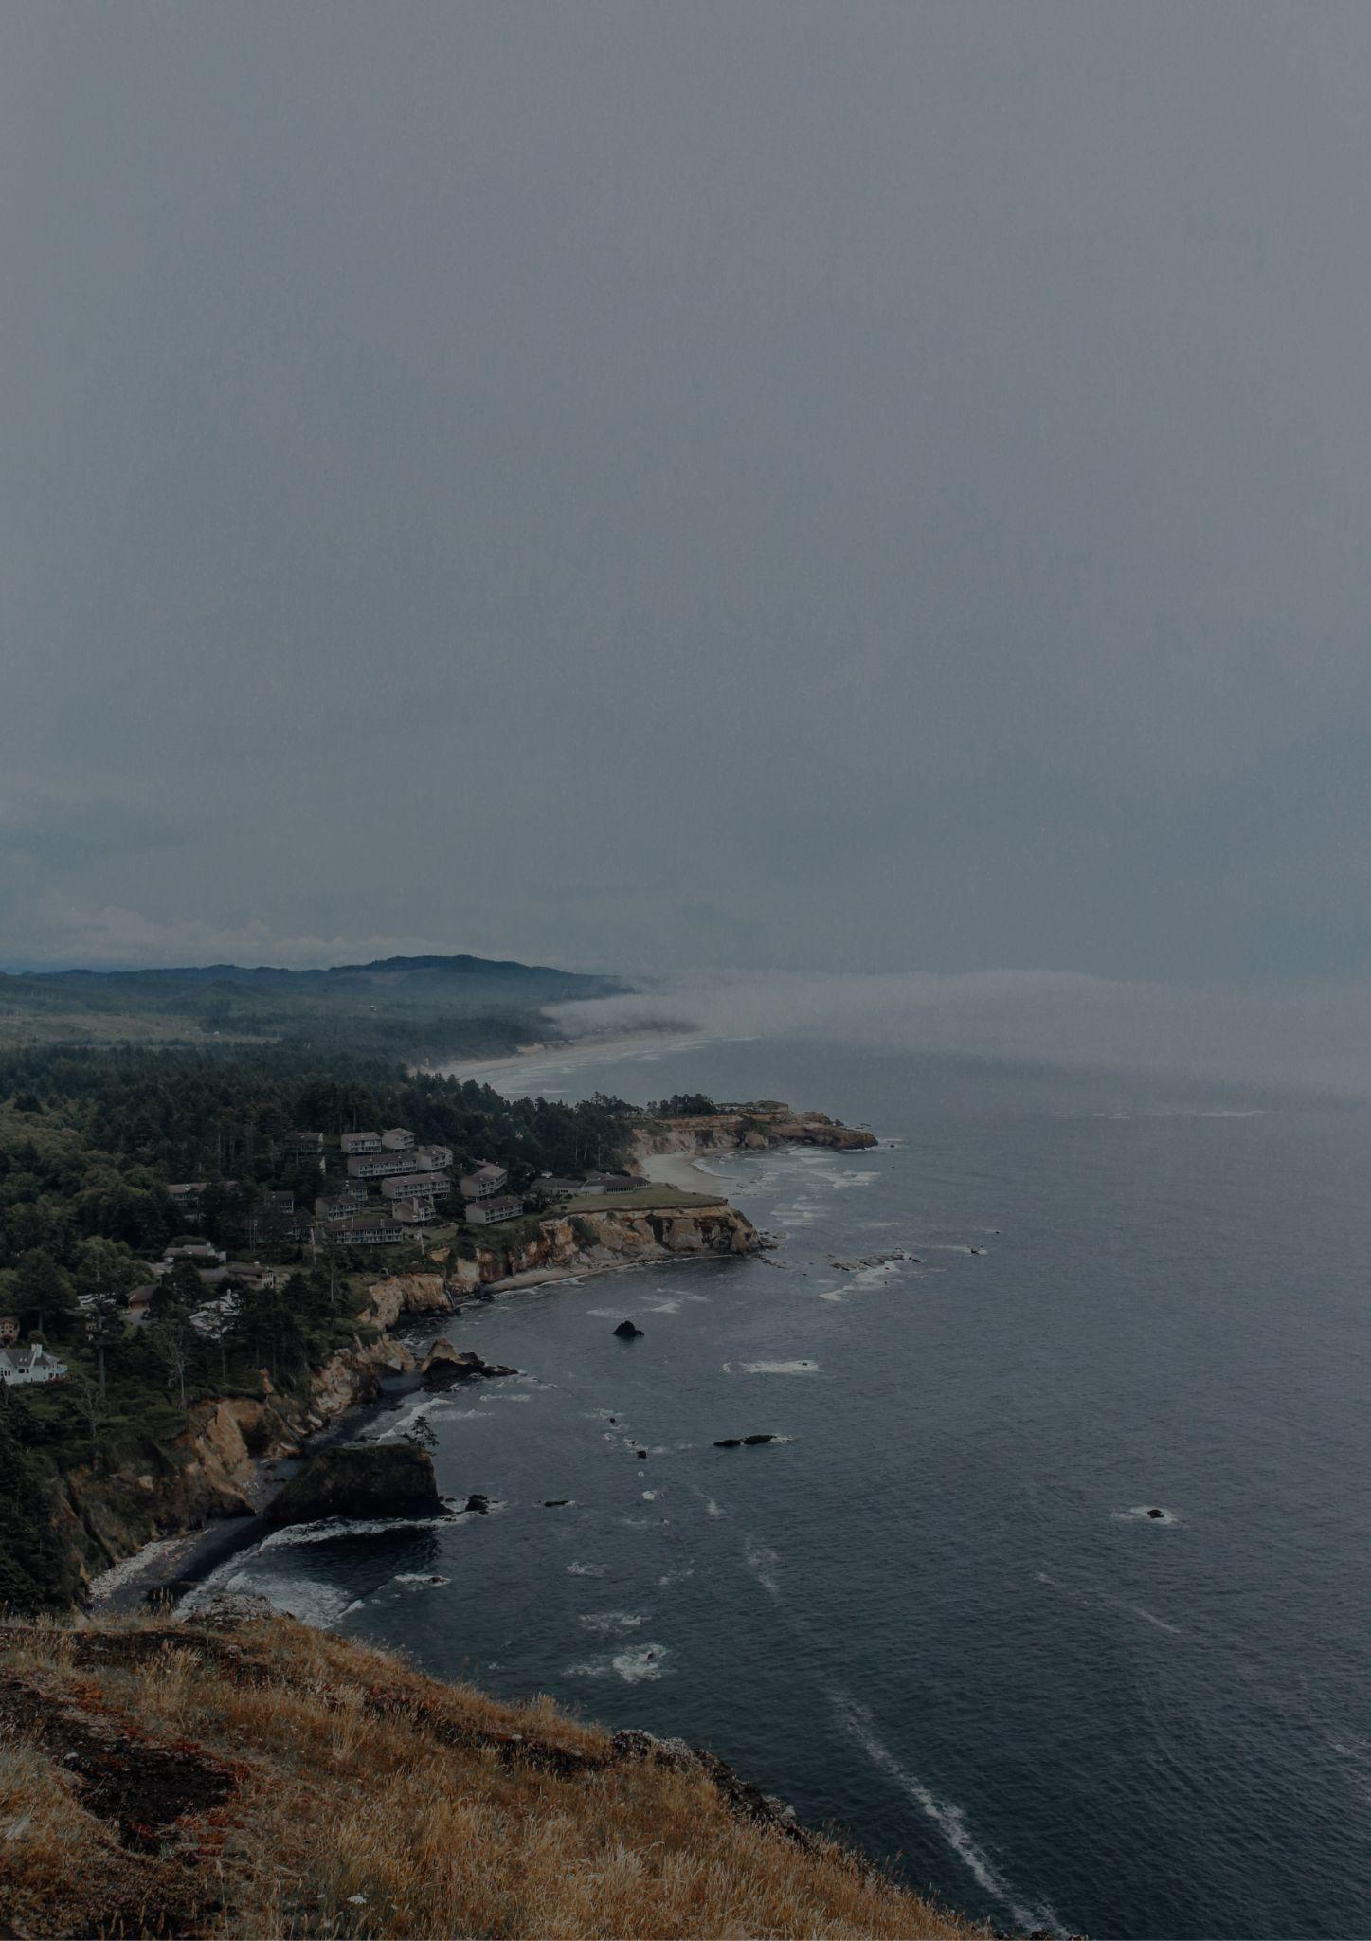
OHIO
Travel bucket list
Cedar Point Amusement Park
Ohio State Reformatory
Cleveland Museum of Art
West Side Market
Rock and Roll Hall of Fame
American Sign Museum
Museum Air Force
Amish Country
Stan Hywet Hall
Columbus Aquarium
Cincinnati Museum
Cincinnati Museum Center
Franklin Park Conservatory
Franklin Park Conservatory
Cincinnati Zoo
Cleveland Museum of Art
Cincinnati Botanical Gardens
Stan Hywet Hall & Gardens
Toledo Museum of Art
Fountain Square, Cincinnati
Fountain Square
West Side Market
Cuyahoga Valley Park
Cleveland Museum of Art
Wright Memorial
Rock and Roll Hall of Fame

