Slide 1
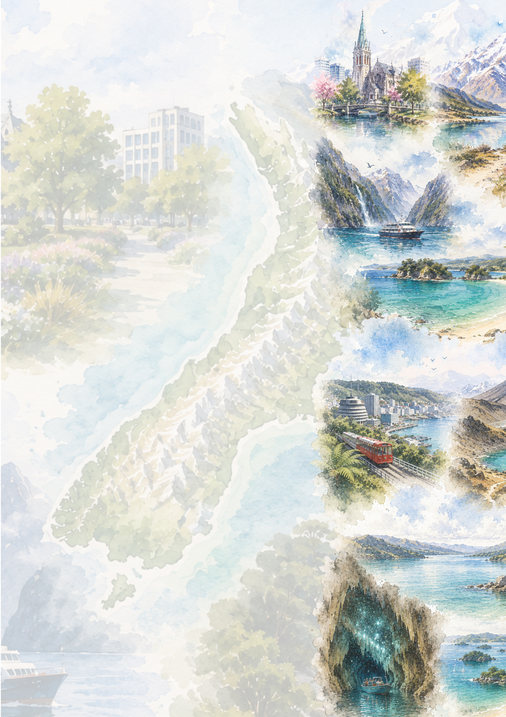
New Zealand
EXPLORER ROUTE
South Island
Day 1: Christchurch
Day 2: Lake Tekapo
Day 3: Queenstown
Days 4 & 5: Milford Sound
Days 6 & 7: Wanaka
Day 8: Fox Glacier
Day 9: Hokitika
Days 10 & 11: Abel Tasman NP
North Island
Day 12: Wellington
Day 13: Tongariro National Park
Day 14: Taupo
Days 15 & 16: Rotorua
Day 17: Hobbiton Movie Set
Day 18: Waitomo Glowworm Caves
Day 19: Coromandel Peninsula
Day 20: Bay of Islands
Day 21: Auckland

