Slide 1
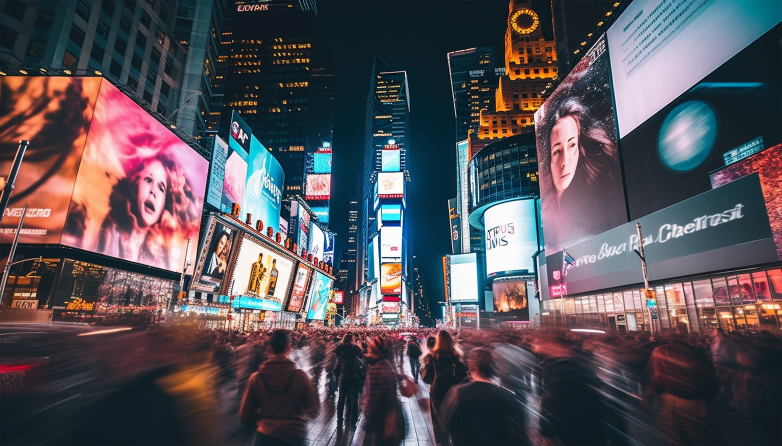
№05
JULY 11, 2028
The New York Chronicles
The Heart of the Big Apple: Exploring Times Square
THE HEART OF THE BIG APPLE
Exploring Times Square
Times Square, often referred to as the "Crossroads of the World," is the beating heart of New York City. From its iconic neon lights to the constant buzz of activity, Times Square is a place that never sleeps. This bustling hub attracts millions of tourists each year, offering everything from Broadway theaters to flagship stores and street performers.
The electric atmosphere makes it a favorite destination for both locals and visitors. Beyond its dazzling facade, Times Square is also home to numerous historical landmarks, including the Times Square Ball Drop and other lesser-known attractions.
The electric atmosphere makes it a favorite destination for both locals and visitors. Beyond its dazzling facade, Times Square is also home to numerous historical landmarks, including the Times Square Ball Drop, which marks the start of each New Year.
Visitors can enjoy world-class dining, exclusive shopping experiences, and immersive entertainment in this vibrant district.
Times Square, often referred to as the "Crossroads of the World," is the beating heart of New York City. From its iconic neon lights to the constant
This bustling hub attracts millions of tourists each year, offering everything from Broadway theaters to flagship stores and street performers. The electric atmosphere makes it a favorite destination for both locals and visitors. Beyond its dazzling facade, Times Square is also home to numerous historical landmarks, including the Times Square Ball Drop, which marks the start of each New Year. Visitors can enjoy world-class dining, exclusive shopping experiences, and immersive entertainment in this vibrant district. Visitors can enjoy world-class dining, exclusive shopping experiences, and immersive entertainment in this vibrant district.

Slide 2

№05
JULY 11, 2028
CENTRAL PARK IN WINTER
A Snowy Wonderland
Central Park transforms into a magical snowy haven during winter. Spanning 843 acres in the heart of Manhattan, the park offers a peaceful retreat from the city's hustle and bustle.
The snow blankets the sprawling landscapes, turning them into a winter wonderland perfect for photography, ice skating, or simply taking a peaceful stroll. Wollman Rink becomes a popular spot for skating enthusiasts, while others gather for sledding at Pilgrim Hill.
For those seeking a more serene experience, a walk by the frozen lake or a visit to Bow Bridge offers breathtaking views. Central Park in winter is not just a scenic escape but a place that embodies the spirit of the season. For those seeking a more serene experience, a walk by the frozen lake or a visit to Bow Bridge offers breathtaking views. Central Park in winter is not just a scenic
For those seeking a more serene experience, a walk by the frozen lake or a visit to Bow Bridge offers breathtaking views. Central Park in winter is not just a scenic escape but a place that embodies the spirit of the season. The snow blankets the sprawling landscapes, turning them into a winter wonderland perfect for photography, ice skating, or simply taking a peaceful stroll. Wollman Rink becomes a popular spot for skating enthusiasts, while others gather for sledding at Pilgrim Hill. Central Park transforms into a magical snowy haven during winter. Spanning 843 acres in the heart of Manhattan, the park offers a peaceful retreat from the city's hustle and bustle.
Central Park transforms into a magical snowy haven during winter. Spanning 843 acres in the heart of Manhattan, the park offers a peaceful retreat from the city's hustle and bustle.
Photographer: Michael Brooks
The snow blankets
Pilgrim Hill
Central Park
For those seeking a more serene experience, a walk by the frozen lake or a visit to Bow Bridge offers breathtaking views. Central Park in winter is not just a scenic escape but a place that embodies the spirit of the season. For those seeking a more serene experience, a walk by the frozen lake or a visit to Bow Bridge offers breathtaking views. Central Park in winter is not just a scenic escape but a place that embodies the spirit of the season. For those seeking a more serene experience.
Central Park transforms into a magical snowy haven during winter. Spanning 843 acres in the heart of Manhattan, the park offers a peaceful retreat from the city's hustle and bustle.
The snow blankets the sprawling landscapes, turning them into a winter wonderland perfect for photography, ice skating, or simply taking a peaceful stroll. Wollman Rink becomes a popular spot for skating enthusiasts, while others gather for sledding at Pilgrim Hill.
The snow blankets the sprawling landscapes, turning them into a winter wonderland perfect for photography, ice skating, or simply taking a peaceful stroll. Wollman Rink becomes a popular spot for skating enthusiasts, while others gather for sledding at Pilgrim Hill. Central Park transforms into a magical snowy haven during winter. Spanning 843 acres in the heart of Manhattan, the park offers a peaceful retreat the park offers a peaceful retreat from the city's hustle and bustle.

Slide 3
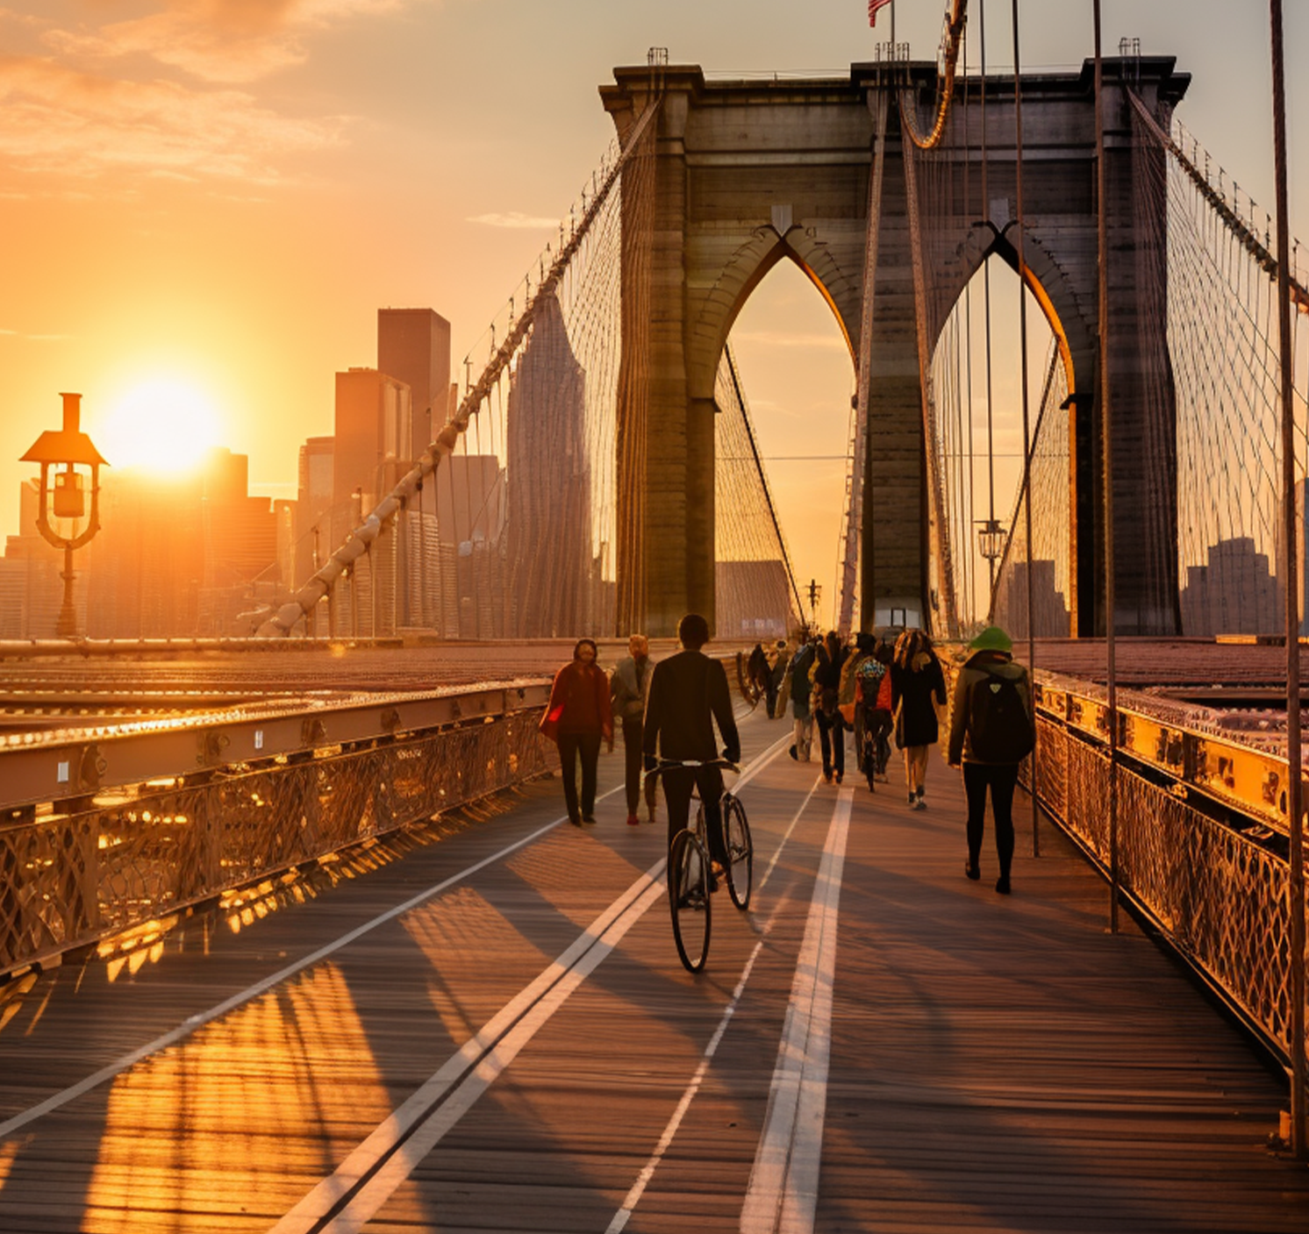
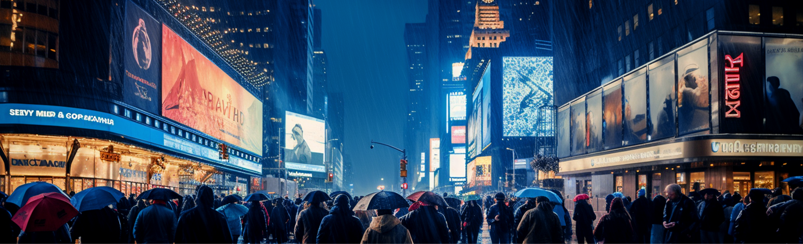
№05
JULY 11, 2028
BROOKLYN
BRIDGE
A Snowy Wonderland
Connecting Manhattan and Brooklyn, the Brooklyn Bridge is an architectural marvel and a symbol of New York’s resilience. Completed in 1883, it was the longest suspension bridge of its time and remains a popular attraction for tourists and locals alike. A walk across the bridge provides stunning views of the East River, the Statue of Liberty, and the Manhattan skyline. Cyclists, pedestrians, and photographers alike cherish the bridge's unique design and breathtaking vantage points. Beyond its and cultural significance, making it a must-visit destination.
Photographer: Michael Brooks
THE MAGIC OF THE STAGE
Broadway
Broadway is the beating heart of New York’s performing arts scene. Its theaters have staged some of the most iconic performances in history, from timeless classics like Les
modern sensations like Hamilton. Walking along Broadway, you’ll be greeted by dazzling marquees and the buzz of excited theatergoers. The district isn’t just about it’s a cultural
it’s a cultural phenomenon that attracts millions annually. Behind the scenes, Broadway employs thousands of actors, musicians, and technicians, all contributing to the magic.
Photographer: Michael Brooks

Slide 4
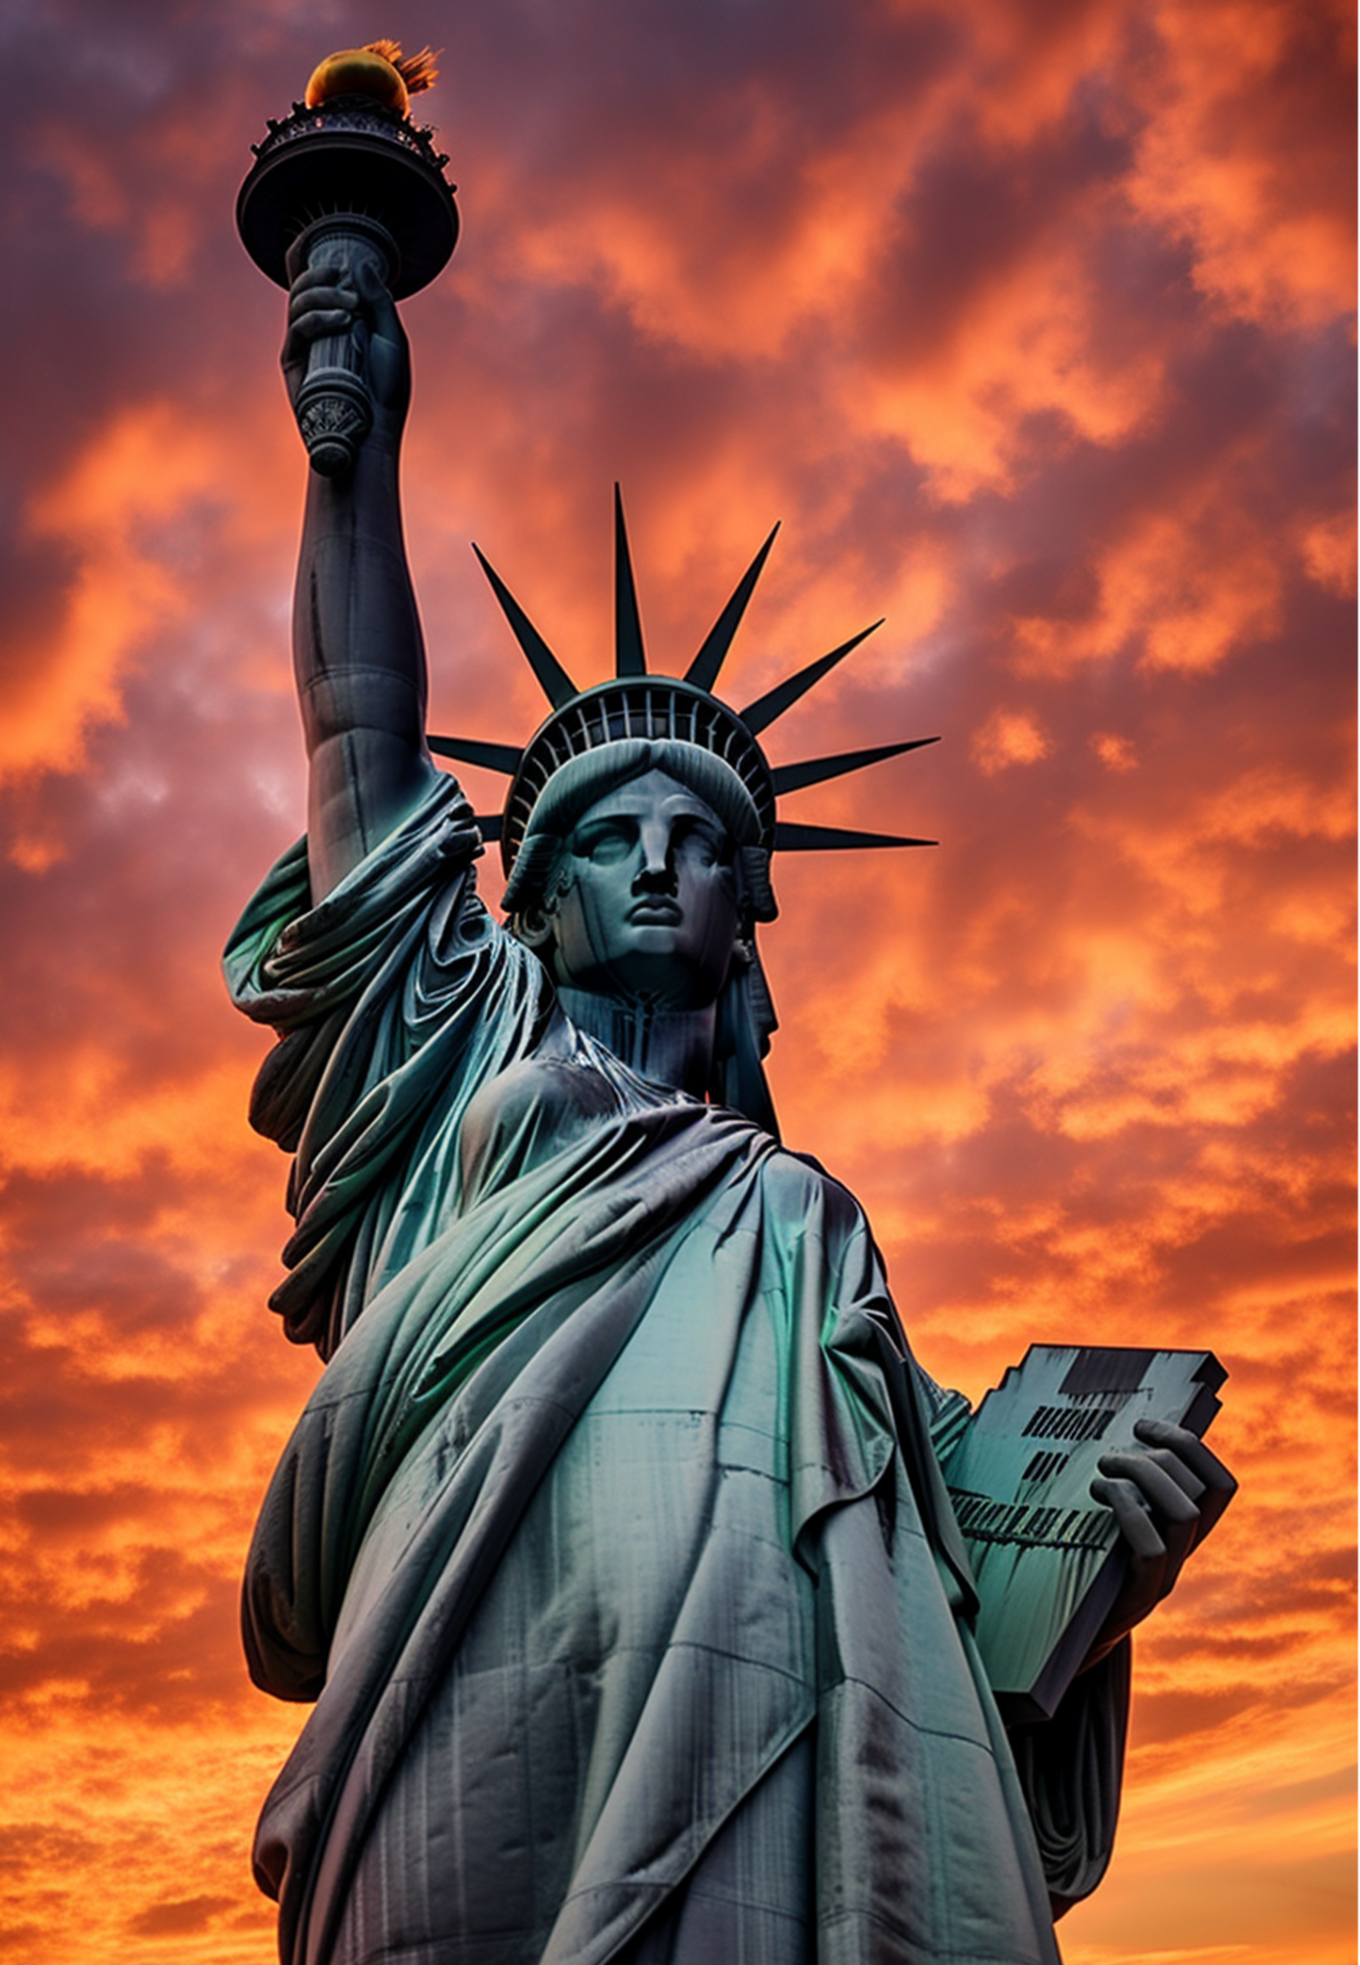
№05
JULY 11, 2028
OUR MOST FAMOUS SYMBOL OF FREEDOM
The Statue of Liberty
The Statue of Liberty stands tall as a beacon of hope and freedom. Gifted by France in 1886, this iconic landmark has welcomed millions of immigrants arriving in America through Ellis Island.
As a universal symbol of democracy and liberty, the statue continues to inspire visitors from around the world. A visit to Liberty Island allows you to explore the statue's rich history through interactive exhibits and guided tours. The crown offers a panoramic view of New York Harbor, rewarding those who climb its 354 steps.
Whether seen from the Staten Island Ferry or up close, the Statue of Liberty is a powerful reminder of the ideals that define the United States. As a universal symbol of democracy and liberty, the statue continues to inspire visitors from around the world. A visit to Liberty Island allows you to explore the statue's rich history through interactive exhibits and guided tours. The crown offers a panoramic view of New York Harbor, rewarding those who climb its 354 steps. Whether seen from the Staten Island Ferry or up close, the Statue of Liberty is a powerful reminder of the ideals that define the United States. Whether seen from the Staten Island Ferry
Photographer: Sarah Bennett
Whether seen from the Staten Island Ferry or up close, the Statue of Liberty is a powerful reminder of the ideals that define the United States. As a universal symbol of democracy and liberty, the statue continues to around the world inspire visitors from around the world. A visit to Liberty Island
As a universal symbol of democracy and liberty, the statue continues to inspire visitors from around the world. A visit to Liberty Island allows you to explore the statue's rich history through interactive exhibits and guided tours. The crown offers a panoramic view of New York Harbor,
This iconic landmark has welcomed millions of immigrants arriving in America through Ellis Island. Whether seen from the Staten Island Ferry or up close, the Statue of Liberty is a powerful reminder of the ideals that define the United States.

