Slide 1
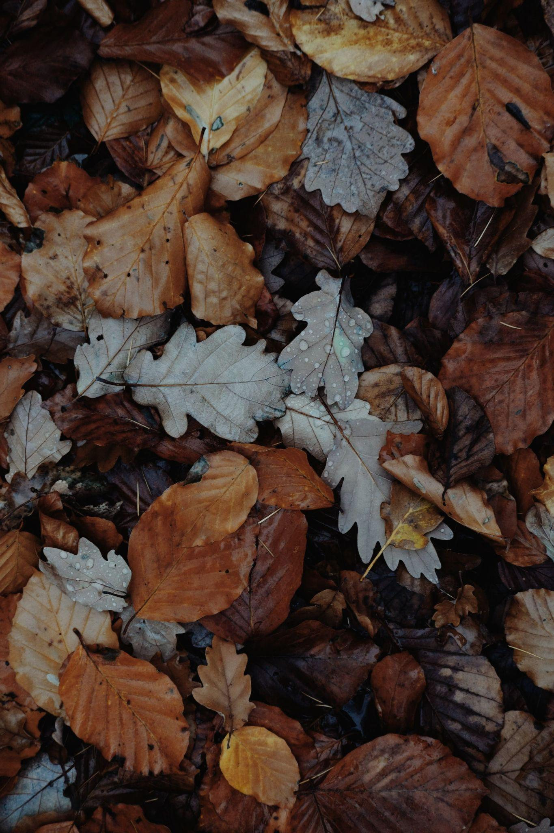
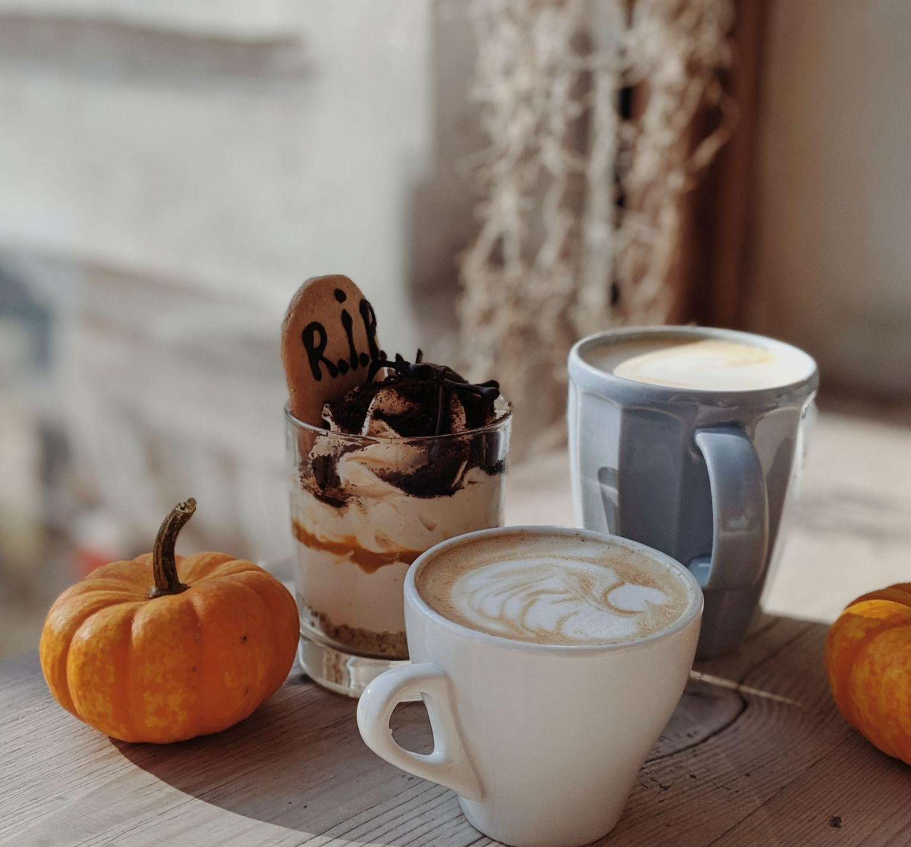
Autumn Bucket list
Shop on Black Friday
Complete an Autumn Craft
Make a Gratitude Journal
Throw a Friendsgiving
Watch the Macy’s Day Parade
Bake Pumpkin Bread
Make a Gratitude Journal
Perfect a Soup Recipe
Make a Scarecrow
Roast Chestnuts
Jump into a Pile of Leaves
Plant Fall Flowers
Knit a Scarf
Take a Fall Foliage Drive
Sip Warm Apple Cider
Attend a Fall Festival
Go on a Hay Ride
Get Lost in a Corn Maze

